Slide 1

Luciferase-based reporter system for in vitro evaluation of elongation rate and processivity of ribosomes
Tiina Tamm
Institute of Molecular and Cell Biology, University of Tartu

Slide 2
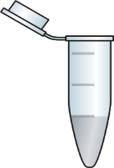
Cell-free in vitro translation system
Cell-free translation systems are powerful experimental platforms with a wide variety of applications.
Crude cell extract contains all the macromolecular components required for translation.
Amino acids, energy sources and energy regeneration system must be supplemented.
The reactions are primed by addition of reporter mRNA encoding protein of interest.
yeast cell free extract
reaction components
reporter mRNA
activity measurement of in vitro synthesised Renilla and firefly luciferases

Slide 3
Reporter system based on Renilla-firefly fusion protein
Kisly et al., 2021
Co-translational folding of Renilla and firefly luciferases enables the precise measurment of time needed to synthesize each luciferase moiety.

Slide 4
Measurement of processivity of ribosomes
X10⁵
8
Rluc
0.4
7
6
0.3
5
Luminescence (RLU)
slope_{Rluc}
Fluc/Rluc slope ratio
4
0.2
3
2
Fluc
0.1
1
slope_{Fluc}
0
0
10
20
30
40
50
60
70
80
90
eL24
eB13Δ
Time (min)
slope_{Fluc}
Kisly et al., 2019
ratio=
slope_{Rluc}
Slope of the Renilla luciferase activity curve depends on the number of ribosomes that completed synthesis of Renilla luciferase.
Slope of firefly luciferase curve depends on the number of ribosomes that complete the synthesis of fusion protein.
Ratio reflects the processivity of ribosomes.

Slide 5
Measurement of ribosome elongation rate
Rluc
Rluc
Fluc
6000
1000
5000
800
4000
Luminescence (RLU)
600
3000
Fluc
2000
400
1000
200
0
1
2
3
4
5
6
7
8
9
10
11
12
0
1
2
3
4
5
6
7
8
9
10
11
12
Time (min)
5.16 ± 0.16
TFA_{Rluc}
TFA_{Fluc}
Rluc
Fluc
ΔTFA = TFA_{Fluc} - TFA_{RLuc}
Kisly et al., 2019
TFA = time of the first appearance of the luminescence signal
ΔTFA represents the time needed to synthesize the Firefly luciferase moiety and terminate translation.
Elongation rate for wild type ribosomes (minimal): 1.8 codons / sec

Slide 6
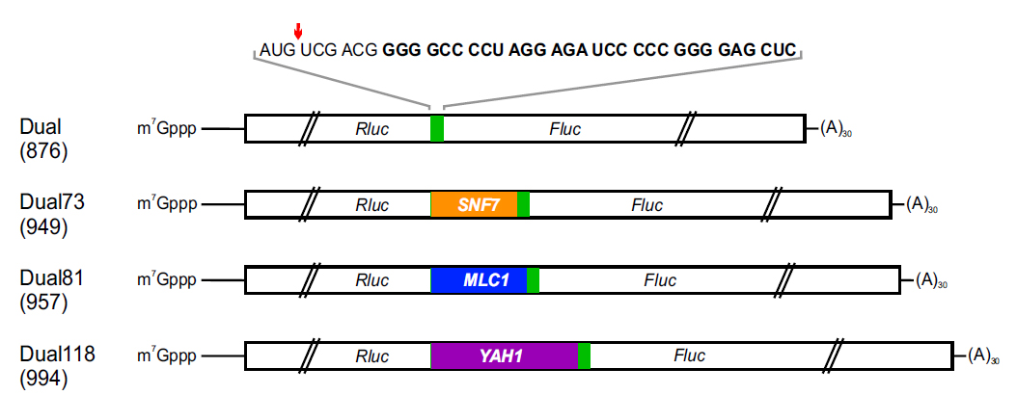
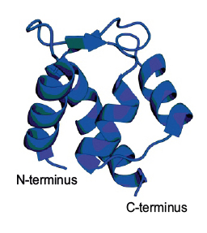
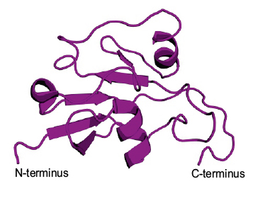
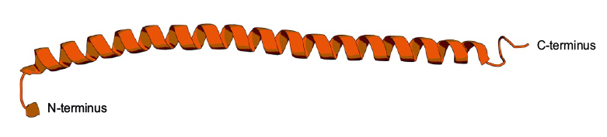
Elongation rate independent of the initiation and termination
Structures of moieties encoded by reporters:
Snf7
Mlc1
Yah1
Kisly et al., 2021

Slide 7
Time course of Renilla luciferase activities over 11 min
Reporter | Dual | Dual73 | Dual81 | Dual118
Codons | - | 73 | 81 | 118
TFA_{Rluc} (min) | 2.40 ± 0.12 | 2.50 ± 0.18 | 2.41 ± 0.12 | 2.57 ± 0.07
Rluc luminescence (RLU)
Time (min)
Identical TFA_{Rluc} values indicate:
a similar rate of initiation
a similar activity of Renilla luciferase, despite fusion with additional domain
a similar quality of transcribed mRNA

Slide 8
Time course of firefly luciferase activities over 11 min
Reporter | Dual | Dual73 | Dual81 | Dual118
Codons | - | 73 | 81 | 118
ΔTFA | 5.54 ± 0.11 | 6.15 ± 0.10 | 6.06 ± 0.09 | 6.87 ± 0.20
V_{elong} (aa/sec) |  | 2.01 ± 0.48 | 2.58 ± 0.68 | 1.47 ± 0.25
Fluc luminescence (RLU)
Time (min)
ΔTFA values for Dual73, Dual81 and Dual118 reporters increased in accordance with the time needed to translate each inserted region.
The elongation rate of ribosomes varies depending on the domain synthesized.

Slide 9
Effect of domain length on the translation elongation
Reporter | Dual | Dual73 | Dual146
Codons | - | 73 | 146
ΔTFA | 5.54 ± 0.11 | 6.15 ± 0.10 | 6.89 ± 0.08
V_{elong} (aa/sec) | - | 2.01 ± 0.48 | 1.80 ± 0.18
Fluc luminescence (RLU)
Time (min)
Increase of ΔTFA value was proportional to the length of added region.
Rate of elonagtion is similar for Dual73 and Dual146 reporters.

Slide 10
Effect of stalling on translation elongation
Reporter | Dual | DualR10
ΔTFA | 5.54 ± 0.11 | 7.37 ± 0.16
V_{elong} (aa/sec) | - | 0.09 ± 0.01
Fluc luminescence (RLU)
Time (min)
Ribosomes needed additional ~109 seconds to translate the ten rare arginine codons.

Slide 11
Effect of stalling on translation elongation
Reporter | Dual | DualR10
ΔTFA | 5.54 ± 0.11 | 7.37 ± 0.16
V_{elong} (aa/sec) | - | 0.09 ± 0.01
Slope ratio | 0.19 ± 0.02 | 0.16 ± 0.01
P_{general} | - | 0.82 ± 0.005
Fluc luminescence (RLU)
Time (min)
Ribosomes needed additional ~109 seconds to translate the ten rare arginine codons.
Ribosomes had a ~1.95% chance of losing processivity at each arginine codon of the R10 sequence.

Slide 12
Conclusions
This system allows to directly determine both rates of elongation and processivity of ribosomes on any coding sequence of interest independently of the initiation and termination steps.
    ΔTFA values allows to estimate the rate of elongation on the studied coding sequences.
    Slope ratios allow to assess the overall processivity of ribosomes and average processivity at each codon.
    Slope of a Renilla luciferase activity curve can be used to assess the initiation of translation.
In addition, this system allows to quantitatively analyse the effect of ribosome pausing on the elongation step of translation.

Slide 13
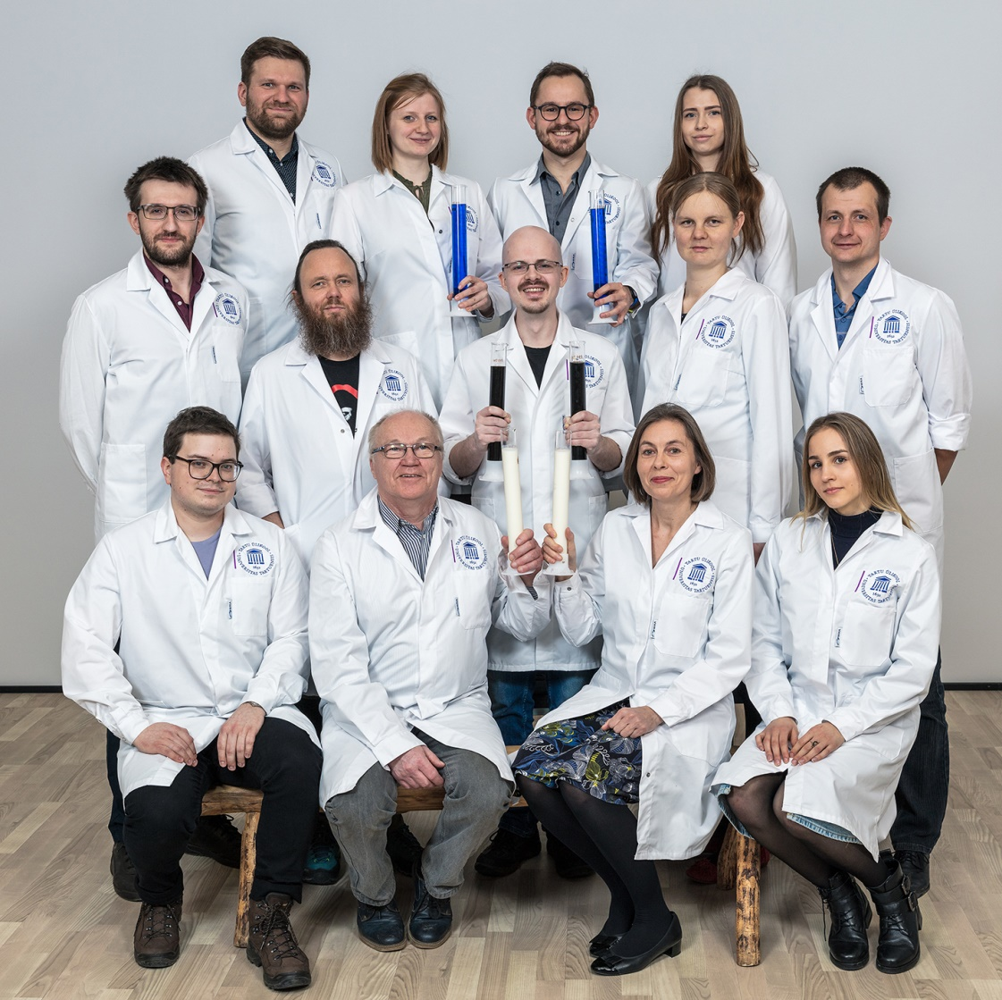




Acknowledgments
Estonian
Ribo-Lab team:
Ivan Kisly
Karolin Kattel
Jaanus Remme
Aivar Liiv
Margus Leppik
Rya Ero
Piret Mihkelson
Ermo Leuska
Kaspar Reier
Silva Lilleorg

