Slide 1

RDM through a UK lens - New Roles for Librarians?
Stuart Macdonald
Research Data Management Service Coordinator
Research & Library Services
University of Edinburgh
Email:
stuart.macdonald@ed.ac.uk
Towards linked science – Open Data and DataCite Estonia, University of Tartu, 23 October, 2014

Slide 2
Outline
Background
Traditional Data Library Services
RDM Programme at University of Edinburgh
Drivers: Funders & Jisc
Data Services and initiatives at University of Edinburgh

Slide 3
Background
EDINA and University Data Library (EDL) together are a division within Information Services (IS) of the University of Edinburgh.
EDINA is a Jisc-designated national centre for digital expertise & online service delivery
The Data Library assists Edinburgh University users in the discovery, access, use and management of research datasets.
Research & Library Services, part of Library and University Collections coordinate the RDM Programme at Edinburgh
Notes:
25 years ago
disk storage - expensive
researchers interested in working with data came together to petition the PLU and the University’s Library – wanting a university-wide provision for files that were too large to be stored on individual computing accounts
Early holdings were research data from universities of edinburgh, glasgow, and strathclyde

Slide 4
‘Traditional’ Data Library Services

Slide 5

What is a data library?
A data library refers to the services that foster use of collections of numeric and/or geospatial data sets for secondary use in research.
A data library is normally part of a larger institution (academic, scientific, medical, governmental, etc.) established to serve the data users of that organisation.
The data tends to be housed local ly or via subscription and accessed through various means (SFTP, CD-/DVD-ROMs or server download).
A data library may also maintain subscriptions to licensed data resources.

Slide 6
Data Library: History
Established out of the Program Library Unit in early 1980s to provide access to data on mainframes, e.g. 1981 population census data. Was part of EUCS, now Information Services
Became a Jisc national data centre as EDINA in 1993
Data Library continues University remit
  celebrated 30th anniversary in 2013
Notes:
One was because disk storage was a scarce and expensive resource. Researchers wanted and petitioned for centrally-managed university wide provision of access to large-scale datasets, typically the decennial population censuses for Scotland, the annual agricultural censuses for England & Wales and for Scotland, the General Household Surveys and a range of digitized boundaries being used in what was still path-breaking ways to do computerized mapping.

Slide 7
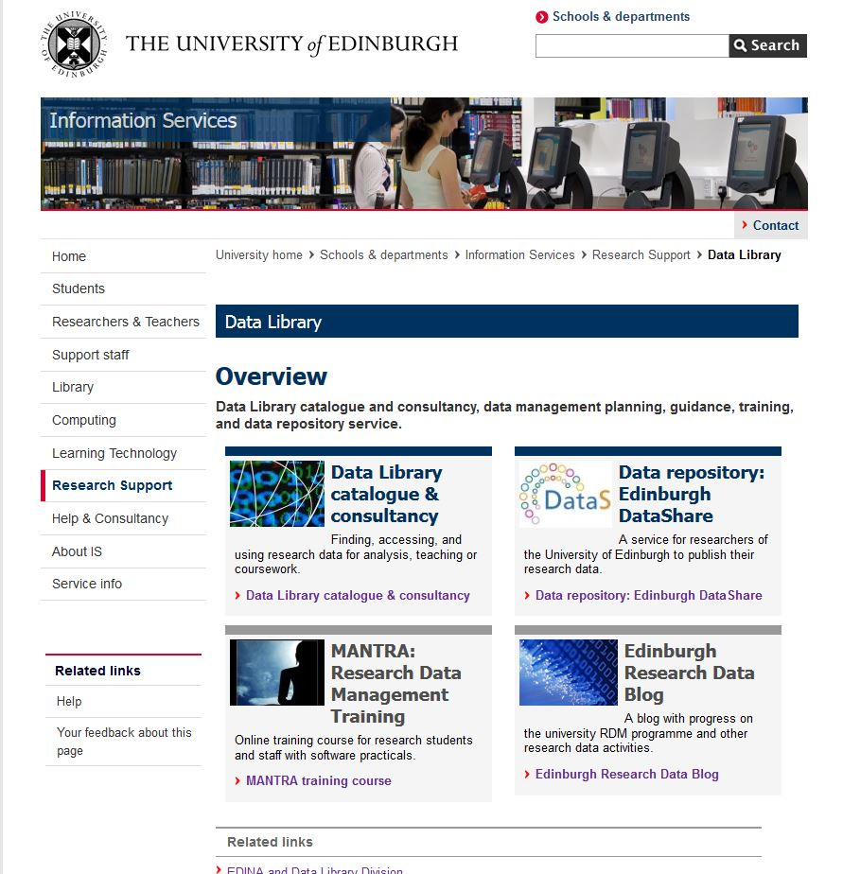
Edinburgh University Data Library

Slide 8
Data Library Consultancy
finding…
accessing …
using …
managing …
Primarily supporting research in the social sciences but
not exclusively so.
Building relationships with researchers via:
Postgraduate teaching activities,
Research support projects,
IS Skills workshops,
Research Data Management training
Through traditional reference interviews.
Notes:
Primarily social sciences but not exclusively so, large scale government surveys (micro data), macro-economic time series data (country-level data), Elections studies, Geospatial data, financial datasets, population census data
Free on internet / subscription / through national data centres/archives / resource discovery portals
Registration / authorisaiton and authentication / special conditions / budget to pay for data
SPSS, STATS, SAS, R, ArcGIS – interpret documentaiton/codebooks, merge and match users data with other data (via look-up tables), subset data
Data Catalogue

Slide 9
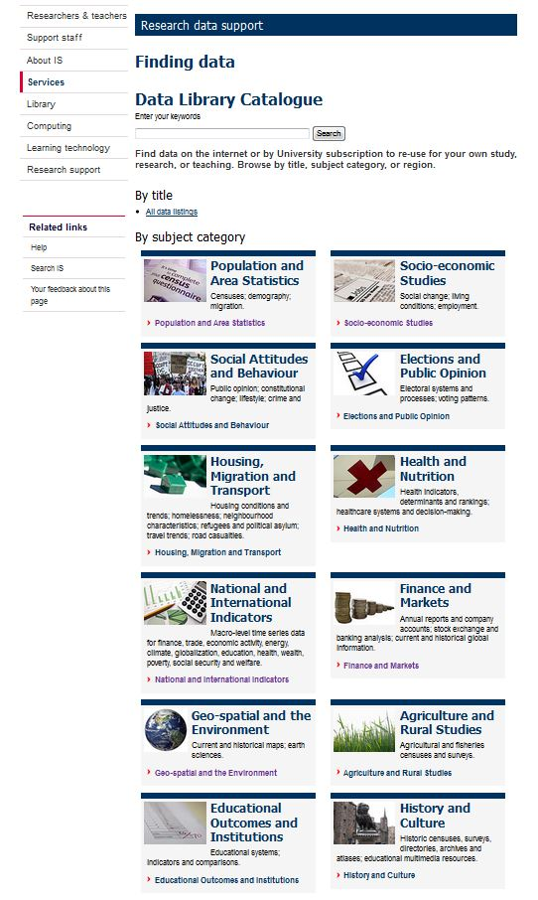
Data Library Resources:
Large-scale Government survey data
Country and regional level time-series data
Population and Agricultural Census data
Financial and market data
Geospatial data
Resources for teaching

Slide 10
Data service delivery models
3 ‘traditional’ Data Libraries in the UK: Edinburgh University Data Library; London School of Economics; Oxford University
In Europe, model primarily is of National Data Archives in the Social Sciences (CESSDA)
In the US, data libraries at all research-intensive universities, some in research centres (e.g. Cornell), some in libraries (John Hopkins, Michigan) – broadening out to be RDM services
In Canada, data libraries are predominantly situated in University Libraries, manned mainly by librarians

Slide 11
Data Liberation Initiative (DLI)
Program between Statistics Canada and Canadian Universities to provide affordable access to public data files for researchers
  Subscription based
Housed in academic libraries
  Due campus-wide coverage
Before 1996 – 9 Universities with Data Library facilities
1996 - 50 became members within the 1st year
2011 - 75 Universities with data service capability (out of a total of 98)
*The Canadian Data Liberation Initiative: http://www.ihsn.org/home/sites/default/files/resources/IHSN-WP006.pdf

Slide 12

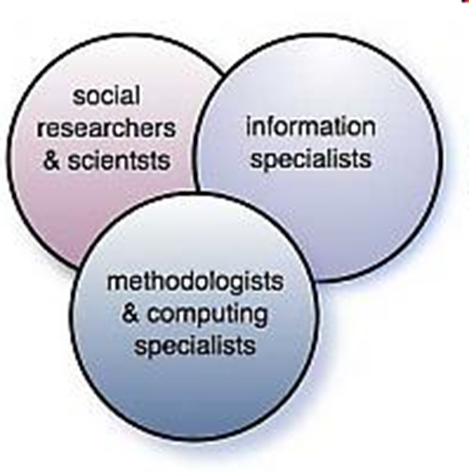
IASSIST is an international organization of professionals working in and with information technology and data services to support research and teaching in the social sciences.
Over 300 members from a variety of workplaces, including data archives, statistical agencies, research centres, libraries, academic departments, government departments, and non-profit organizations.

Slide 13
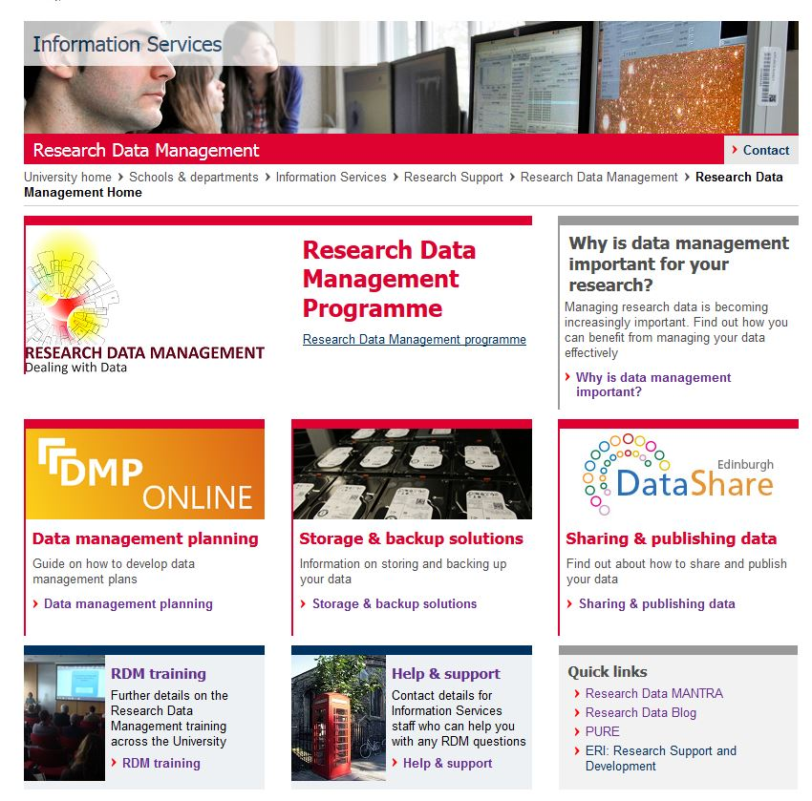
University of Edinburgh RDM Programme

Slide 14
RDM Services and Support
RDM Roadmap – sets out a high-level programme of RDM infrastructure, service and support deliverables to implement Edinburgh’s RDM Policy
3 phases: August 2012 – May 2015
Services already in place:
  Data management planning (F-2-F, DMPonline)
  Active working file space = DataStore
  Data publication repository = DataShare
Services in development:
  Long term data archive = DataVault
  Data Asset Register (DAR)
RDM support: Awareness raising, training & consultancy

Slide 15
Data Library & RDM
Research data management training:
  Research Data MANTRA
Institutional data repository provision
  Edinburgh Datashare
Assistance with deposit in national archives to comply with funder requirements
Assistance with Data Management Plans (DMPs)
Notes:
Security, backing up, data storage, data documentation and metadata, file formatting, versioning, preservation and sharing, copyright and ethical concerns, IPR etc

Slide 16
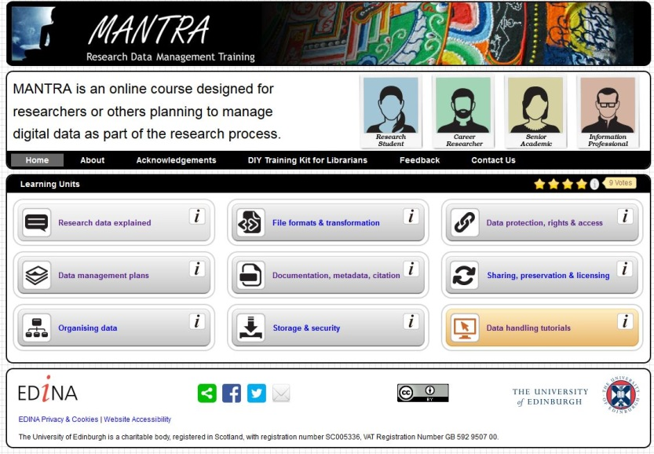
Research Data MANTRA
  Open online course aimed at researchers managing digital data as part of the research process
Units map on the research data lifecycle
PLUS software-specific data handling practicals
Open online, self-paced course for researchers
RDM DIY Training Kit for Librarians
CC licences
Notes:
Research Data MANTRA is an online, self-paced course developed by the Data Library with IAD for University PhD students. There are eight interactive learning units with pictures, video clips and quizzes, as well as four data handling practical exercises with open datasets for use in R, SPSS, NVivo and ArcGIS.
Increasingly, research funders are requiring good data management practice for the research they fund. Data management skills will help you organise and document your data, keep your data safe, make your research more reproducible, and preserve it for future use.

Slide 17
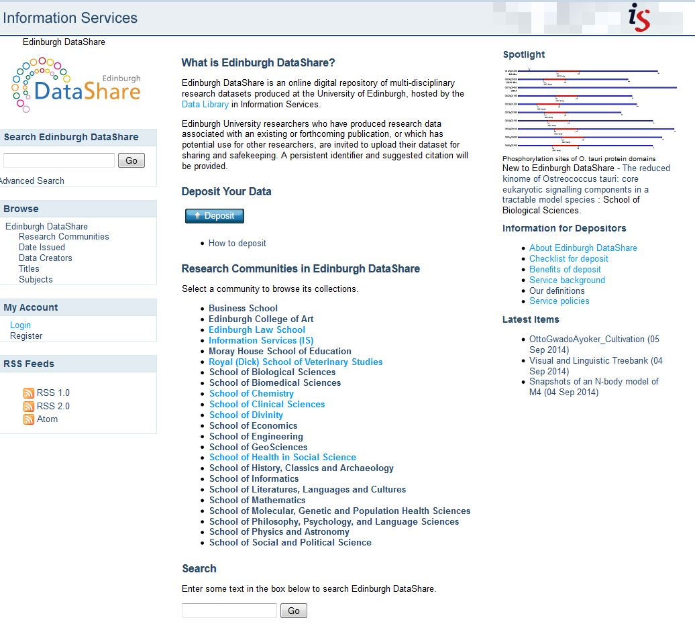
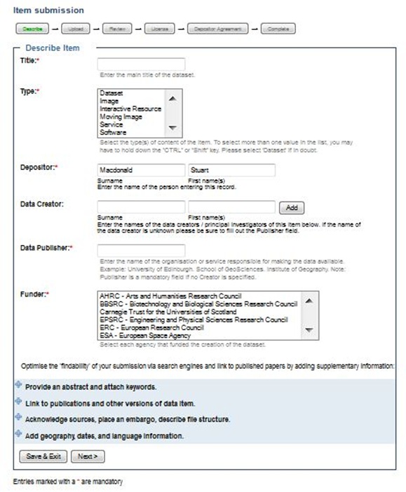
Edinburgh DataShare
Edinburgh DataShare is an online multi-disciplinary data repository for Edinburgh researchers who want to publish and openly share their data .
Citation
ODC Attribution licences
Persistent Identifers
OAI-PMH

Slide 18
Institutional RDM Infrastructure
Drivers: Funders & Jisc

Slide 19
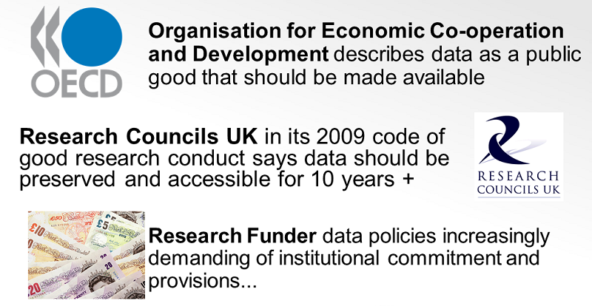
DRIVERS

Slide 20
Jisc-funded MRD Programmes (UK)
Jisc is ‘a registered charity [.. that ..] champions the use of digital technologies in UK education and research.’ It is funded by UK HE and FE funding bodies (and from 2014-15 membership subscription)
Strand 1 Projects (Oct. 2009 – Sept. 2011):
Piloting RDM infrastructures within institutions
Developing RDM Training materials
Strand 2 Projects (Oct. 2011 – Jul. 2013:
To help universities develop RDM support infrastructure & build capacity
To customize DCC’s DMP Online tool for institutional use
Strand 2 activities were complemented by work to develop disciplinary-focused RDM training materials for liaison librarians and research officers etc

Slide 21
DCC RDM 2014 Survey
National picture of institutional progress in RDM (post- Jisc MRD)
Understand barriers, perceived gaps in RDM support
Pro-VC’s for Research & Heads of Library, IT, Research Support & Commercialisation
Institutions with at least 10% income from research
87 responses from 61 institutions (incl. all 24 Russell Group* institutions)
* The Russell Group is an association of 24 British public research universities whose objective is to lead the research efforts of the UK. They receive approximately two-thirds of all university research grant and contract income in the United Kingdom.

Slide 22
Funding & staffing
c. 90% of institutions used internal funding for new appointments in RDM, for training and development of researchers and support staff, and for infrastructure.
Almost half of institutions (48%) expect that 'most' staffing of RDM roles in future will be resourced by restructuring existing roles
Overall provision for RDM is currently 4.4 FTE on average
4.7 FTE being the average in Russell Group institutions and 2.6FTE the average in other target group institutions.
Library roles are prevalent, supporting 1 fixed term and 1 permanent staff member on average.

Slide 23
RDM staffing is expected to double to 9.5 FTE in Russell Group institutions in next year, split roughly equally between Library, IT and Research Office staff.
For others institutions in target group RDM staffing is expected to rise only slightly to 3 FTE
Overall, the picture that emerged is of substantial investment by institutions in staff and infrastructure for RDM, but much of it concentrated In Russell Group institutions.
There is a strong appetite for collaborative solutions through regional consortia of institutions

Slide 24
How does University of Edinburgh measure up?
RDM Programme:
Funded internally (c. 1.5 Million Euros)
75% - infrastructure / storage
25% - staffing (recurrent for 3 years)
MANTRA and DataShare – originally Jisc project funding
Staffing:
Data Library: 2.5 FTE equivalent core funding + 1.75 FTE from RDM Programme (fixed term)
Research & Library Services: 2 FTE equivalent
Following RDM training (including training on writing DMPs) the job description of all Academic Support Librarians have been restructured to incorporate RDM as part of their role.

Slide 25

Data Services and initiatives at University of Edinburgh

Slide 26
Administrative Data Research Centre Scotland
ESRC-funded to provide trusted researchers access to de-identified administrative data in a secure environment. Based at the University of Edinburgh
Digital Curation Centre (DCC)
A renowned centre of expertise in digital curation with a focus on building capacity, capability and skills for RDM across the UK's higher education research community.
DCC provides expert advice and practical help to anyone in UK higher education and research wanting to store, manage, protect and share digital research data
EDINA – a Jisc-designated national centre of expertise in digital innovation and data service delivery

Slide 27
Centre for Doctoral Training in Data Science
EPSRC Centre for Doctoral Training (CDT) in Data Science will be hosted by the School of Informatics
The CDT in Data Science will train a new generation of data scientists with the technical skills and interdisciplinary awareness necessary to become research leaders in Data Science.
Comprising 50 PhDs over five intake years - the first cohort will start in the programme in September 2014
CDT applications will automatically be considered for the full 1 year MSc by Research + 3 year PhD programme.

Slide 28
Links
Aitäh!
  Data Library Services: http://www.ed.ac.uk/is/data-library
  EDINA: http://edina.ac.uk/
  IASSIST: http://www.iassistdata.org/
  Univ.of Edinburgh RDM Programme: http://www.ed.ac.uk/is/data-management
  RDM Roadmap: http://edin.ac/1u3sKqy
  Edinburgh DataShare - http://datashare.is.ed.ac.uk/
  MANTRA - http://datalib.edina.ac.uk/mantra
  RDM Guidance: http://tinyurl.com/pq3szvf
  Jisc Managing Research Data Strand 1: http://www.jisc.ac.uk/whatwedo/programmes/mrd.aspx
  Jisc Managing Research Data Strand 2: http://tinyurl.com/6w6g6qx
  Final Results from the DCC RDM Survey 2014 - https://www.zotero.org/groups/jhu_dms/items/itemKey/BNRG25T3
  ADRC Scotland - - http://adrn.ac.uk/centres/scotland
  EPSRC Centre for Doctoral Training (CDT) in Data Science: http://datascience.inf.ed.ac.uk/
  Digital Curation Centre: http://www.dcc.ac.uk/

