Slide 1
Open Science and the European Open Science Cloud
Andreas Veispak
European Commission, DG CONNECT

Slide 2
Why do we need Open Science?
Open Science means sharing
  knowledge and tools
  as early as possible
  between researchers and between disciplines, and also with society at large
Open Science has the potential to increase:
  Quality and efficiency of R&I, if all the produced results are shared, made reusable, and if their reproducibility is improved;
  Creativity, through collective intelligence and cross-disciplinary research that does not require laborious data wrangling;
  Trust in the science system, engaging both researchers and citizens.

Slide 3
Main challenges and priorities
Improve the practice of research and innovation
Openly accessible scholarly publications
Early sharing of all research outputs
All data FAIR, RDM
Reproducible results
Societal engagement and responsibility
Develop proper enablers
Rewards and incentives to adopt Open Science practices, with appropriate metrics
Infrastructures (including EOSC)
Appropriate skills and education, including for research integrity

Slide 4
Progress thus far
Council Conclusions
(EOSC, knowledge circulation)
Council Conclusions
(Open Science)
2015
2016
2017
2018
2019
2020
2021
Horizon Europe Launch
  European Code of Conduct implemented under Grant Agreement H2020
  Launch OSPP
  OD mandatory in H2020 (with exceptions)
  HE Regulation
  Launch EOSC
  OSPP: integrated advice (new metrics to be developed; rewards for OS a priority)
  Revised recommendation on access to scientific information
  Plan S launch
  Copyright Directive
  Open Data Directive
  Horizon Europe preparations
  EOSC first iteration (2018- 20): governance and operations
  Data Strategy Communication
  Horizon Europe preparations
  Launch ORE
  24 projects, 74 million EU contribution on citizen science projects (SwafS)
  OSPP report to COMP Council?

Slide 5
However…
Uncertainty about IPRs and (mis)use – legal, commercial, confidentiality, security, privacy, ethical (and semantic) constraints for sharing and reuse
Researchers generally not rewarded for data management and ‘FAIR-ification’ of data
General gap in skills for data stewardship
Additional resources and tools for data retention, preservation, access, analysis e.g. Text and Data Mining etc.
Technical challenges of integration, e.g. infrastructure, standards

Slide 6
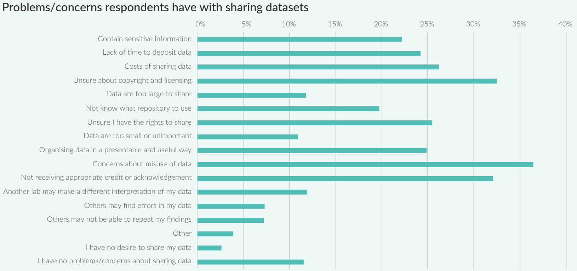
Source: Digital Science and Figshare Report: The State of Open Data 2019

Slide 7
OS practice and research careers
Source: EUA, 2019 Open Science survey

Slide 8
Consequently …
Vast majority of data never makes it to a trusted, certified and sustainable repository
Around half of all research data and experiments considered not reproducible
Large differences between disciplines in their approach to data openness, metadata description and uptake of persistent and unique identifiers

Slide 9
Main priorities
Immediate
Get Horizon Europe ready
Operationalise EOSC
Short term
Support the revision of the rewards & incentives system
Explore responses to the reproducibility crisis
Articulate FAIR “data spaces” to EOSC
Medium term
Higher quality and more efficient R&I system

Slide 10
Open Access and Open Research Data
in EU R&I programmes
2021
FP7
OA Pilot
Deposit and open access
Horizon 2020
OA Mandatory
Deposit and open access
& ORD/DMP Pilot
Horizon 2020
OA Mandatory
Deposit and open access
& ORD/DMP by default
(opt-out)
2017
Horizon Europe (TBC)
OA Mandatory
Deposit and open access
DMP in line with FAIR Mandatory
ORD by default (exceptions)
& Open Science embedded
2014
2008

Slide 11
Open Access and Open Research Data
in Horizon Europe
Art. 10 - Open Science
The approach
Art. 35 - Exploitation and Dissemination
The modalities
Open access to scientific publications to be ensured
Open access to research data to be ensured in line with principle 'as open as possible, as closed as necessary'
Responsible research data management to be ensured in line with FAIR principles
Other open science practices to be promoted and encouraged
Reciprocity in open science to promoted and encouraged in all association and cooperation agreements with third countries
Open access to scientific publications obligatory: sufficient IPR to be retained
Open access to research data, 'as open as possible, as closed as necessary' : exceptions
Responsible research data management in line with FAIR principles; Data Management Plan mandatory; possible obligations (in specific WPs) to use the European Open Science Cloud for storing and providing access to data
Possible additional incentives or obligations through work programmes for other open science practices

Slide 12
Horizon Europe to walk the talk on Open Science
(work in progress)
Publications: Immediate open access; copyright retention and open licenses
Research data: in line with FAIR principles; as open as possible as closed as necessary; mainstreaming of RDM (with DMP)
Emphasis on validation of research results for reproducibility of research as requirement in MGA
Open science practices to be part of proposal evaluation
Mainstreaming co-creation with citizens (including citizen science)
Option through the WP for EOSC

Slide 13
The European Open Science Cloud
The role of the EOSC is to ensure that European scientists reap the full benefits of data-driven science, by offering:
“1.7 million European researchers and 70 million professionals in science and technology a virtual environment with free at the point of use, open and seamless services for storage, management, analysis and re-use of research data, across borders and scientific disciplines”
2016 Communication on the “European Cloud Initiative”

Slide 14
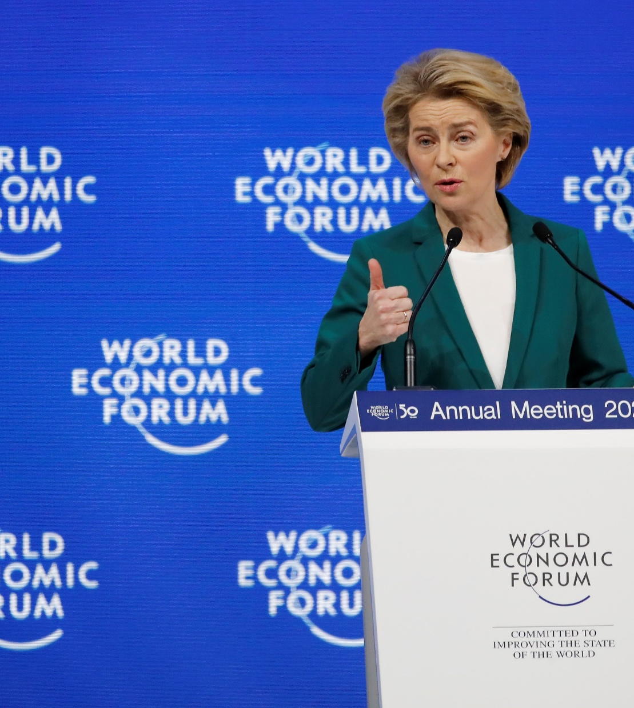
President U. von der Leyen
World Economic Forum, Davos, Jan. 22nd, 2020
“We are creating a European Open Science Cloud now”
“It is a trusted space for researchers to store their data and to access data from researchers from all other disciplines”
“We will create a pool of interlinked information, a web of research data”

Slide 15
Why the EOSC?
  Vehicle for Open Science and the Digital Single Market
  Offer researchers anywhere in the EU the resources they need
  Build an open and inclusive data commons in Europe and develop a system of FAIR digital objects
  Facilitate interdisciplinarity and research to applications
  Reduce fragmentation and costs through increased resource sharing and federating existing infrastructures
  Enabler of an open, transparent, rule-of-law-based, federated ecosystem, providing access to core digital infrastructure and service resources with the objective of:
    Maximising digital capacities available to researchers
    Supporting public authorities in informed policy development and implementation, including for key societal challenges
    Enable the Digital Single Market, help stimulate the emergence of a competitive EU cloud sector

Slide 16
What is the EOSC?
  Trusted and open virtual environment with seamless access to services (with highest TRLs) addressing the whole research data life cycle:
    Federate and connect existing or planned RIs
    Make data FAIR, store them, ensure long-term preservation
    Services to find, access, combine, analyse and process data
  Multi-layered federation (federating core, rest of the ecosystem), bringing together supply and demand in a trusted environment
  Open, transparent, rule of law based: no lock-in by individual service providers, data portability, IPR, cloud security…
  Adaptively user-oriented and inclusive (across borders and disciplines)
  Accessible through a non-exclusive, simple, universal access point
  Governed by clear and unambiguous Rules of Participation
  Steered by an inclusive governance structure

Slide 17
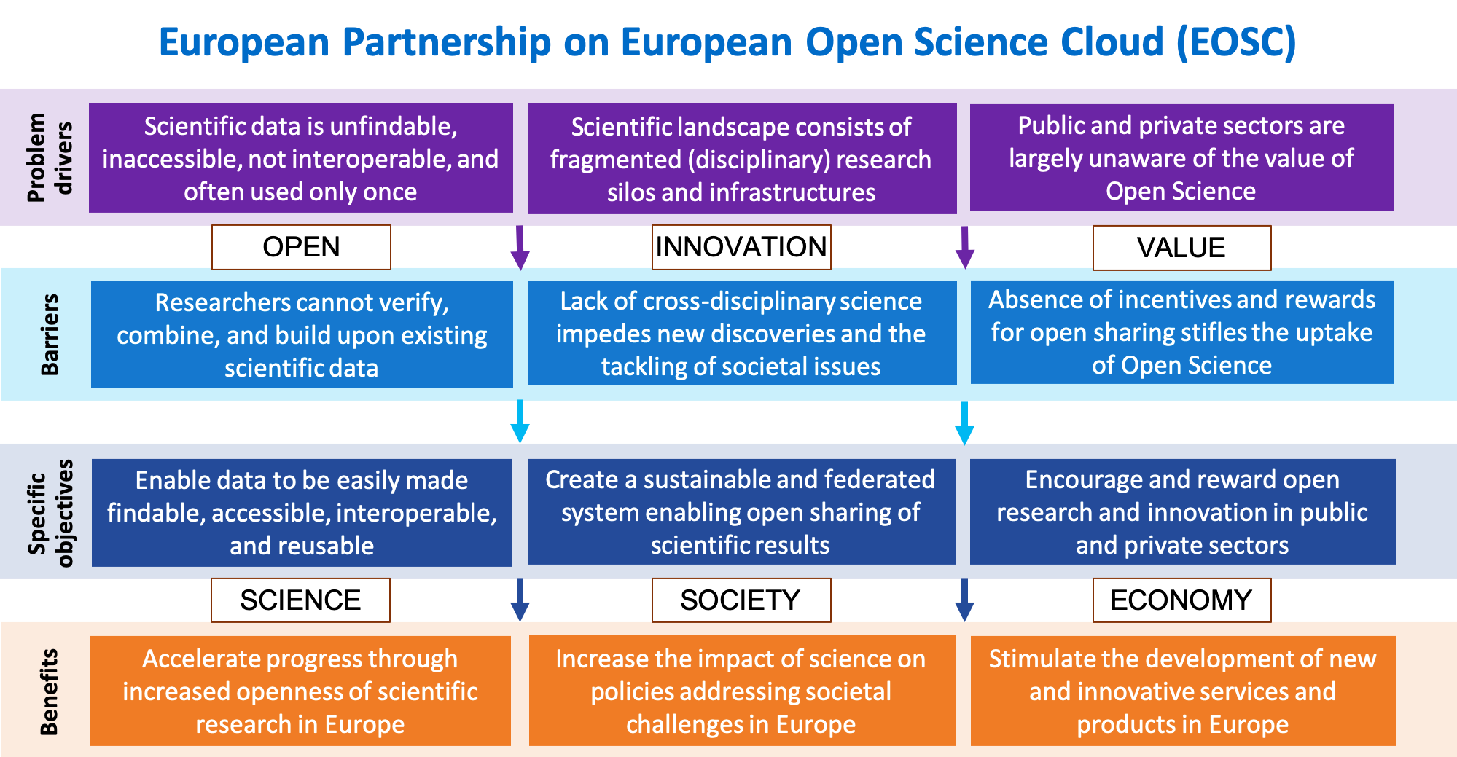
  Rationale for EOSC

Slide 18
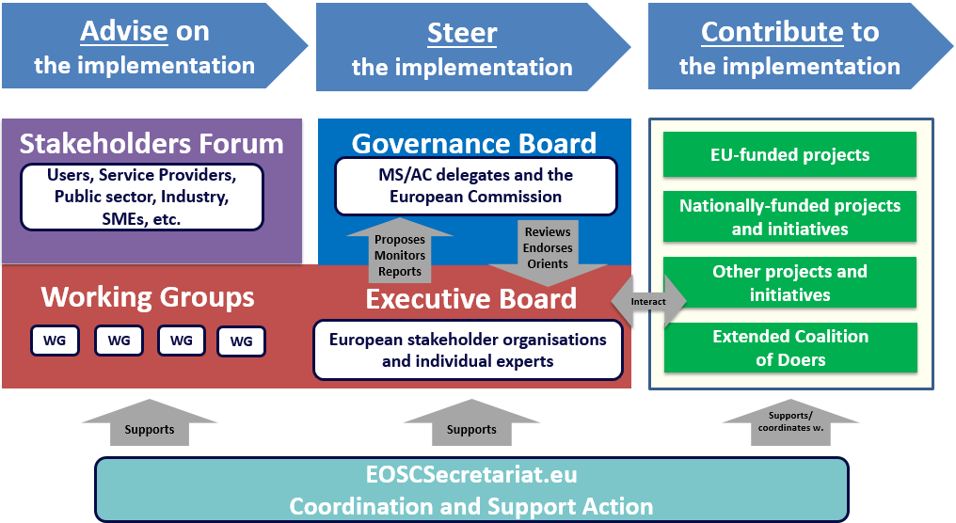
EOSC governance structure

Slide 19
EOSC EB Working Groups and Task Forces
EOSC Executive Board
Communications Task Force
Landscape WG
Sustainability WG
International Engagement Task Force
Strategic focus
Close liaison with Governance Board
Rules of Participation WG
Architecture WG
FAIR WG
Practical implementation focused WGs
Skills & Training WG

Slide 20
A first edition of EOSC by end 2020
Rules of Participation WG:
  Agreed and tested Rules of Participation
Landscape WG:
  Analysis of existing national infrastructures and policies
Sustainability WG:
  Financing model, legal entity, and post 2020 governance structure
Architecture WG:
  Functioning federated core
  Initial/minimum set of EOSC data and services
  EOSC Interoperability Framework (with FAIR WG)
FAIR WG:
  Persistent Identifier policy (with Architecture WG)
  Metrics for FAIR data and certified services
Training & Skills WG:
  EOSC MVP for training & sustainability model (with Architecture WG and Architecture WG)
  Recommendation for EOSC skills/training in national digital skills policies

Slide 21
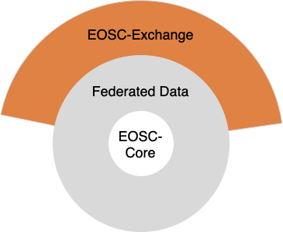
First edition: minimum viable EOSC (MVE)
The MVE includes EOSC-Core (layer of discovery and interoperability) and EOSC-Exchange (layer of enriched services), both of which work with federated FAIR datasets
MVE must enable the federation of existing and planned research data infrastructures
Step 1: Federate the thematic clusters and regional projects
Advance incrementally: Begin with simple use cases (open data, rather than sensitive or closed).

Slide 22
EOSC-Core: functions and proposed coverage
Provides the means to discover, share, access and re-use data and services (layer of discovery and interoperability)
In its first iteration, not planned to store, transport or process data
To be as widely used as possible: accessible to any authenticated user to promote uptake of EOSC
Current discussion on minimum requirements vs. nice to have (Minimum Viable EOSC vs. Maximum Valuable EOSC)
Some services under consideration:
AAI framework
PID services
Shared open science policy framework
Data access framework
Service management & access framework
Minimum legal metadata framework
Help-desk

Slide 23
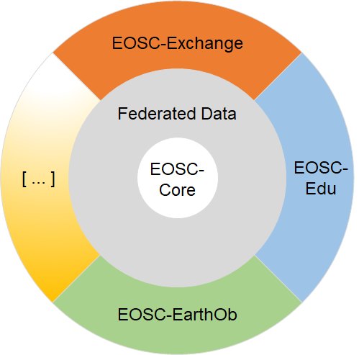
Proposed second and third iterations
Public-funded research
All research communities to be tackled by the first iteration under EOSC-Exchange layer
Incremental extensions to target public administration and industry
Vision: One ‘marketplace’.
Differing requirements/legislation may require linked but alternately governed spaces
Public sector
Private sector

Slide 24
Ongoing partnership proposal and SRIA
Current governance of EOSC will present a proposal to the European Commission for a co-programmed partnership under Horizon Europe
The proposed partnership will make the initiative evolve from a project-based approach to an all-encompassing ecosystem where the different stakeholders take the necessary commitments to accomplish it.
Counter-signatory of the Commission will be a legal entity to be set up before the end of the year representing key stakeholders in the EOSC process
Discussions are taking place on how the European Commission, Member States and Associated Countries, and this legal entity of organisations will steer EOSC post-2020
A Strategic Research and Innovation Agenda will set the long-term strategic priorities and will serve as a handbook for implementing the EOSC vision

Slide 25
Thank you

