Slide 1

Literary Festival Prima Vista:
The message of libraries in space and time
Elena Sipria-Mironov
Project Manager
University of Tartu Library

Slide 2


Literary Festival
Officially organised by:
  NPO Literary Festival Prima Vista
Actual organisers and initiators are:
  University of Tartu Library
  Tartu Public Library
  Tartu Department of the Estonian Writers’ Union
  Estonian Literary Society
The organizing committee:
  15 members (including 5 Advisory Board members)
  Partners from other groups and organisations

Slide 3
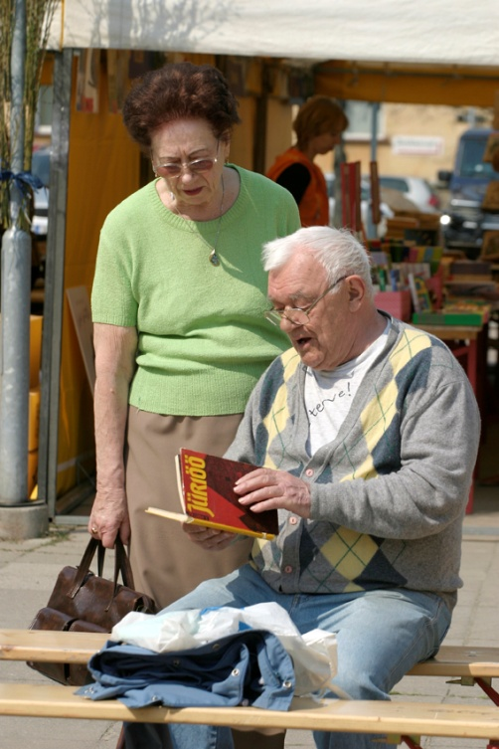
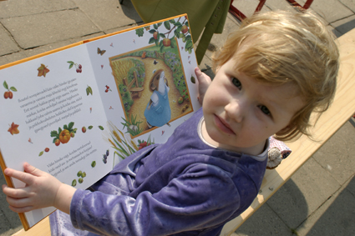
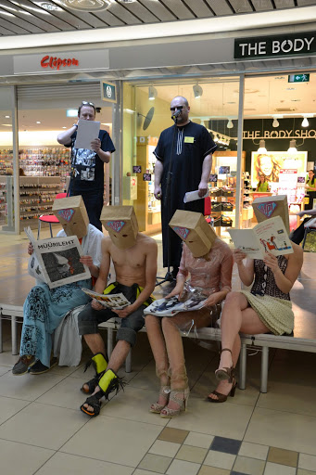
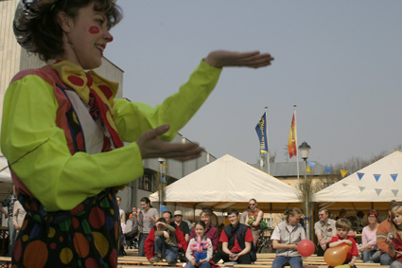
What make this festival unique?

Slide 4
How did we come to the idea of a literary festival?
Library Users’ Survey 1999
  The library user questionnaire (more than 350 responses)
  The focus group interview
Survey Results :
  book sales were most popular
  events related to art and music were also mentioned
  joint projects with other cultural institutions and publishers were regarded as successful and interesting
„There is no better place and no better audience in Tartu“
“It is truly one of the places where the spirit of Tartu nests, its importance cannot be underestimated“

Slide 5
The birth of the great literary festivity
The book fair UTLIB Market in UT Library as the predecessor of the festival
  Included inerpretation seminars, meetings with writers, exhibitions of book illustrations, workshops
The Park Library, concerts of singing writers and other events for readers organised by Tartu Public Library
Intense activity from the Tartu Department of the Estonian Writers’ Union and the Estonian Literary Society

Slide 6
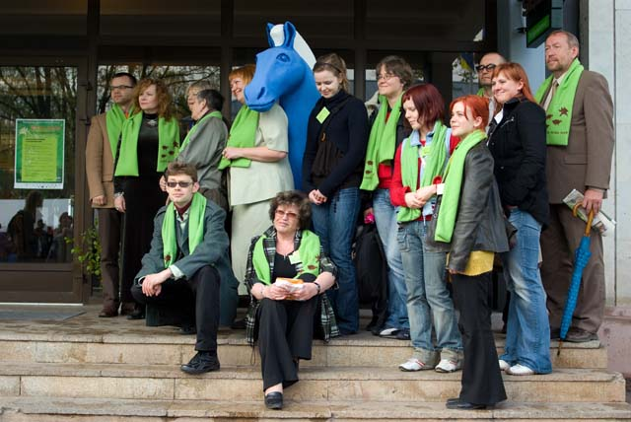

Slide 7
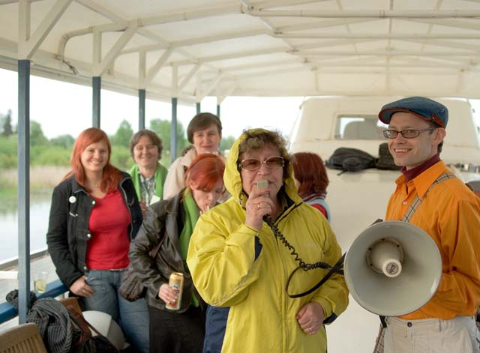
From idea to realization
The first literary festival Prima Vista received the title of the Culture Event of the Year in Tartu
In 2010 the organising committee of the festival became winner of the Culture Carrier award for Producer of the Year in Tartu.

Slide 8
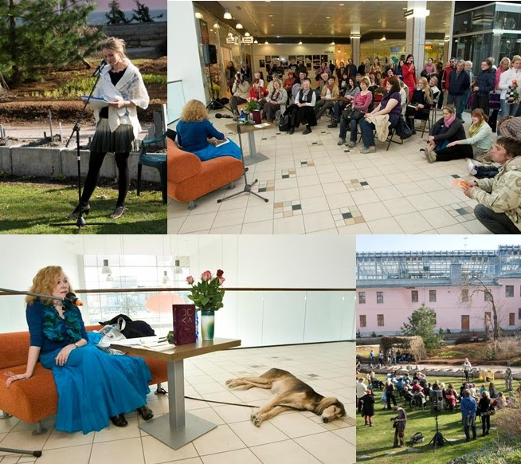
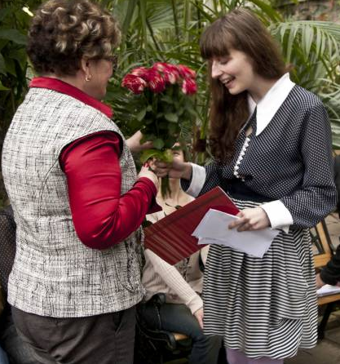
Book and Rose Day celebrated in April 23rd
“First Step”
a yearly literary prize for the best fiction debut published in media

Slide 9
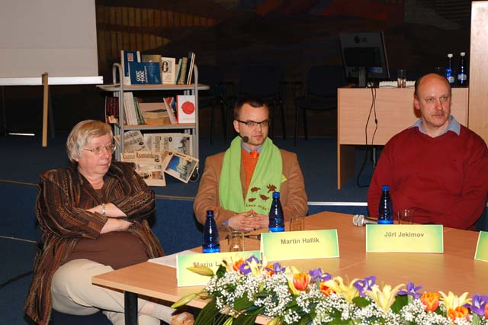
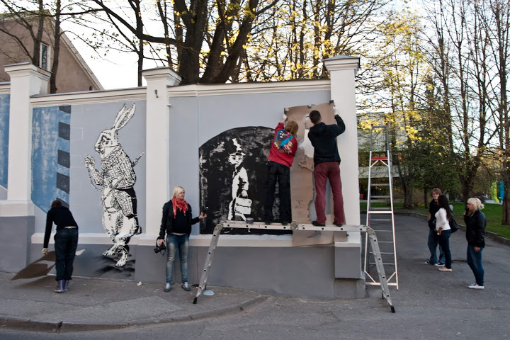
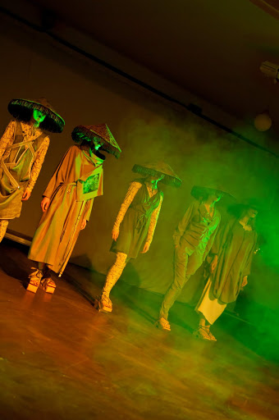
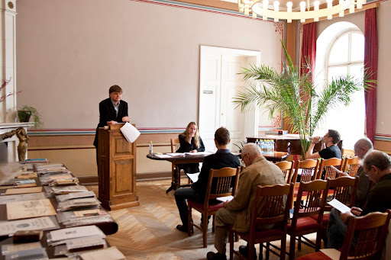
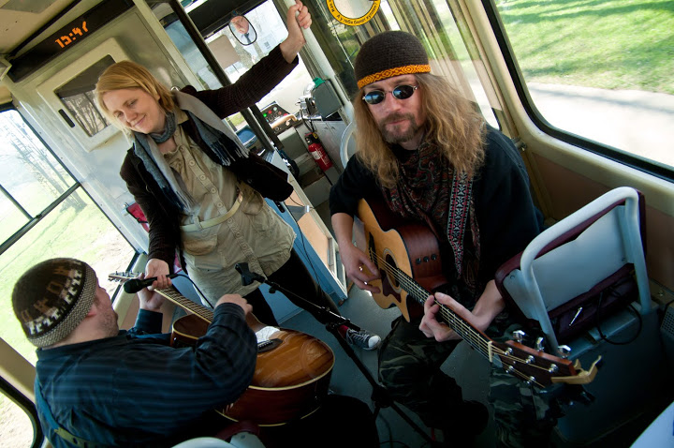
From idea to realization
more than 100 different events
more than 100 performers
an audience of about 15, 000 people

Slide 10
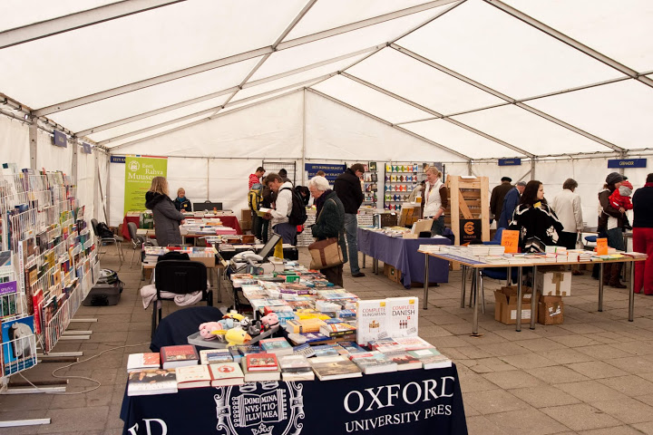
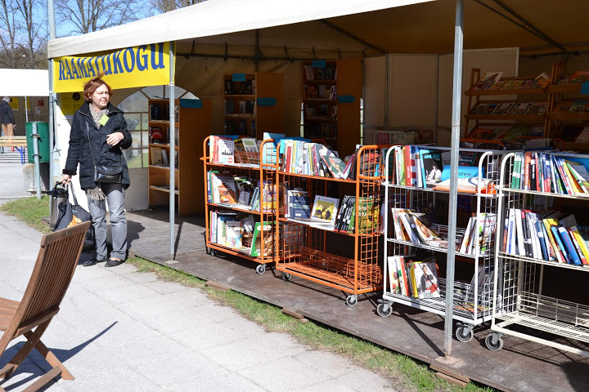
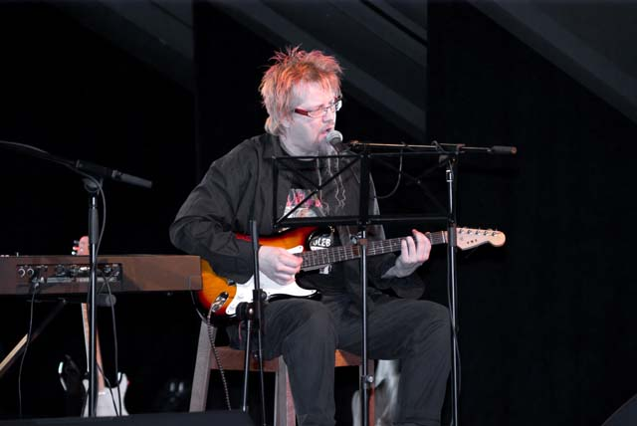
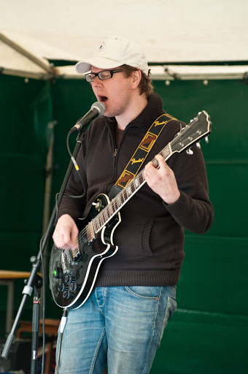
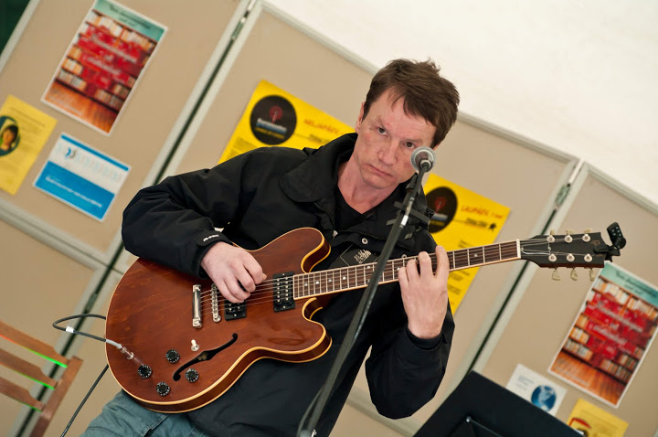
The traditional events
Prima Vista book fair
Park Library
Very popular concert of the singing writers

Slide 11
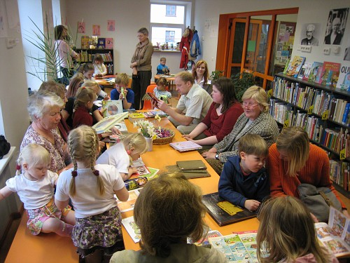
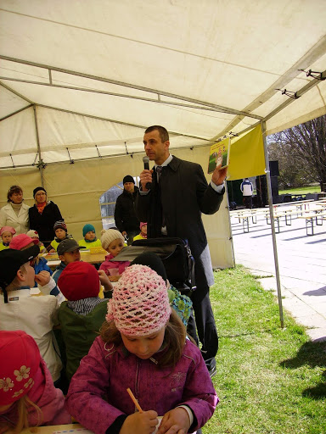
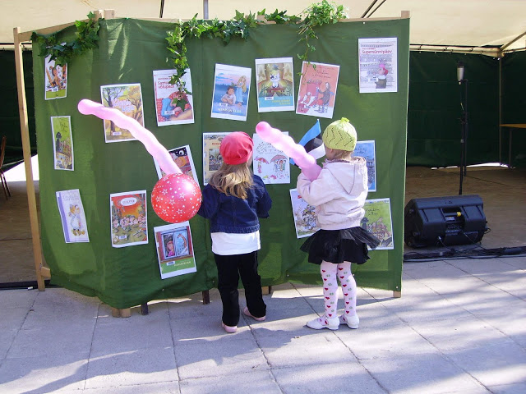
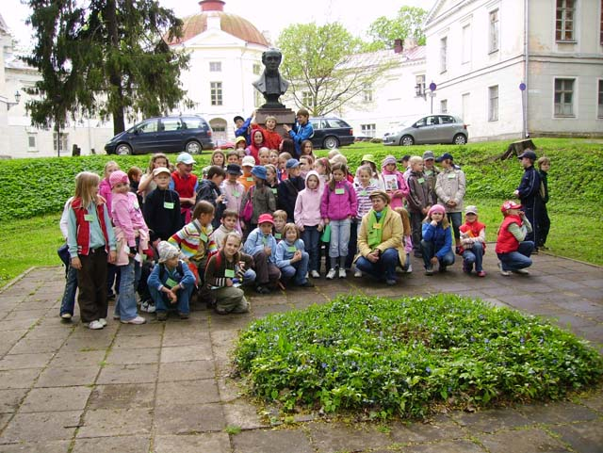
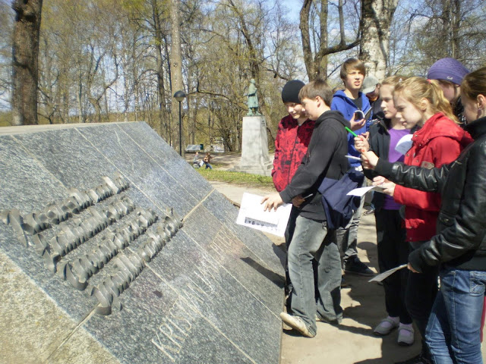
Children’s programme includes around 20 events

Slide 12
Prima Vista has many partners
Embassies, Councils and Cultural Institutions
different departments of the University of Tartu
Estonian National Museum
Tartu Toy Museum
schools and day-care centers
literary magazine Värske Rõhk
Estonian Librarians’ Association
movie theatre Tartu Elektriteater
Tartu Uus Teater (Tartu New Theatre)
Tartu Art College
other festivals such as tARTuFF and Mailaul
and many other

Slide 13
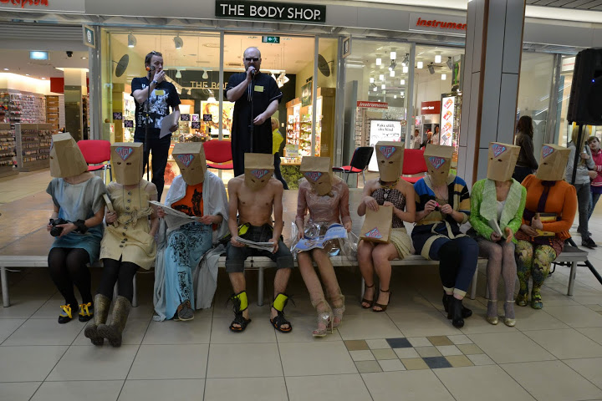
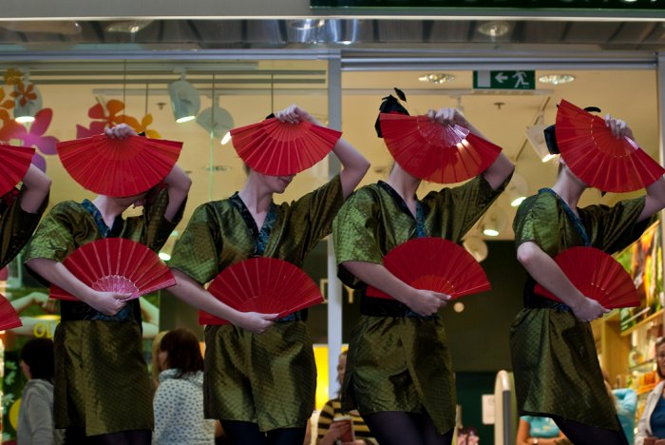
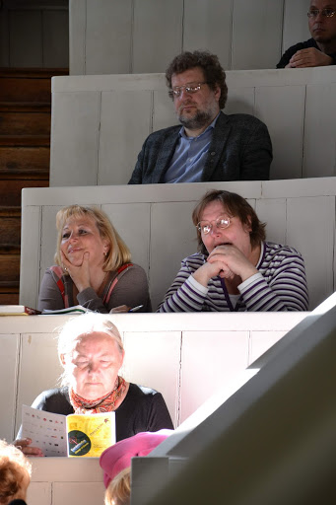
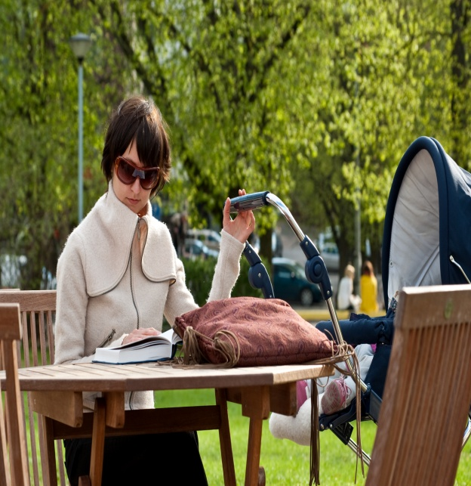
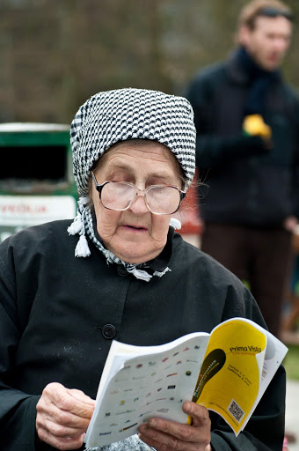
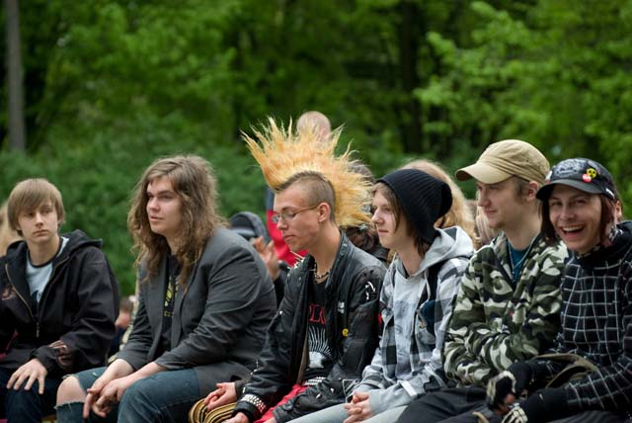
Growing cultural event which brings together people with very different interests

Slide 14
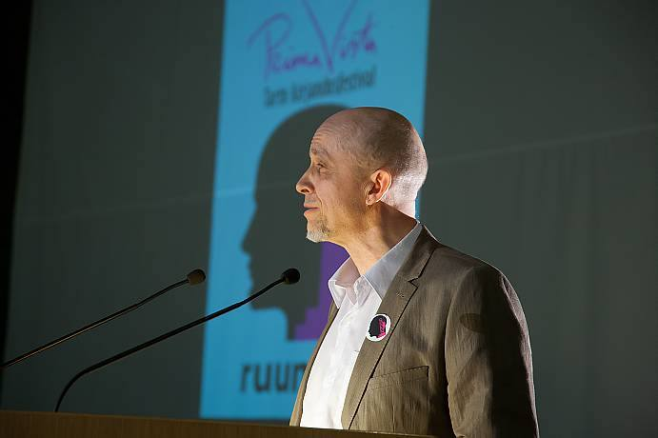
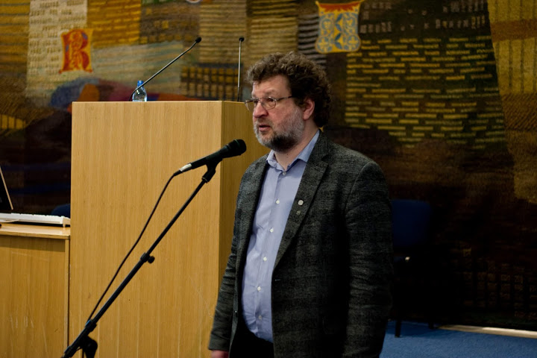
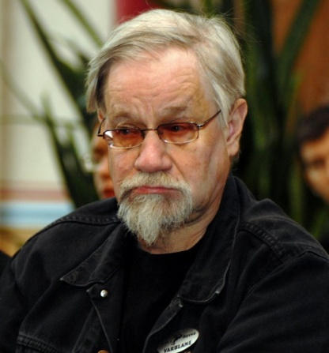
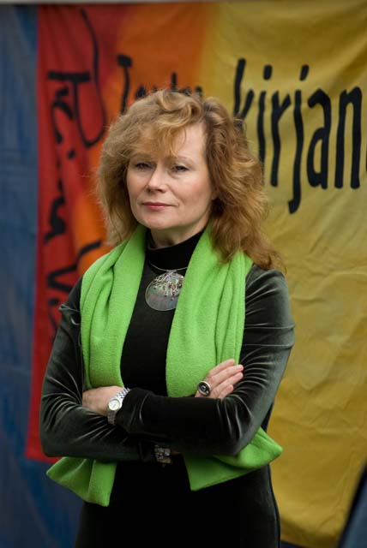
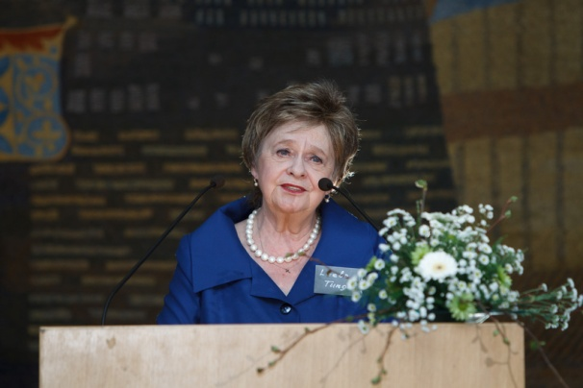
Main theme or a slogan:
„The Last Days of Libraries?“
„The Art of Survival”
„Change of Course“
„RoomID“
„Time flies!“
Mihkel Mutt
Rein Raud
Hannes Varblane
Doris Kareva
Leelo Tungal

Slide 15
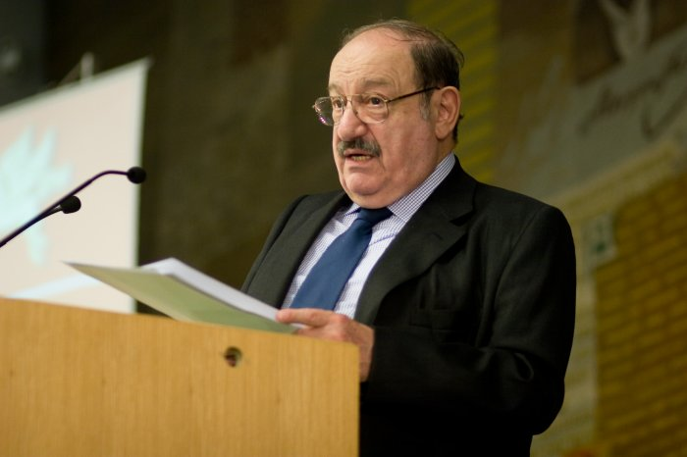
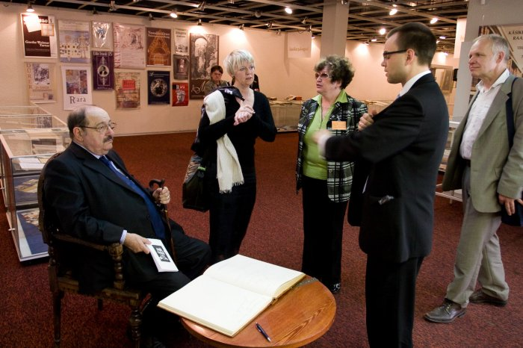
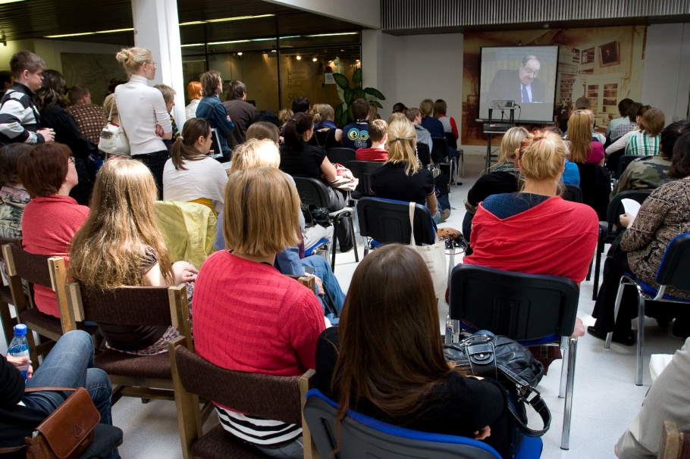
Famous writers who have visited Tartu
“The only advice I can give to a young person who wants to start writing is: READ!”
Umberto Eco
The festival has also been visited by:
German musician and poet Wolf Biermann British punk poet John Cooper Clarke
American cyberpunk classic Bruce Sterling Finnish writer Joel Haahtela
Hungarian writer Attila Bartis
and many other renowned authors

Slide 16
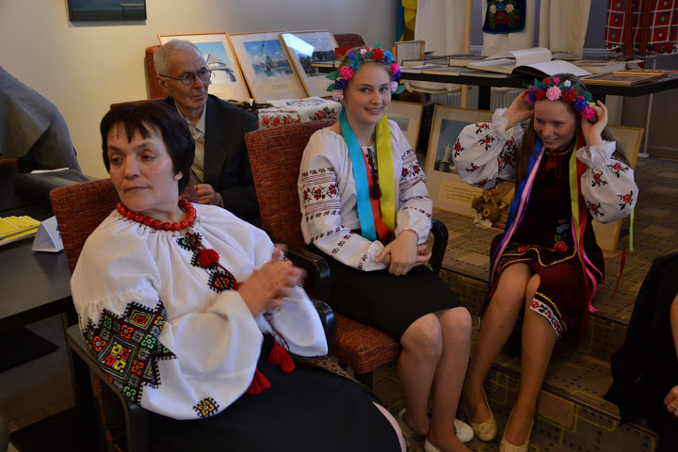
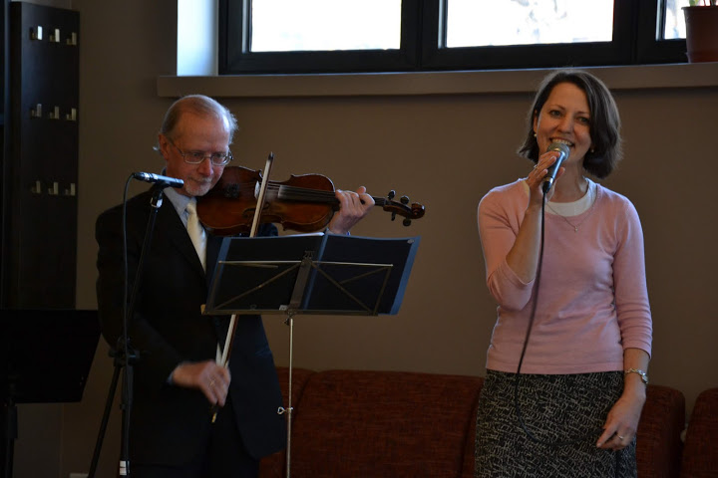
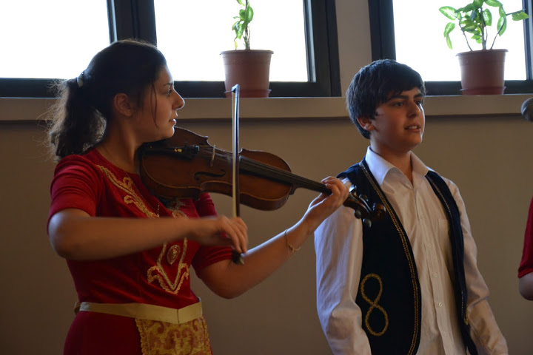
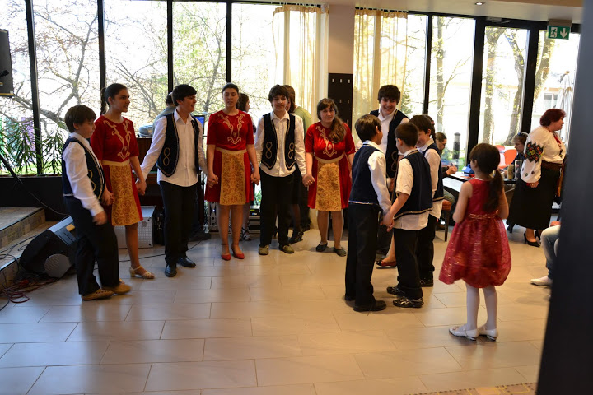
Prima Vista integrate the local non-Estonian communities

Slide 17
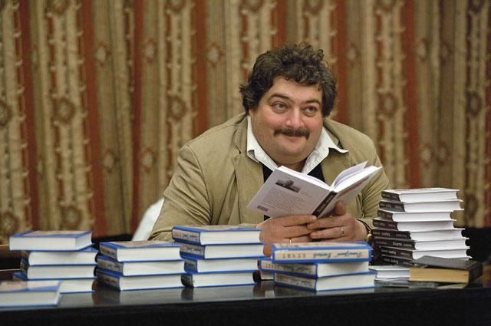
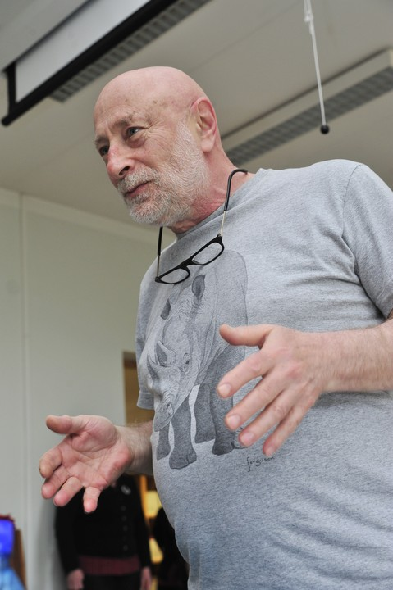
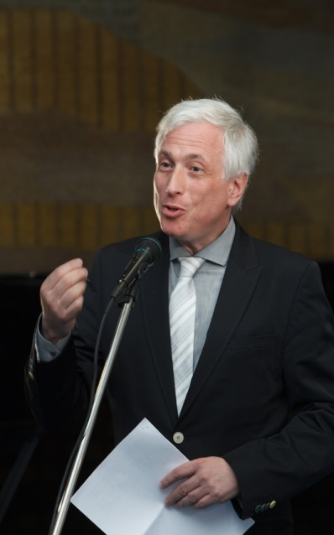
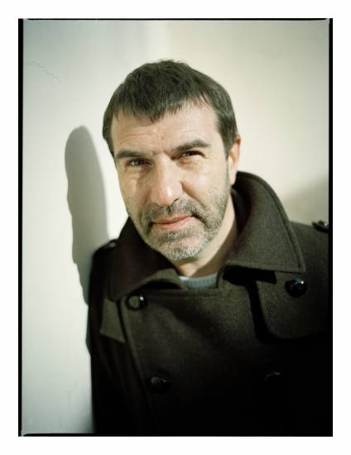
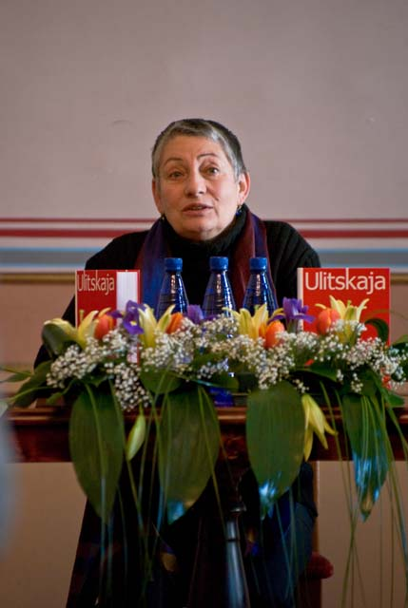
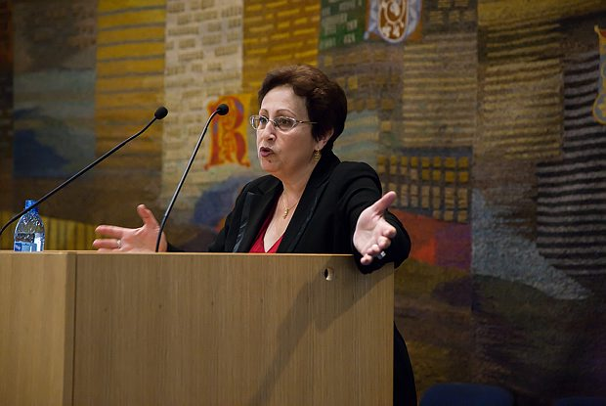
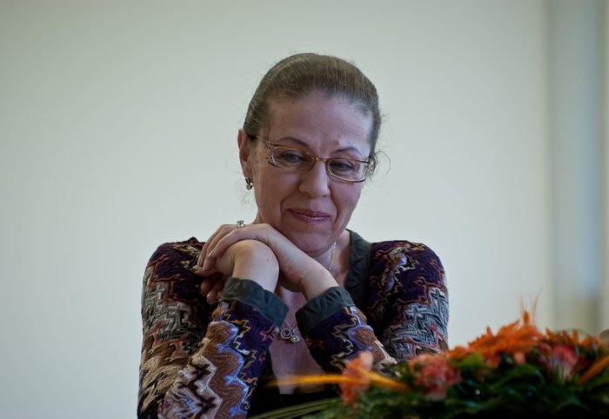
Renowned Russian writers
Dmitri Bõkov
Grigori Oster
Leonid Mletšin
Jevgeni Griškovets
Ljudmila Ulitskaja
Dina Rubina
Aleksandra Marinina

Slide 18
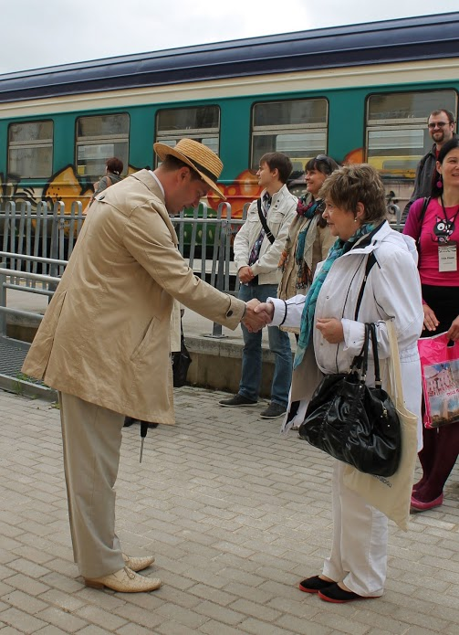
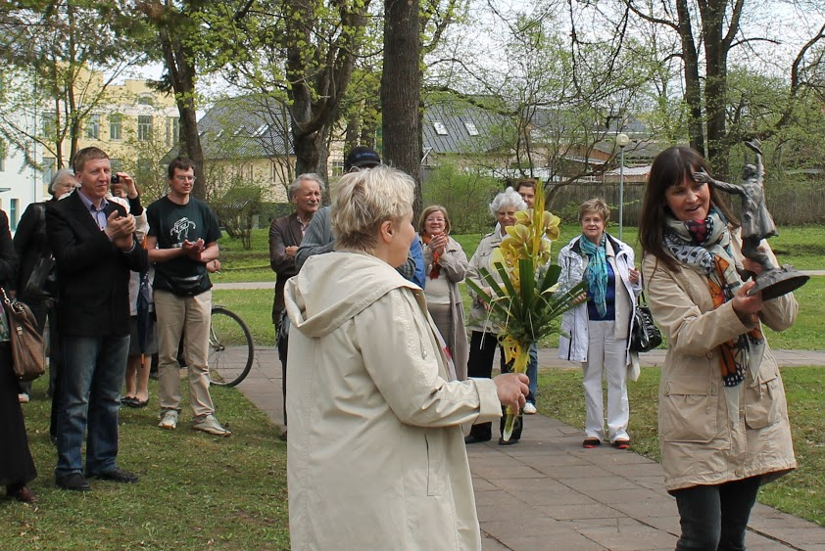



The partner-town programme is always coordinated by the lockal library
Partner-libraries from:
  Narva,
  Pärnu
  Viljandi
  Põltsamaa
  Võru
  Elva
  Valga

Slide 19
Money matters…
 | 2011 | 2012 | 2013
Tartu City Government | € 18 717,00 | € 20 400,00 | € 20 400,00
Cultural Endowment of Estonia | € 9 450,00 | € 12 730,00 | € 14 000,00
Estonian Ministry of Culture | € - | € 2 000,00 | € 3 000,00
Estonian Gambling Tax Council | € 1 000,00 | € 1 000,00 | € 1 750,00
Cultural Endowment of Tartu | € 583,00 | € 400,00 | € 350,00
 | € 29 750,00 | € 36 530,00 | € 39 500,00

Slide 20


University of Tartu and Library
“The library has grown together with the University of Tartu which has been and probably remains for a long time the most important intellectual centre of Estonia.“ (Prof. Jüri Talvet)

Slide 21
You’re all very welcome to attend Prima Vista events during the second week of May 2014!

