Slide 1


ANATOMY OF LIBRARY-LED CHANGE
Heather Sardis, Associate Director for Technology, MIT Libraries
Erin Stalberg, Associate Director for Collections, MIT Libraries
November 1, 2022
Estonian Library Association

Slide 2
MIT’S HISTORICAL STRENGTHS
Science and engineering
Early adopters of open source technologies (developers of DSpace)
Open Access and Open Scholarship
  OpenCourseWare (2000)
  One of the US’ first all-faculty open access policies (2009)
  Involved in launch of the Creative Commons
  MIT Framework for Publisher Contracts

Slide 3
MIT LIBRARIES’ CONTEXT
Technology sophisticated
Highly decentralized
Engineering mindset, problem-solving mindset
Different that a humanities-centered institution, MIT does not see the library as the center of its universe

Slide 4
MIT LIBRARIES’ VISION
This crisis demands an accelerated transformation of our library into a platform for the creation, discovery, use, dissemination, and preservation of knowledge that is fully open and equitably accessible.
Our vision for the MIT Libraries, now and in a post-Covid future, requires a laser-sharp focus on collections, services, and technology with maximum and inclusive impact.
From MIT Libraries Vision: A New Urgency, May 2020

Slide 5
NEW URGENCY PRINCIPLES
Digital first
Open and equitable scholarship
Support for data and computation
Essential core of physical resources
Commitment to diversity, equity, and inclusion
Bold leadership

Slide 6
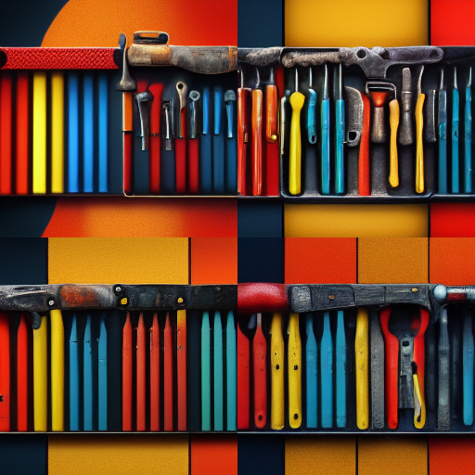
EXPANDING THE LIBRARY’S SPHERE OF INFLUENCE: A CHANGEMAKER’S TOOLKIT
Images generated by A.I. using the Midjourney Bot @ https://www.midjourney.com/

Slide 7
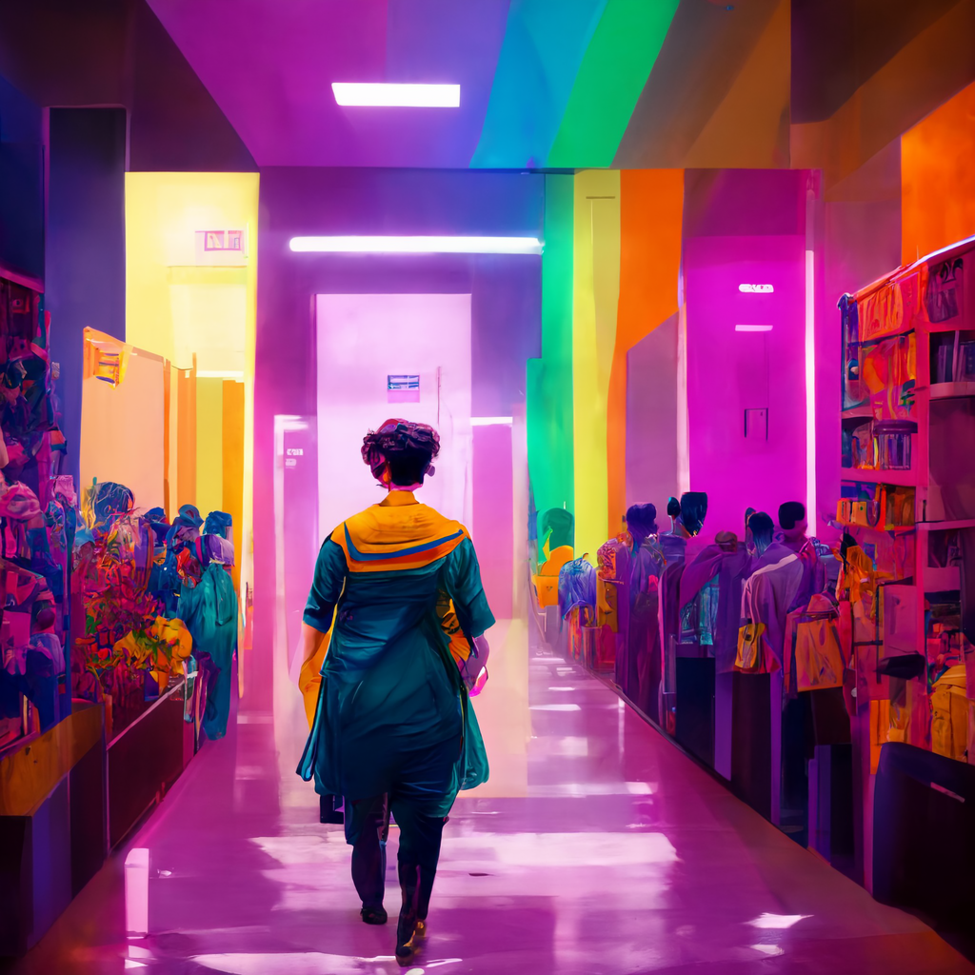
LIBRARY LEADERSHIP FIGHTING FOR A SEAT AT THE TABLE

Slide 8
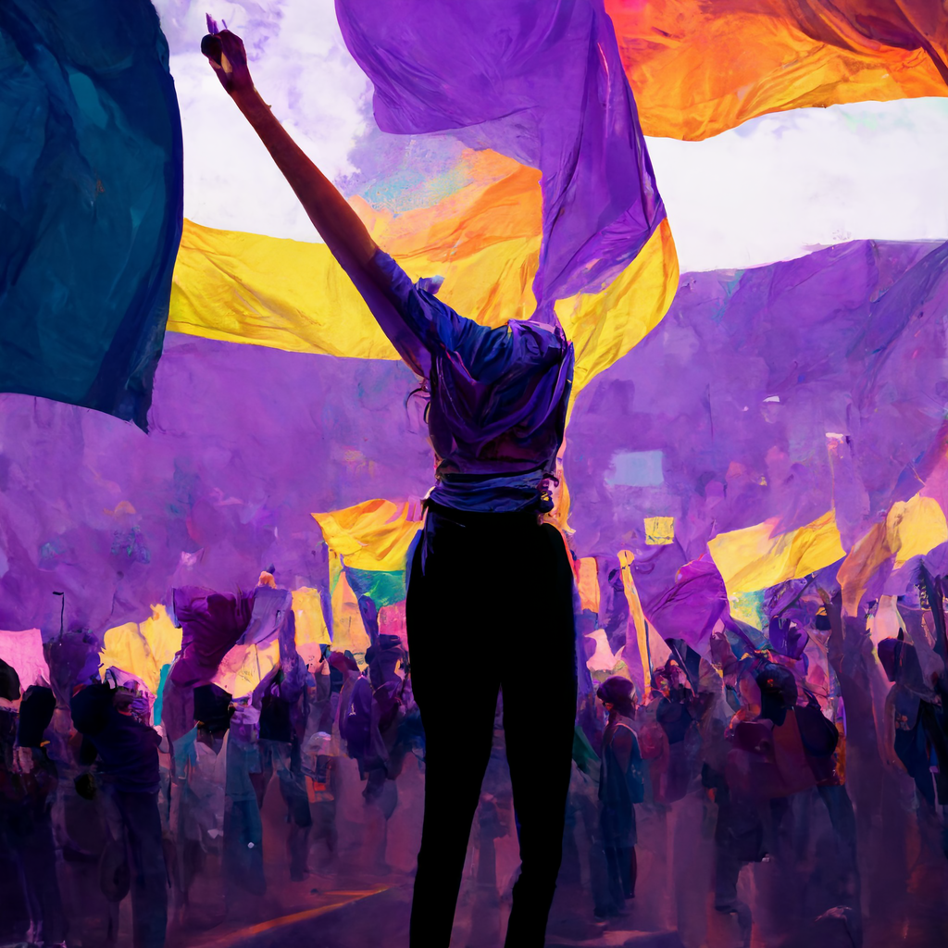
CHOOSING A CAUSE YOU BELIEVE IN

Slide 9

KNOWING YOUR EXPERTISE

Slide 10

PERSISTENCE AND READINESS

Slide 11

BUILDING INTERNAL ALIGNMENT

Slide 12

BUILDING COALITIONS

Slide 13

CHANGE MANAGEMENT

Slide 14


QUESTIONS?

Slide 15
LINKS AND CITATIONS
MIT Future of Libraries Report (2016)
MIT Open Access Task Force Report (2019)
MIT Framework for Publisher Contracts (2019)
MIT Libraries Vision: A New Urgency (2020)
MIT Mission and MIT Values Statement (2022)
The Three Essential Properties of the Engineering Mind-Set
(Farnam Street Media, adapted from Applied Minds: How Engineers Think,
Guru Madhavan, 2015)
Midjourney AI Bot

