Slide 1
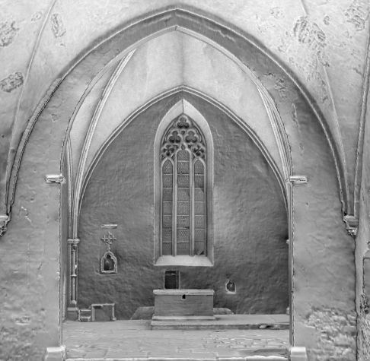
3D Dokumenteerimine
Andres Uueni
Ennistuskoda KANUT
Kääriku
2014
Notes:
1

Slide 2
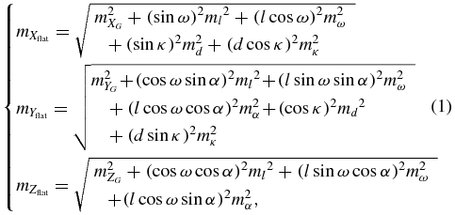

Slide 3
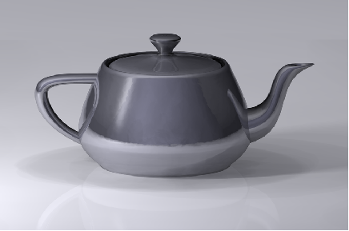
Martin Newell , Utah’ teepoti mudel (1975)

Slide 4
‘Metric survey’ - describes the application of precise,
reliable and repeatable methods of measurement for
cultural heritage documentation.
[English Heritage]
Notes:
4
Depending directly
4

Slide 5
3D digiteerimine
... on protsess, kus konverteeritakse füüsiline objekt digitaalseteks andmeteks
igal ühikul väärtus XYZ-teljestikus (pikkus, laius, kõrgus)
3D graafika baseerub vektorgraafikal
Notes:
5

Slide 6
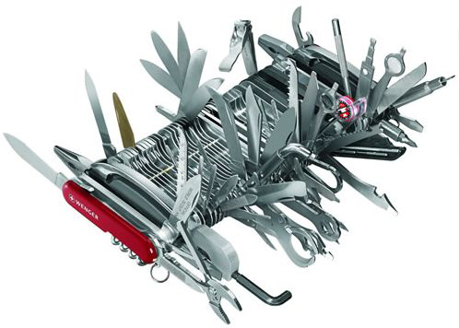
3D dokumenteerimine
Dokumenteerimine on nii protsess kui toode
Interdistsiplinaarne
Kättesaadav
Praktiline
Efektiivne
Notes:
6

Slide 7
kultuuripärand
  Objekti mõõdistamine, andmete töötlemine
  3D mudeli haldamine ja säilitamine
  Visualiseerimine ja esitlemine
  Uuringud, kvaliteedi kontroll
  Informatsiooni jagamine erinevatel eesmärkidel
Notes:
7

Slide 8
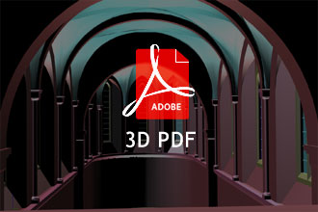
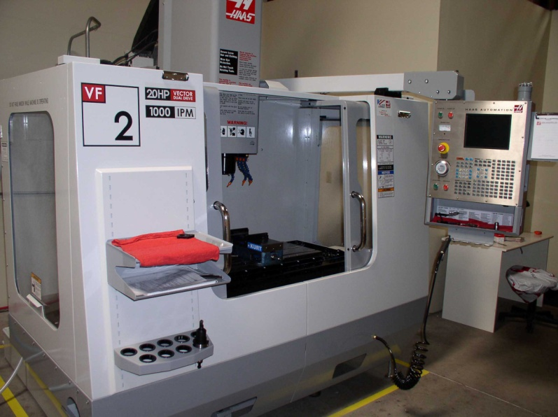
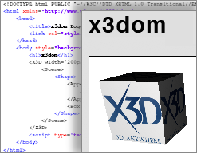
Lingid 2D ja 3D objektide vahel
Integreeritav teiste allikatega
Kaasajal sobiliku(ma)d formaadid
3D printerites, CNC pinkides
Notes:
8

Slide 9
meetodid
Eesmärk
Reaalsed uuringud (reality-based survey)
  Riistvara, tarkvara, geolokaliseerimine (DTM/DSM, GIS/WebGIS, GNSS, INS/IMU)
Reaalsusele mitte vastavad lahendused (nonreal approach)
  Tarkvara
Notes:
9

Slide 10
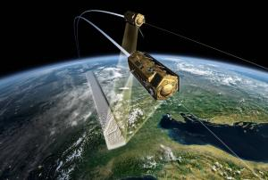
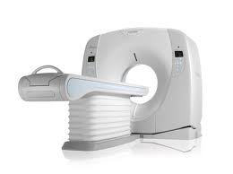
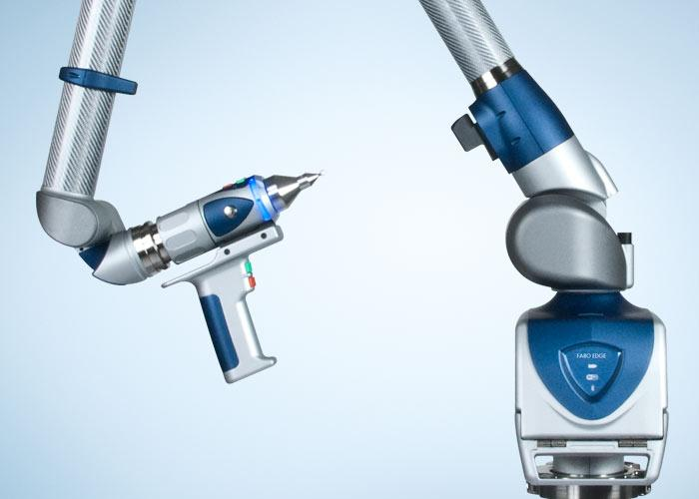
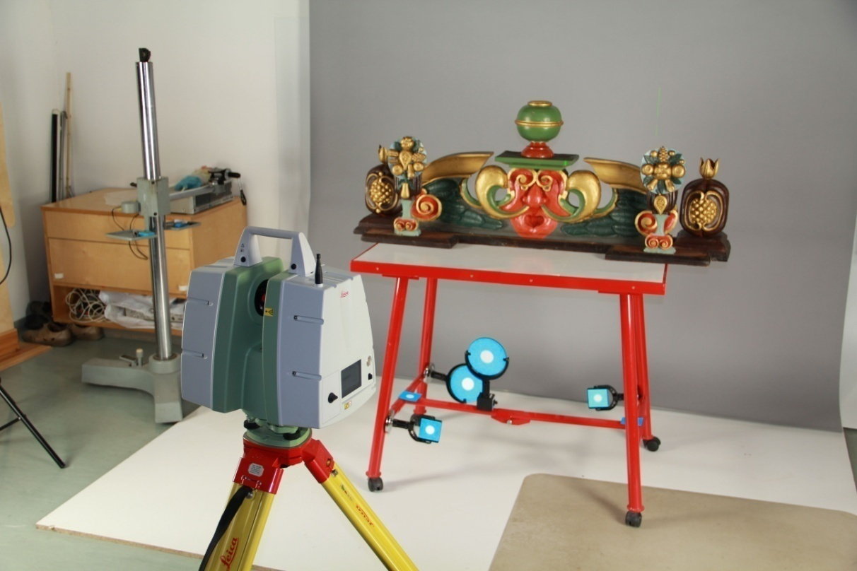
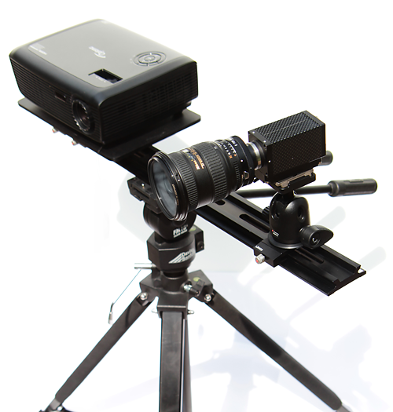
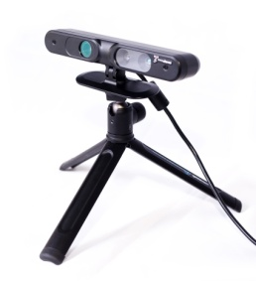
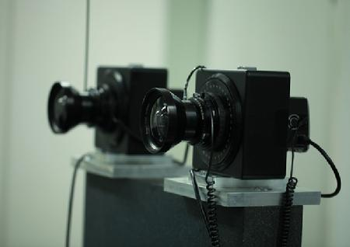
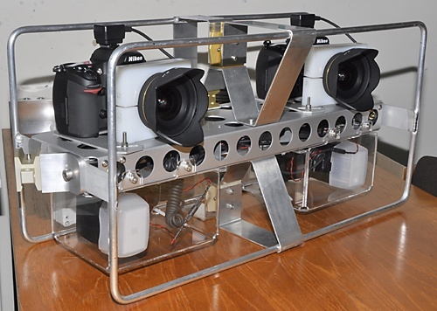
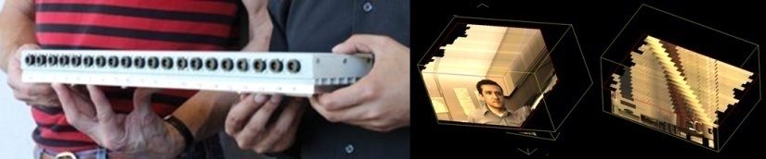

Slide 11
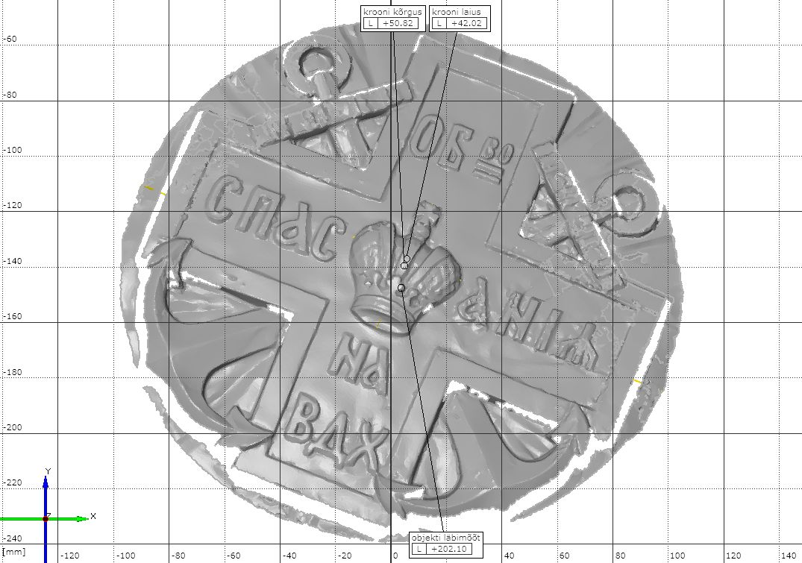
A. Uueni, 2013

Slide 12
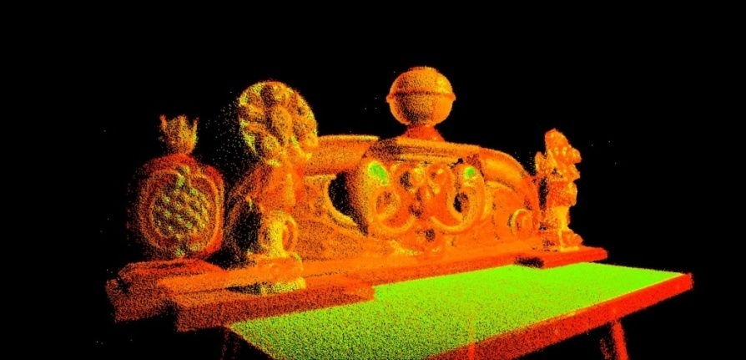
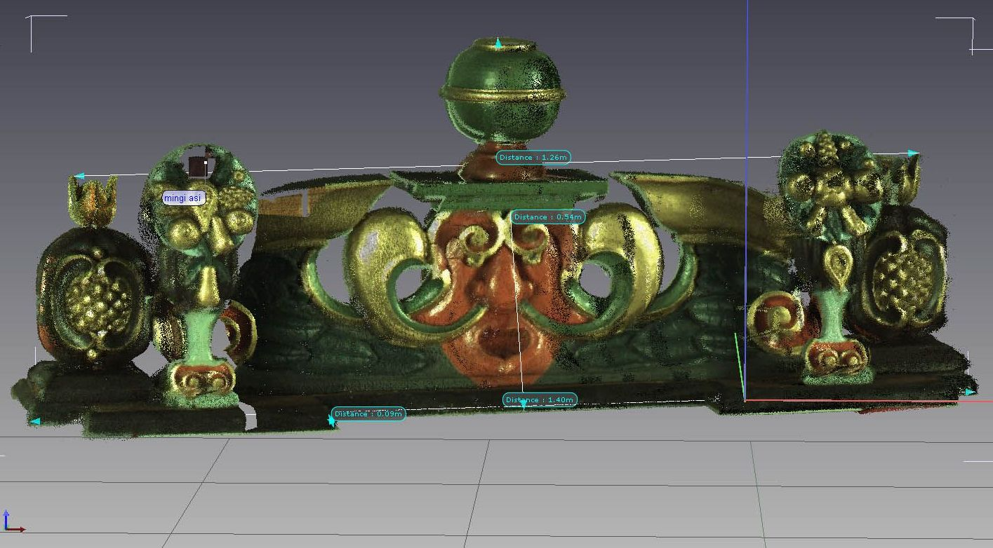
A. Uueni, 2013

Slide 13
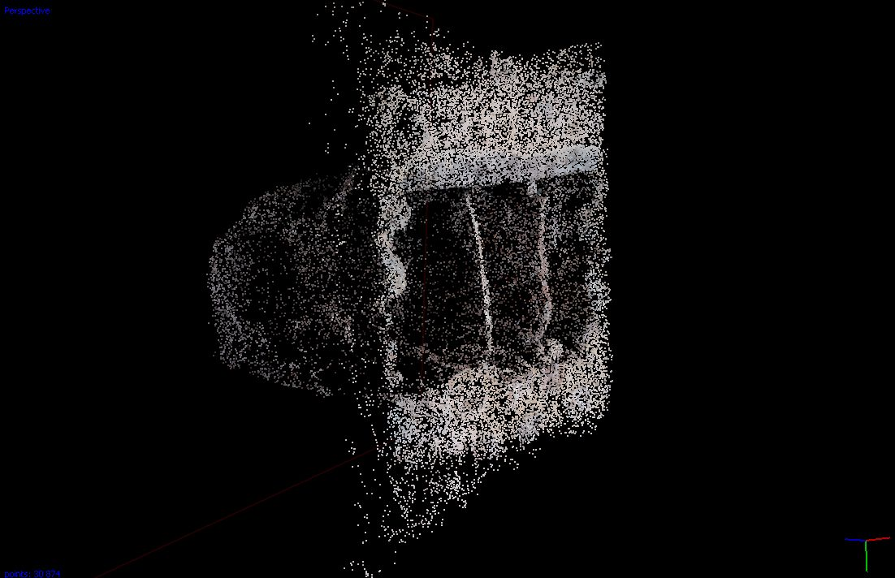
A. Uueni, 2013

Slide 14
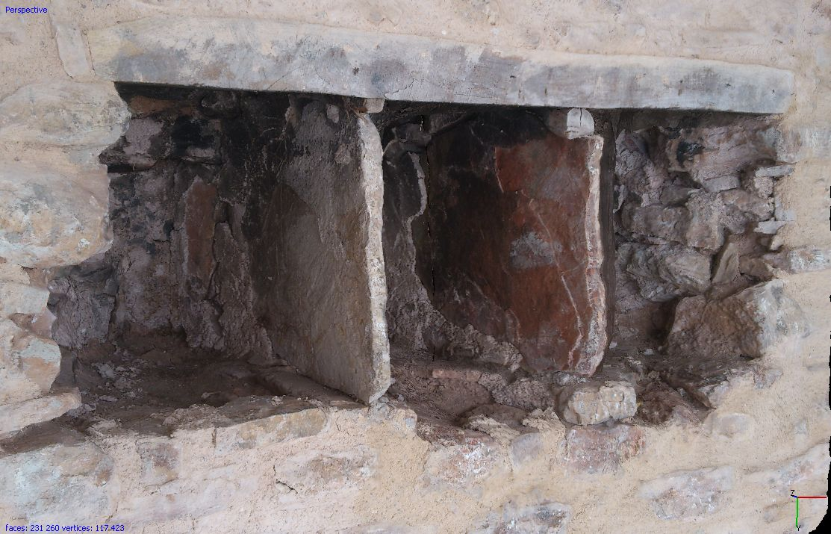
A. Uueni, 2013

Slide 15
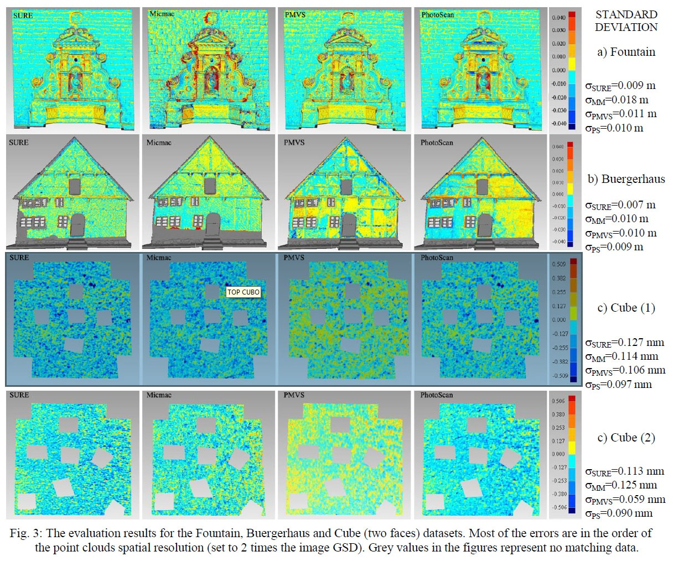
meetodid
Oodatud täpsus vs. vajalikud ressursid
Dense image matching: comparisons and analyses
Fabio Remondino, Maria Grazia Spera, Erica Nocerino, Fabio Menna, Francesco Nex
3D Optical Metrology (3DOM) unit
Dept. Mechanics
Politecnico of Milano
Notes:
15
Depending directly
15

Slide 16
kriteeriumid
  Hind
  Objekti materjal(id)
  Objekti mõõtmed
  Seadmete portatiivsus
  Süsteemi täpsus = less uncertainty
  Tekstuur
  Tehnika võimekus
  Vajalikud oskused
  Vastavus standarditele
Notes:
16
There are several criteria tables available for choosing an appropriate digitisation system
10 methods for objects, ca 4 methods for monuments (empirical, topographic, laser scanning, photogrammetric)
16

Slide 17
3D digiteerimine
3D andmete töötlemine
3D andmete säilitamine
3D andmete arhiveerimine ja haldus
Paljundamine
Visualiseerimine ja levitamine
Algoritm
Riistvara
Tarkvara
Notes:
17
17

Slide 18
lahendused
Keerukusaste (kuju, vorm, suurus, materjalid)
  Seotud meetodid
  Seotud uuringud (IR (temperatuur, niiskus), UV (kihid, üle-maalingud), X-ray)
Fotogramm-meetria
3D skanneerimine
Laser skanneerimine, struktuurvalgus, 2Dslice (CT)
Topograafilised uuringud
Tarkvaraline modelleerimine
Notes:
18

Slide 19
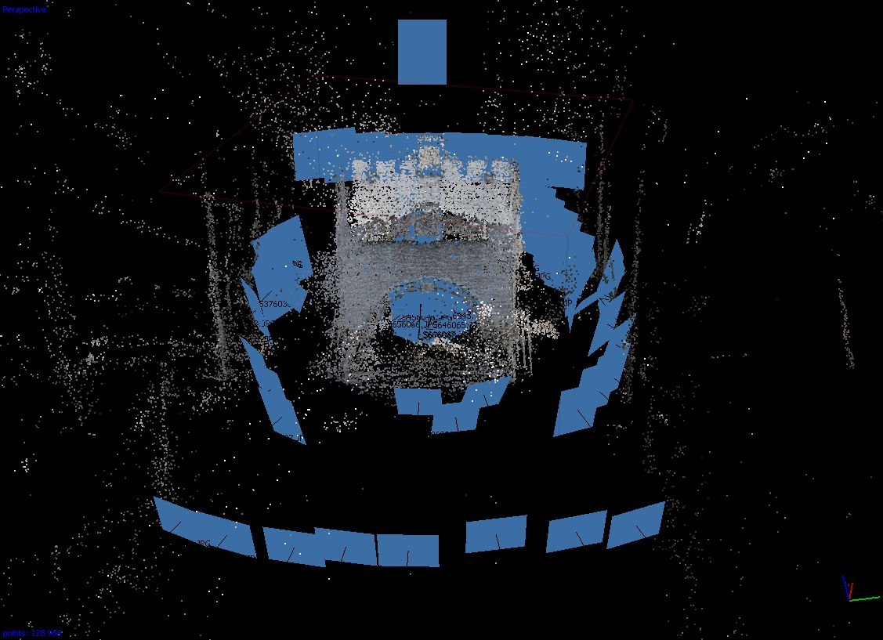
A. Uueni, 2013

Slide 20
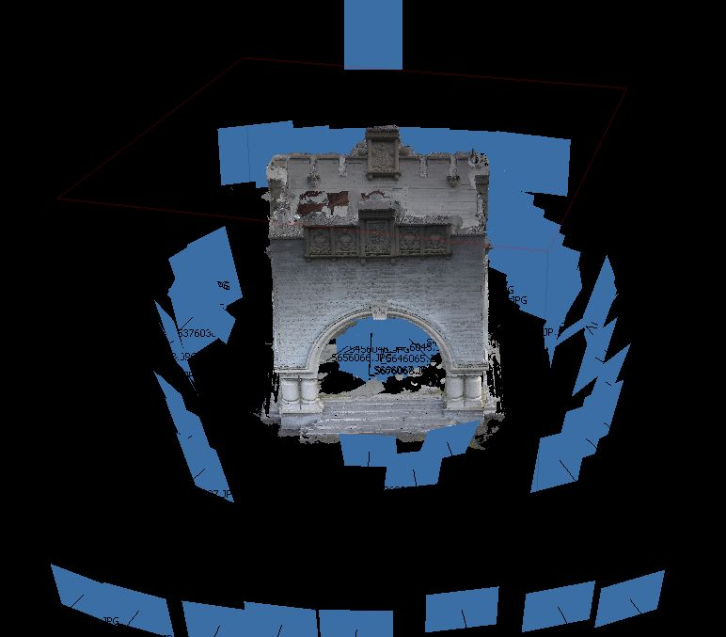
A. Uueni, 2013

Slide 21
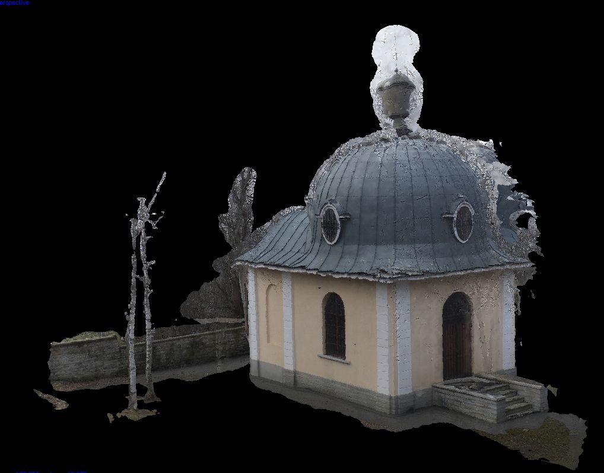
A. Uueni, 2013

Slide 22
3D dokumenteerimine
Objekt on reaalselt digiteeritud
  Objektil ei kasutata reepereid
  Operatiivsus
  (üli)täpne
  Erinevate väljundite loomise võimalus
Algmaterjali hilisem töötlus
Notes:
22

Slide 23
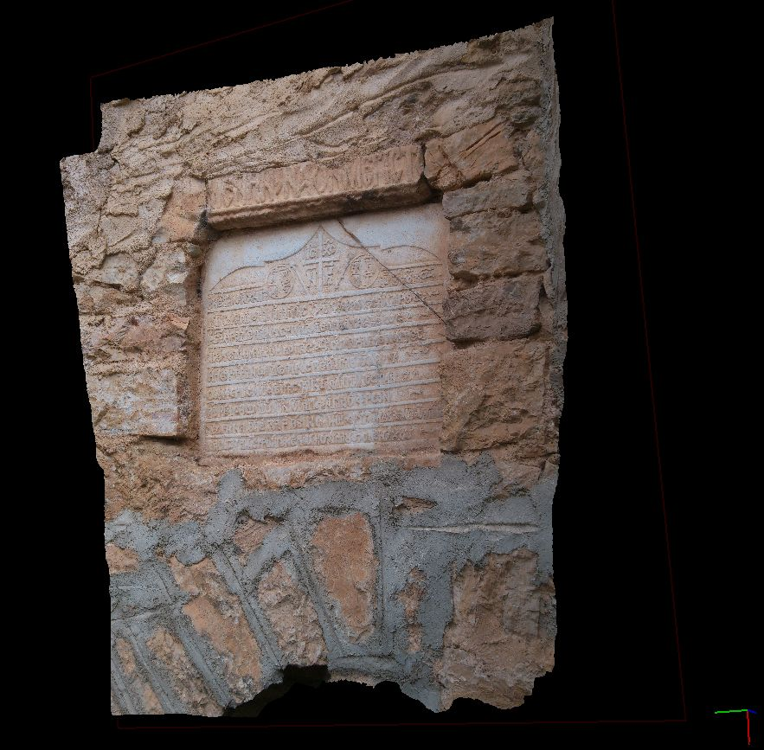
A. Uueni, 2013

Slide 24
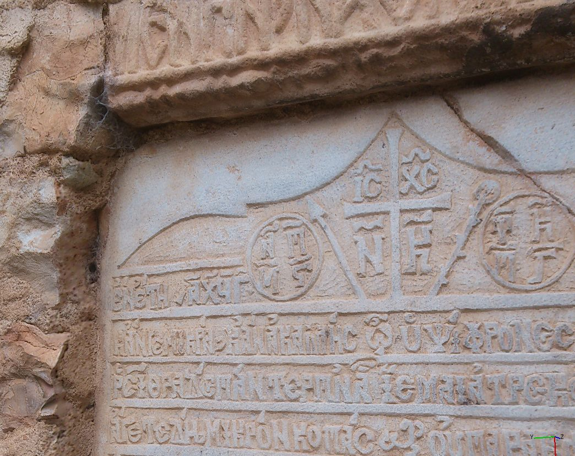
A. Uueni, 2013

Slide 25
kitsaskohad
Üksikobjekti digiteerimise hind
Riist- ja tarkvara hind
Väljundite sidumise keerukus
Pika-ajaline säilitamine
Andmete maht
Ressursid (aeg, oskusteave)
Notes:
25

Slide 26
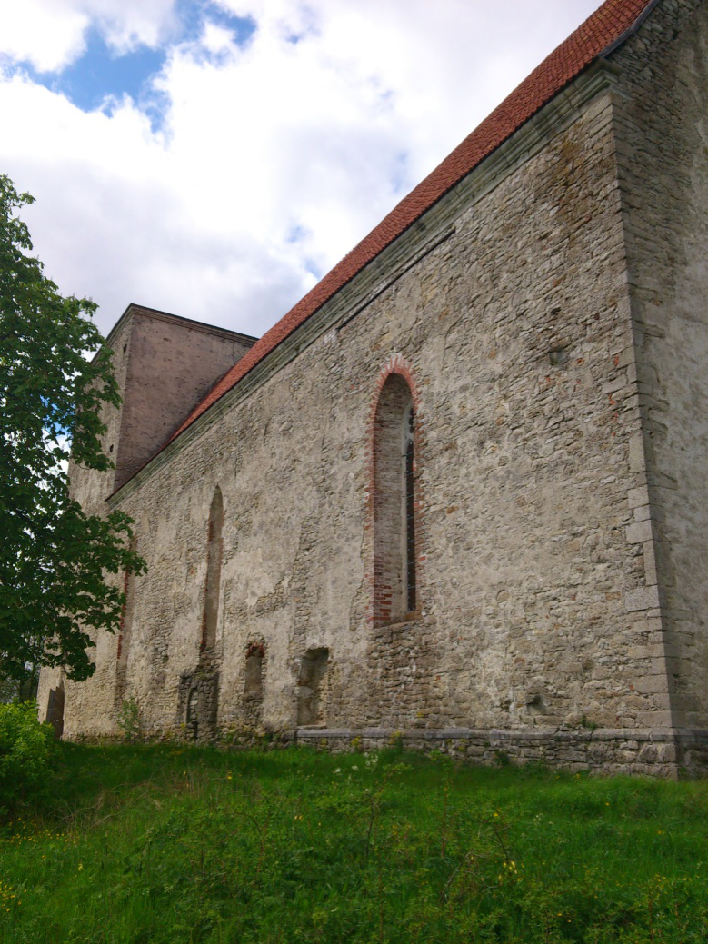
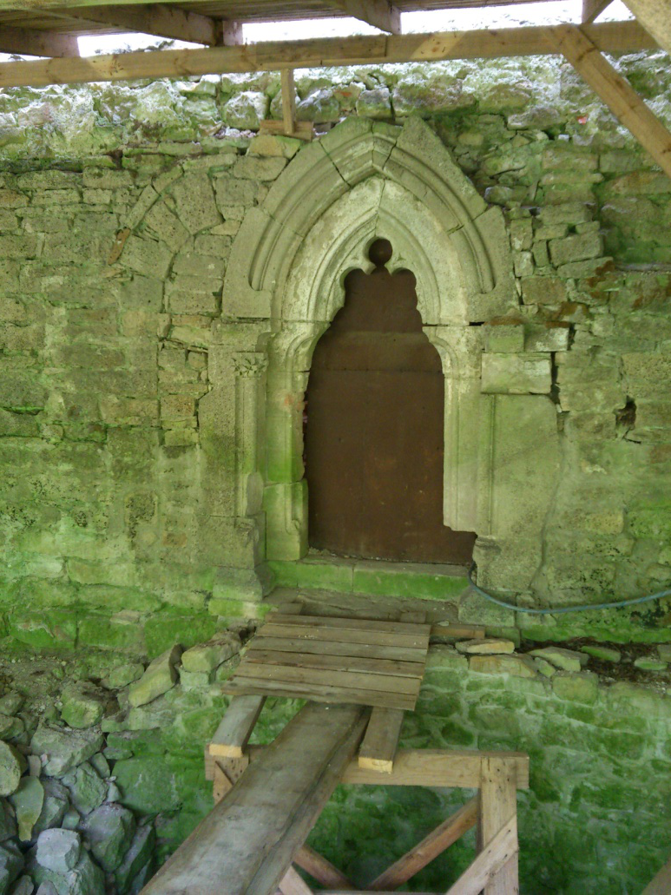
A. Uueni, 2013
A. Uueni, 2013

Slide 27
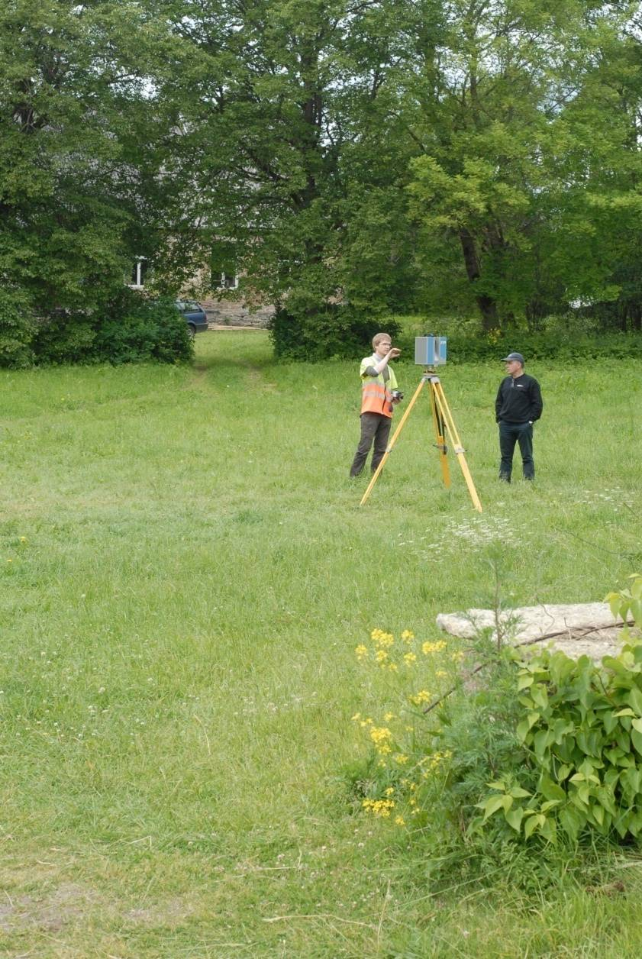
Pöide kirik
SMC PROJECT
smcproject.org.ee
Skannerimine: 19. juuni 2012
(13.30-22.30)
Skanneeringuid: 114 x 2
Punktipilve puhastamine: 1,5n
Formadid: dxf, obj, x3d, xyz
Punkte: 60M
Maht: 3Gb
A. Uueni, 2013
Notes:
27

Slide 28
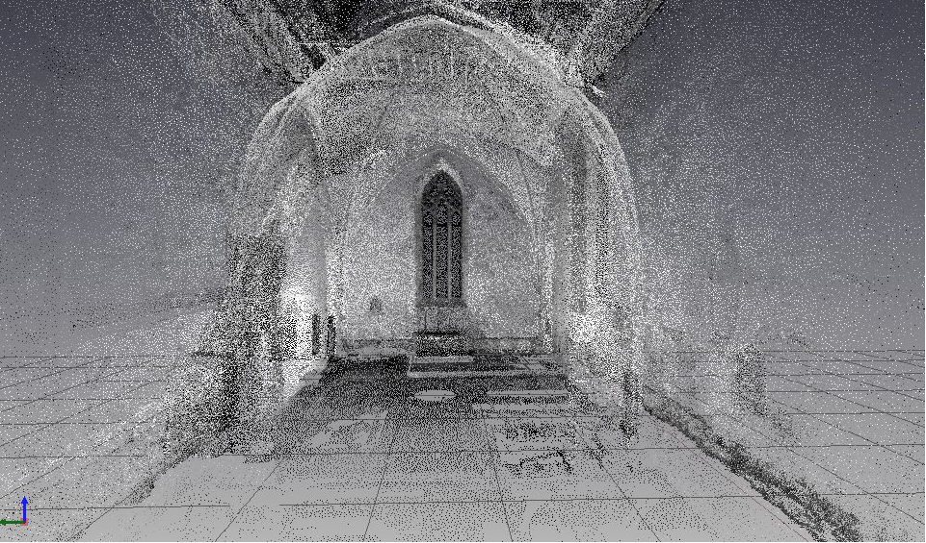
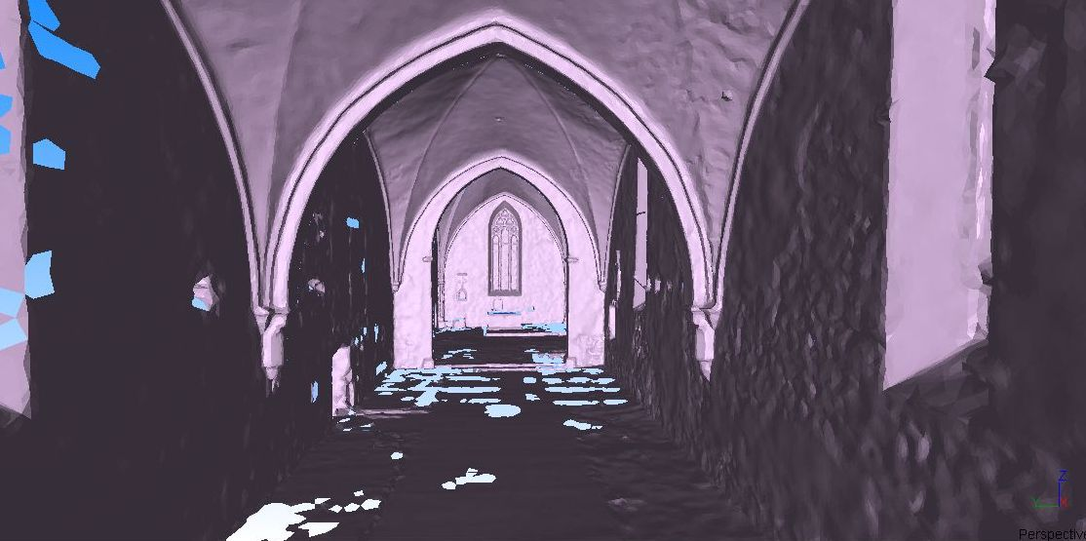

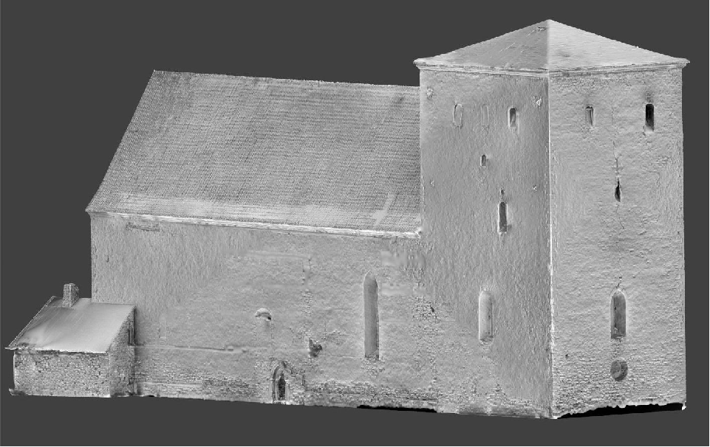
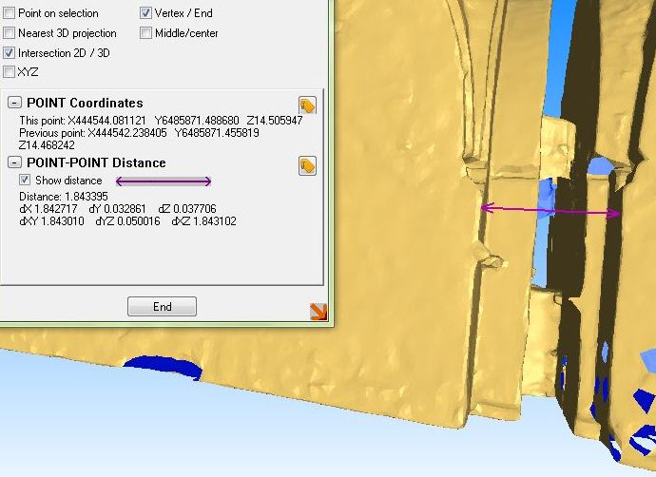
A. Uueni, 2013

Slide 29
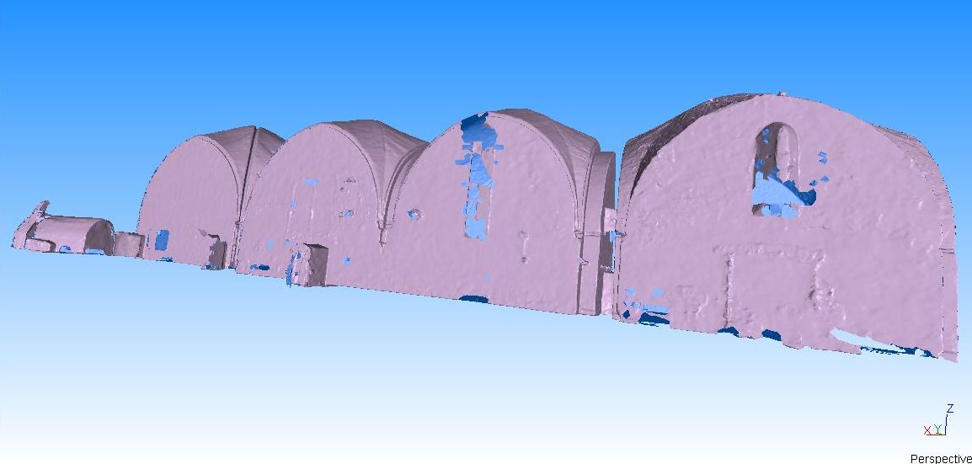
A. Uueni, 2013

Slide 30
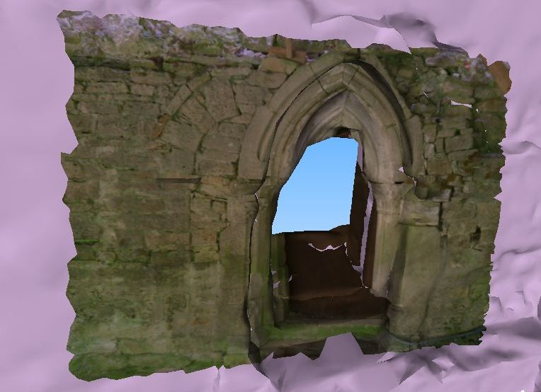

A. Uueni, 2013
Lihtsustatud punktipilv: 3,1M
Maht: 150Mb
A. Uueni, 2013
Notes:
30
20 x väiksem
30

Slide 31
 | CT Siemens Sensation 64 | NextEngine | FARO Scan Arm | MephistoEX-Pro | Agisoft Photoscan SE
Tektuur | Ei | Ja | Ei | Ja | Ja
määramatus / uncertainty(μm) | 460 | ≈100 | 35 | 50 | Sõltub kaamerast ja objektiivist
Hind € | 0-250 /h | 3500 | 60 000 | 30 000 | 169 + (Nikon 800E ja 50mm objektiiv – 3000.-)
Pöördalus | n.a. | Ja | Ei | Ja | Ei
Tehnoloogia | röngten | laser skanner | laser skanner | struktuurvalgus | fotogrammeetria
Salvestamine (min) | 1 | 85 | 20 | 20 | 30
Töötlus (min) | 5 | / | 20 | 65 | 240
Järeltöötlus (min) | 15 | 320 | / | 25 | /
Kokku (min) | 21 | 405 | 40 | 110 | 270
Sellest inimesel kulunud aeg (min) | 15 | 320 | 20 | 10 | 40

Slide 32
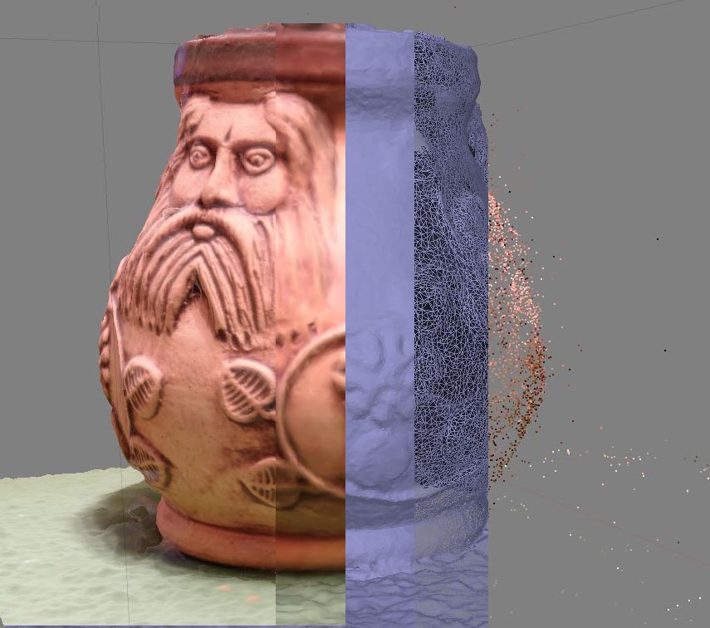
Shaded model
Solid mesh
Wireframe
Texture model
Point cloud
A. Uueni, 2013
Notes:
32
Archiving is required for all the raw scan files, pre mesh, polygonal mesh and decimated mesh files.
32

Slide 33
3D faili formaadid
  Tavakasutuses vähemalt 170 erinevat faili formaati
  Avatud formaadid (ply, stl, obj, xml põhised, 3ds, etc)
    Subformaadid (autodesk Collada)
  Faili formaatide registrid (PRONOM – DROID)
  Kõik on erinevad, sõltuvalt eesmärgist ja lahendustest
  Uuendamine ja/või konvertimine = informatsiooni kadu
    Funktsionaalsuse säilitamine
Notes:
33
3D file formats: open playground
about 170 different 3D file formats in commmon usage
several open formats exist (ply, stl, obj, collada (dae) xml based format, 3ds, etc)
subformats autodesk collada
all are different (depends about the format purpose - geometry stored as parametric surface, poincloud
Archiving is required for all the raw scan files, pre mesh, polygonal mesh and decimated mesh files.
File format registries (PRONOM - DROID is a software tool developed by The National Archives to perform automated batch identification of file formats.
Important remarks
updating and/or converting = information loss to identify important data properties and to ensure these are maintained/managed documented metadata
preserving its interactive functionality, emulation, the process of recreating on current hardware the technical environment required to view and use digital objects from earlier times
33

Slide 34
3D dokumenteerimise väljakutsed
  Sobilikus formaadis (long-lived file format)
  Piisav kirjeldus (olulised omadused)
  IPR - Digital rights management
  3D rekonstruktsioonide ebatäpsuste selge kirjeldus
  3D mudelite versiooni kontroll
  Sobilik metaandmete struktuur
  Pika-ajaline säilitamine
  Koostalitusvõime
  3D otsing
  Analüüsi vahendid
Notes:
34
preserving its interactive functionality, emulation, the process of recreating on current hardware the technical environment required to view and use digital objects from earlier times
Interoperability The creation of 3D cultural heritage archives also requires new solutions for interoperability of 3D models, both with other models in the archive, as well as with external sources. For example, effective
archives should support conversion of models to a common format, and provide access to georeferencing metadata that allows different models to be properly located relative to one another in the same coordinate system.
34

Slide 35
3D säilitamisel vajalikud metaandmed
  Allikate/failide nimekiri
  Plug-ins/shaders, mida on kasutatud
  Kihid, komponendid
  Tehnoloogiad, meetodid, lahendused
  Mudeli loomiseks kasutatud algmaterjal
  Versioon, kontroll
Notes:
35
Metadata for 3D models:
list of external files (required)
plug-ins/shaders in use
layers/components
materials
as well as
audience type of interaction (who and how)
methods and techniques used to create a model
datasets used to create a 3D model
35

Slide 36
3D säilitamisel vajalikud metaandmed
  Adminstrative
  What are the privacy issues?
  Who can access this object?
  Has the object been modified since its creation?
  How can the content of the object be trusted?
  Descriptive
  What does the 3D digital object represent?
  Are there any flaws in the 3D digital object?
  What are the properties of the 3D digital object?
  What are the features of the human body represented in the 3D digital object?
  Technical
  How was the (3-D) digital object acquired?
  How many scans (views) of each object are there?
  How were these scans integrated? With what software?
  What is the precision and accuracy of the data?
  What kind of calibration technique was used?
  What kind of modelling technique was used?
Notes:
36
Adminstrative
How can the content of the object be trusted? (is it digitally signed? Is there a checksum?)
Descriptive
Are there any flaws in the 3D digital object? (This could include how good/bad the calibration is, whether the object is precise and therefore reproducible and whether it is accurate i.e. whether it corresponds to reality.)
• What are the properties of the 3D digital object? (This might include format, owner of format, resolution, version, colour, orientation, compression, mesh representation, parametric representation, textures, scale, spatial
sampling, raw data etc.)
• What are the features of the human body represented in the 3D digital object? (For example what are the anthropometric
landmarks, is the image a full body scan or a partial view, what is the anthropometric posture and the associated anthropometric data?)
Technical
• How was the (3-D) digital object acquired? I.e. Through what technologies? (for example, laser scanner, photogrammetric
system?)
• What kind of modelling technique was used? (for example, views registration, hole filling, averaging, software used for registration and editing).
36

Slide 37
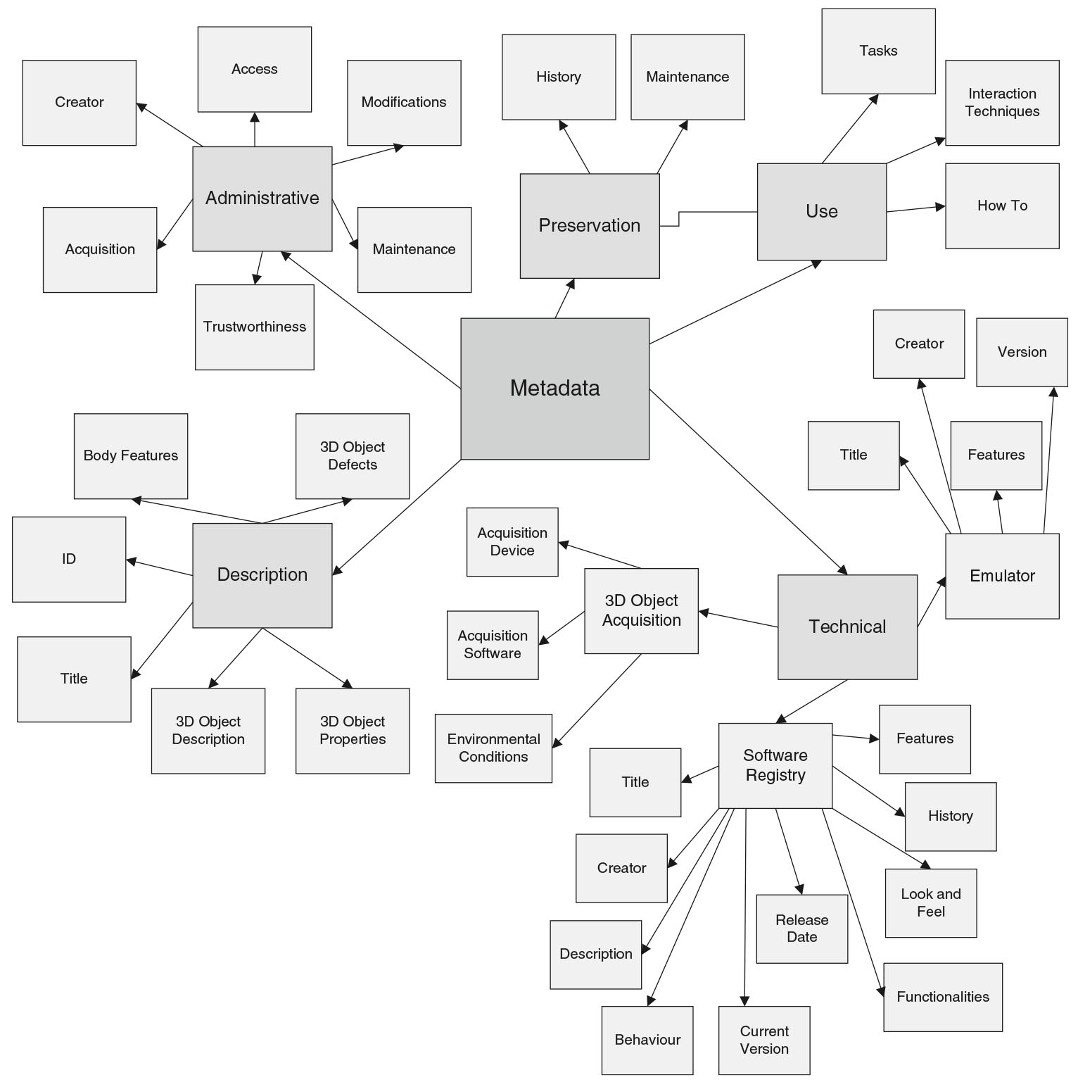
Metadata Structure
J. Doyle, H.Viktor, E. Paquet: Long-term digital preservation: preserving authenticity and usability of 3-D data
Notes:
37
preserving authenticity and usability of 3-D data
The inclusion of these metadata with 3D models are critical to achieve transparency to the user in a way analogous to notes, commentary, and bibliography in a traditional academic print publication.
37

Slide 38
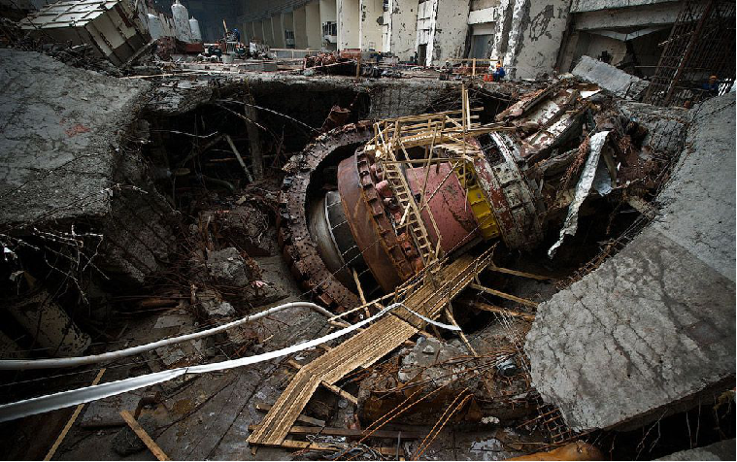
http://en.wikipedia.org/wiki/Sayano%E2%80%93Shushenskaya_Dam

Slide 39
Tänan!
andres.uueni@kanut.ee
Notes:
39
Depending directly
39

