Slide 1

RDM Programme @ Edinburgh
Stuart Macdonald
RDM Service Coordinator
University of Edinburgh
stuart.macdonald@ed.ac.uk

Slide 2
Background
  EDINA & Data Library
Defining research data
Research data management
  benefits, drivers, funders
RDM programme
  policy and implementation
RDM services and support
  RDM planning
  data stewardship
  awareness raising and training
JISC

Slide 3
BACKGROUND
EDINA and University Data Library (EDL) together are a division within Information Services (IS) of the University of Edinburgh.
EDINA is a Jisc-funded National Data Centre providing national online resources for education and research.
The Data Library assists Edinburgh University users in the discovery, access, use and management of research datasets.
Data Library Services: http://www.ed.ac.uk/is/data-library
EDINA: http://edina.ac.uk/
Notes:
25 years ago
disk storage - expensive
researchers interested in working with data came together to petition the PLU and the University’s Library – wanting a university-wide provision for files that were too large to be stored on individual computing accounts
Early holdings were research data from universities of edinburgh, glasgow, and strathclyde

Slide 4
EDINA – Jisc-designated centre for digital expertise & online service delivery
  Mission statement: “.. [to] develop and deliver online services and digital infrastructure for UK research and education ...”
  Networked access to a range of online resources for UK FE and HE
  Services free at the point of use for staff and students in learning, teaching and research through institutional subscription
  Focus on service but also undertake R&D (projects ➢ services)
    delivers about 20 online services
    5 - 8 major projects (incl. services in development)
    employs about 80 staff (Edinburgh & St Helens)
Notes:
Division with Information services along with Applications , IT Infrastructure, Library and Collections, User Services Division, DCC

Slide 5
DATA LIBRARY
finding…
accessing …
using …
troubleshooting …
managing …
Primarily supporting research in the social sciences but not
exclusively so
Building relationships with researchers via postgraduate
teaching activities, research support projects, IS Skills
workshops, Research Data Management training and through
traditional reference interviews.
Notes:
Primarily social sciences but not exclusively so, large scale government surveys (micro data), macro-economic time series data (country-level data), Elections studies, Geospatial data, financial datasets, population census data
Free on internet / subscription / through national data centres/archives / resource discovery portals
Registration / authorisaiton and authentication / special conditions / budget to pay for data
SPSS, STATS, SAS, R, ArcGIS – interpret documentaiton/codebooks, merge and match users data with other data (via look-up tables), subset data
Data Catalogue

Slide 6
DEFINING RESEARCH DATA
Research data are collected, observed or created, for the purposes of analysis to produce and validate original research results.
Research data can be generated for different purposes and through different processes in a multitude of digital formats
Both analogue and digital materials are ‘data’.
Digital data can be:
  created in a digital form ('born digital')
  converted to a digital form (digitised)

Slide 7
TYPES OF RESEARCH DATA
Instrument measurements
Experimental observations
Still images, video and audio
Text documents, spreadsheets, databases
Quantitative data (e.g. household survey data)
Survey results & interview transcripts
Simulation data, models & software
Slides, artefacts, specimens, samples
Sketches, diaries, lab notebooks …

Slide 8
RESEARCH DATA MANAGEMENT
Research data management is caring for, facilitating access to, preserving and adding value to research data throughout their lifecycle.
Data management is one of the essential areas of responsible conduct of research.
It provides a framework that supports researchers and their data throughout the course of their research and beyond.

Slide 9
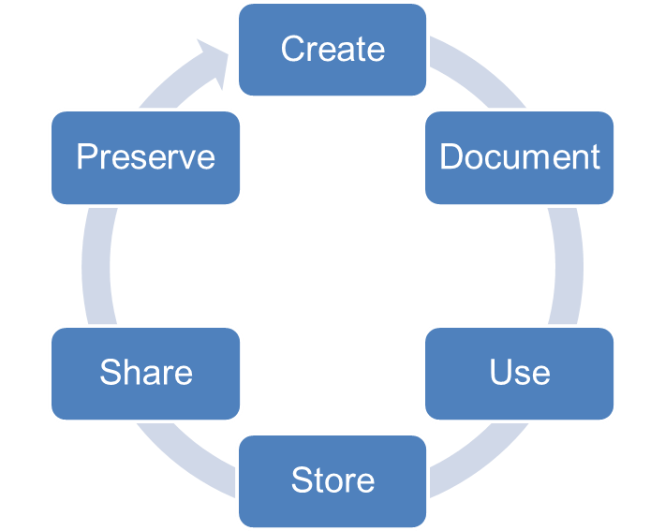
ACTIVITIES INVOLVED IN RDM
Data Management Planning
Creating data
Documenting data
Accessing / using data
Storage and backup
Sharing data
Preserving data

Slide 10
BENEFITS
Managing your data means that you will:
Meet funder / university / industry requirements.
Ensure data are accurate, complete, authentic and reliable – as per good research practice.
Ensure research integrity and replication.
Enhance data security & minimise the risk of loss.
Protect important IPR.
Increase efficiency - save time & resources.
Increase impact by sharing data (increase in citations 9 - 30% : Piwowar & Vision 2013)

Slide 11
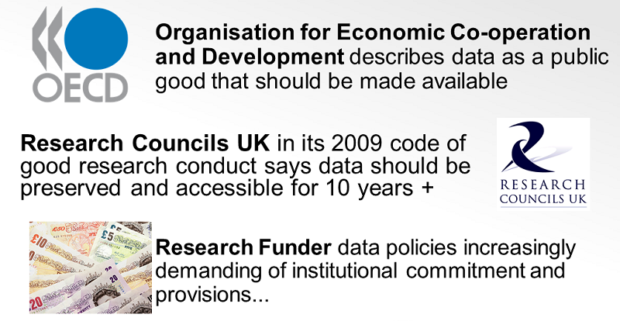
DRIVERS

Slide 12
FUNDER REQUIREMENTS
AHRC, BBSRC, ESRC, MRC, NERC, and STFC all require some form of data management or sharing plan as part of a funding application.
The requirements are diverse, but they all have the RCUK Common Principles as their foundation.
Cancer Research UK and the Wellcome Trust are not part of RCUK but both require data sharing plans.
http://www.dcc.ac.uk/resources/data-management-plans/funders-requirements

Slide 13
COMMON THEMES ACROSS FUNDING BODIES
What data will be created? (format, types, volumes etc)
What standards and methodologies will you use?
How will ethics and Intellectual Property be managed? (highlight any restrictions on data sharing e.g. embargoes, confidentiality)
What are the plans for data sharing and access?
What is the strategy for long-term preservation?

Slide 14
RDM PROGRAMME @ EDINBURGH
- an institutional approach
Edinburgh Data Audit Framework (DAF) Implementation Project
(May – Dec 2008)
A JISC-funded pilot project produced 6 case studies from
research units across the University in identifying research data
assets and assessing their management, using DAF methodology
developed by the Digital Curation Centre.
2 main outcomes:
Develop university research data management policy
Develop services & support for RDM (in partnership IS)
DAF Implementation Project: http://ie-repository.jisc.ac.uk/283/
Notes:
Training for postgraduates and early career researchers
These were the School of Divinity, School of History, Classics and Archaeology), School of Biomedical Sciences), (School of Molecular and Clinical Medicine), (School of Physics and Astronomy). Also, the School of Geosciences

Slide 15
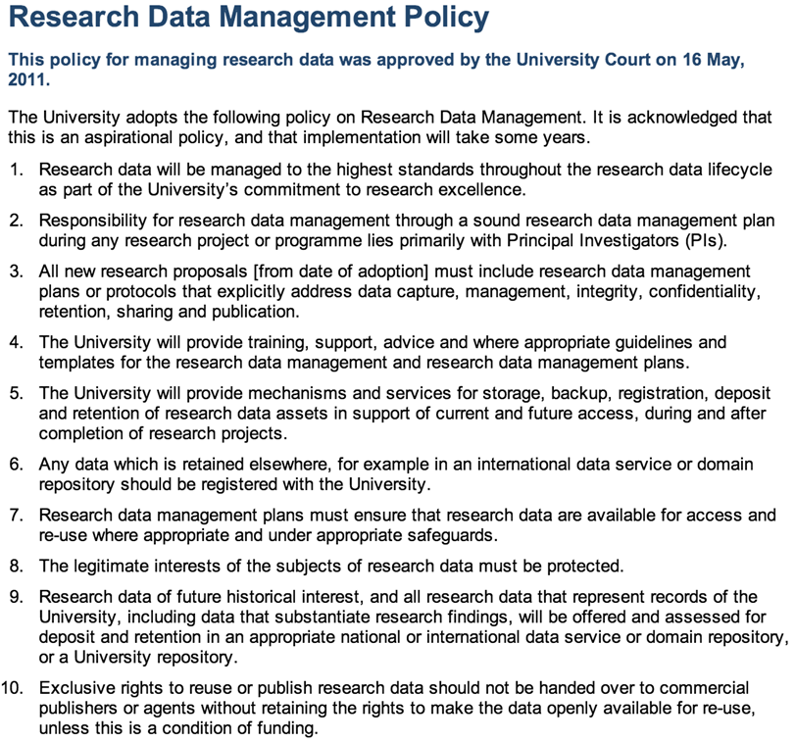
UNIVERSITY OF EDINBURGH RDM POLICY
University of Edinburgh is one of the first Universities in UK to adopt a policy for managing research data: http://www.ed.ac.uk/is/research-data-policy
The policy was approved by the University Court on 16 May 2011.
It’s acknowledged that this is an aspirational policy and that implementation will take some years.

Slide 16
POLICY IMPLEMENTATION
RDM Programme in 3 phases:
  Phase 0: August 2012 – August 2013: Planning phase, with some pilot activity and early deliverables.
  Phase 1: September 2013 – May 2014: Initial rollout of primary services.
  Phase 2: June 2014 – May 2015: Continued rollout; maturation of services.
Full details of the programme is available at:
      http://edin.ac/1eE3sav

Slide 17
COMMITTEES
An RDM Policy Implementation Committee was set up by the
Vice Principal Knowledge Management charged with delivering services
that will meet RDM policy objectives:
Membership from across IS
Iterate with researchers to ensure services meet the needs of researchers
The Vice Principal also established a Steering Committee led by
Prof. Peter Clarke with members of Research Committee from the 3
colleges, IS, DCC and Edinburgh Research and Innovation (ERI).
Their role is to:
Provide oversight to the activity of the Implementation Committee
Ensure services meet researcher requirements without harming research competitiveness
Notes:
Funders have policies, responsibilities fall to the
university as well as the researcher
Researchers are mobile
Institution and researcher must work together,
define the responsibilities
Awareness raising within university of practicalties

Slide 18
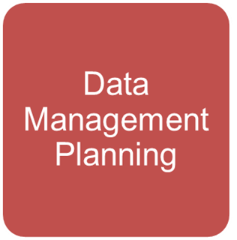
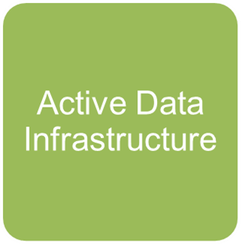
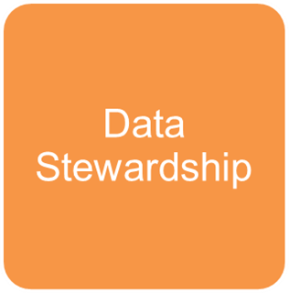
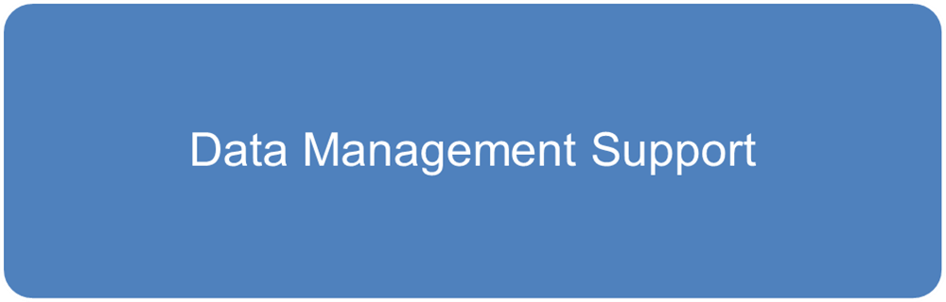
RDM SERVICES AND SUPPORT
Services already in place:
  Data management planning
  Active working file space = DataStore
  Data publication repository = DataShare
Services in development:
  Long term data archive = DataVault
  Data Asset Register (DAR)
RDM support: Awareness raising, training & consultancy
RDM Roadmap
      http://edin.ac/1u3sKqy

Slide 19
RESEARCH DATA MANAGEMENT PLANNING
Support and services for planning activities that are performed at the conceptual stage before research data are collected or created
  Tailored DMP assistance for researchers submitting research proposals
  Customised instance of DMPonline toolkit for University of Edinburgh use

Slide 20
WHAT IS A DATA MANAGEMENT PLAN (DMP)?
DMPs are written at the start of a project to define:
What data will be collected or created?
How the data will be documented and described?
Where the data will be stored?
Who will be responsible for data security and backup?
Which data will be shared and/or preserved?
How the data will be shared and with whom?

Slide 21
DMP SUPPORT
Academic Support Librarians have received RDM training, including training on writing Data Management Plans.
Research Administrators staff have received training to provide support at the grant application stage across the 3 Colleges.
ERI staff will be receiving RDM training.
Tailored DMP courses for research staff and PGRs are being delivered.
MANTRA also has a module on DMP for self-paced learning.
General DMP queries can be sent to the IS Helpline who will direct them as appropriate.

Slide 22
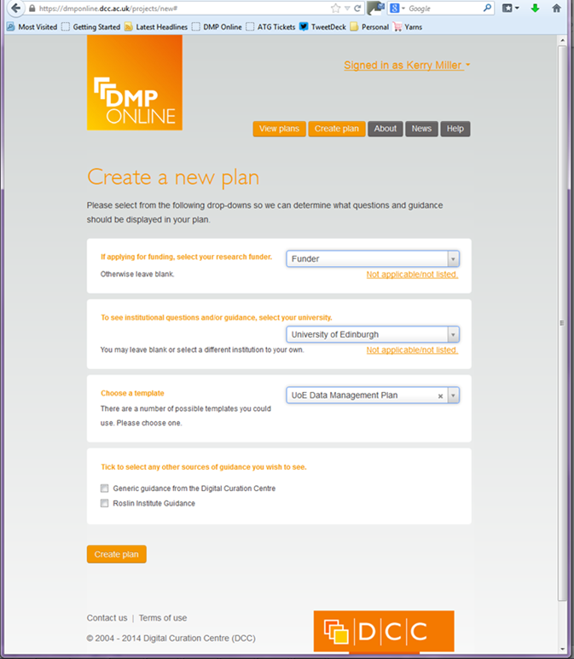
DMPONLINE TOOLKIT
Free and open web-based tool to help researchers write plans: https://dmponline.dcc.ac.uk/
It features:
  Templates based on different requirements
  Tailored guidance (disciplinary, funder etc.)
  Customised exports to a variety of formats
  Ability to share DMPs with others

Slide 23
TEMPLATES AND GUIDANCE
Edinburgh University Templates and Guidance are still in draft.
Edinburgh University Guidance is provided for those applying to: AHRC, BBSRC, CRUK, ESRC, MRC, NSF, NERC, STFC, & Wellcome Trust.
Edinburgh University Templates are available for Researchers and PGRs not applying to any of the above.
Customised Guidance is given for those working at the Roslin Institute.

Slide 24
DATASTORE
Facility to store data that are actively used in current research activities
Provision: 1.6PB storage initially
0.5 TB (500GB) per researchers, PGR upwards
Up to 0.25TB of each allocation can be used to create “shared” group storage
Cost of extra storage: £200 per TB per year= 1TB primary storage, 10 days online file history, 60 days backup, DR copy
Infrastructure in place. Allocation of space devolved to IT departments of respective Schools overseen by Heads of IT from each College.

Slide 25
DATA SYNC
to allow sharing of research data via web interface onto DataStore data,
provide drop-box style functionality
uses open source ‘ownCloud’ technology
In order for desktop machines to synchronize files with the ownCloud server:
  desktop clients are available for PCs running Windows, OS X, or Linux
  Mobile clients also exist for iOS and Android devices.
Files can also be accessed using a web browser without any additional software. Any updates to files are pushed between all devices connected to a user's account.

Slide 26
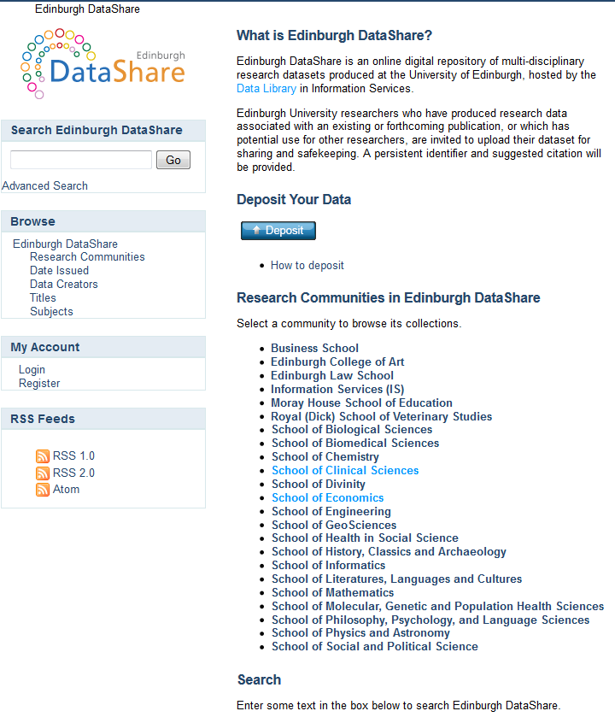
DATASHARE
Edinburgh DataShare is the University data repository for publishing your research data openly: http://datashare.is.ed.ac.uk
It will help you disseminate your research, get credit for your data collection efforts, and preserve your data for the long-term.
It backs up the University Research Data Management policy.
It can help you comply with funder requirements to preserve and share your data.

Slide 27
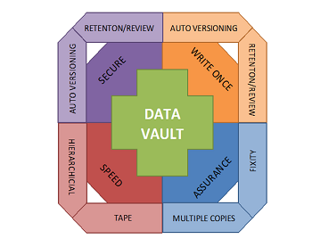
DATA VAULT
Safe, private, store of data that is only accessible by the data creator or their representative
Secure storage:
  File security
  Storage security
  Additional security: encryption
Long term assurance
Automatic versioning
http://datablog.is.ed.ac.uk/2013/12/20/thinking-about-a-data-vault

Slide 28
DATA ASSET REGISTER (DAR)
a catalogue of data assets produced by researchers working for the University of Edinburgh,
will be a key component of the University of Edinburgh Research Data Management (RDM) systems
will give researchers a single place to record the existence of data assets they have produced so that they can be discovered, accessed, and reused as appropriate.
Paper proposing the adoption of PURE as the University’s DAR submitted the RDM Steering Committee for approval (Oct. 2014)
http://datablog.is.ed.ac.uk/2013/12/12/thinking-about-research-data-asset-registers

Slide 29
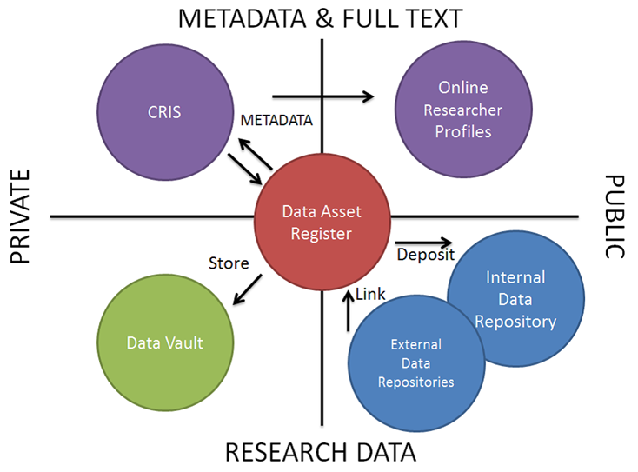
INTEROPERATION
Systems do not live in isolation, and become more powerful and more likely to be used if they are integrated with each other.
However, the last thing that we want is to introduce further systems that need to be fed with duplicate information.
This means interoperation for some or all of the components

Slide 30
RDM SUPPORT
Making the most of local support!
RDM team will work with the Research Administrators in each School.
Academic Support Librarians (who represent each of the 22 Schools).
IT staff in each School.
ERI staff. They will be receiving RDM training.
Each School’s Ethics Committee
Bespoke RDM email address or queries can be sent to the Helpline who will direct them as appropriate.

Slide 31
COMMUNICATIONS PLANS
    There are a number of different groups within the university and outside with whom we need to communicate our RDM programme.
    This will be done through a variety of communication activities.
Target Audiences
University of Edinburgh staff need to understand the principles of RDM and how it is practiced and supported within the University:
  Research active staff
  IS and School/college support staff
  Other university committees and groups (research policy group, library committee, IT committee, knowledge strategy committee)
External collaborators and stakeholders such as funding bodies, Russell Group, national and international RDM community e.g. RDA, DANS, ANDS, COAR, DPC, DCC

Slide 32
KEY MESSAGES:
Co-ordinated, Consistent, Coherent
There are three key messages which will need to be tailored and made timely and relevant to our target audiences.
The core of each message must be maintained to ensure that everyone gains the same level of understanding.
The University is committed to and has invested in RDM
  services, training, support
What is meant by Research Data Management?
  definitions, data lifecycle, responsibilities
The University is supporting researchers
  encourage good research practice, effect culture change
Notes:
There are a wide variety of different communication activities that will be required to ensure that all audiences receive the right message, at the right time, and in an appropriate way

Slide 33
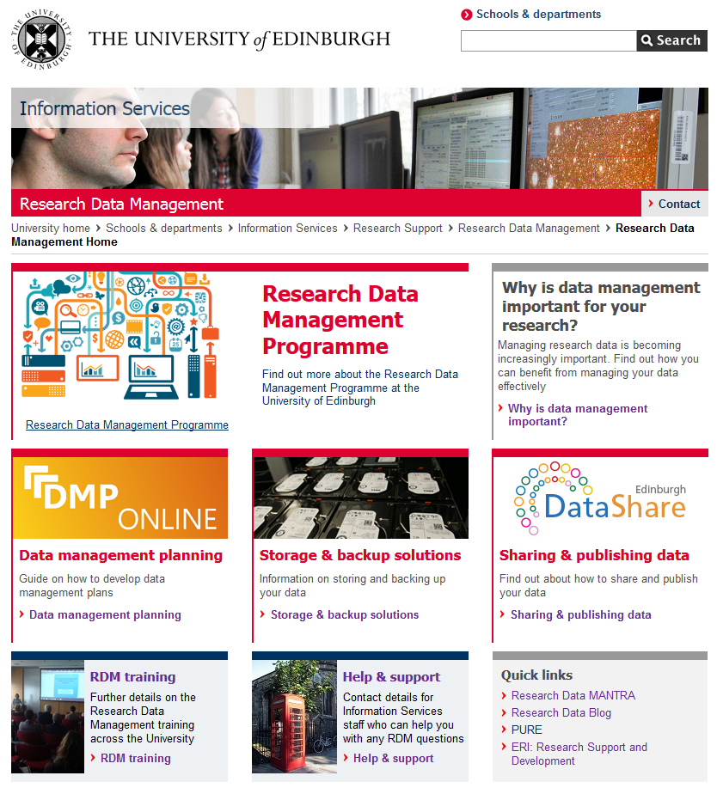
AWARENESS RAISING
Introductory sessions on RDM services and support for research active and research admin staff in Schools / Institutes / Research Centres
Contact Cuna Ekmekcioglu at cuna.ekmekcioglu@ed.ac.uk for a session for your School/Research Centre
RDM website: http://www.ed.ac.uk/is/data-management
RDM blog: http://datablog.is.ed.ac.uk
RDM wiki:
https://www.wiki.ed.ac.uk/display/RDM/Research+Data+Management+Wiki
http://www.ed.ac.uk/is/data-management

Slide 34
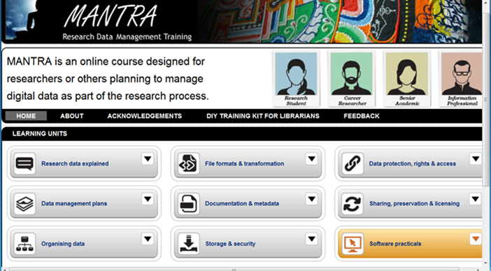
TRAINING: MANTRA
MANTRA is an internationally recognized self-paced online training course developed here for PGR’s and early career researchers in data management issues.
Anyone doing a research project will benefit from at least some part of the training – discrete units
Data handling exercises with open datasets in 4 analytical packages: R, SPSS, NVivo, ArcGIS
http://datalib.edina.ac.uk/mantra

Slide 35
TRAINING: TAILORED COURSES
A range of training programmes on research data management (RDM) in the form of workshops, power sessions, seminars and drop in sessions to help researchers with research data management issues
http://www.ed.ac.uk/schools-departments/information-services/research-support/data-management/rdm-training
Creating a data management plan for your grant application
Research Data Management Programme at the University of Edinburgh
Good practice in Research Data Management
Handling data using SPSS
Handling data with ArcGIS
  http://edin.ac/1kRMPv3

Slide 36
PROGRESS SO FAR
Data Share – Live Now
DMPonline – Live Now
Website – Live Now
Data Management Planning Support – Aug 2014
Data Store – Roll-out completed by Dec 2014
Training – Ongoing
Awareness Raising - Ongoing
Data Asset Register – Dec 2014
Data Vault – Spring 2015

Slide 37
THANK YOU!
Acknowledgements:
Dr. Cuna Ekmekcioglu (Research & Learning Services)
Sarah Jones (Digital Curation Centre)
Stuart Lewis (Research & Learning Services)
Kerry Miller (Research & Learning Services)
Robin Rice (EDINA & Data Library)
Dr. Orlando Richards (IT Infrastructure)
Dr. John Scally (Library and Collections)
Tony Weir (IT Infrastructure)

