Slide 1


Healthy training for brain
The Beginning of Excellent Research
by Ilva Paidere
Head librarian, UL Library
Notes:
Good morning everyone! I would like to introduce our litlle project which we have started last autumn – healthy training for brain. This is one of the ways how we train academic staff and students.

Slide 2
THE BEGINNING
Notes:
In the begining i would like to accent, why the training system is important not just for librarians, but for academic staff too. University of Latvia strategic plan 2012-2020 states that "The library contributes information literacy development by providing consultations and lectures. Participation in study and further education programs should be specified, as well as preparing and implementing an e - course of e-resource search and information production ." This knowledge can be considered as one of the high quality teaching foundation.

Slide 3
HOW
WE
DO
IT
Notes:
So how do we manage it?

Slide 4
3 LEVELS
SEVERAL WAYS
Notes:
We organize training for both vertical and horizontal levels by involving database representatives, librarians and library users.

Slide 5
REPRESENTATIVE OF DATABASE
LIBRARIAN
LIBRARIAN
USER
Notes:
Databases representatives train library staff, who train library users. Also, the library staff - e-resources specialist trains library staff who further works with users. After those trainings we test our librarians in a training school. (Several topics, they pull a topic and 30min presents the topic for imagined target group – then jury assesses the presentation).
For the academic staff and other interests we offer trainings from database representatives directly. With this kind of system we try to manage that every librarian is able to serve our library users.

Slide 6
STUDENT TRAINING DuRING LECTURES
UPGRADED E-COURSE
«INTRODUCTION TO INFORMATION LITERACY»
UL STAFF TRAINING
Notes:
All these outcomes are managed in several ways. Our librarians in faculties trains university students during the lectures.
We have upgraded and going to legalize our e-course, which is now called Introduction to information literacy
There are different kinds of training for academic staff and PhD students – webinars, seminars and workshops. And then there is our new project called....

Slide 7
HEALTHY TRAINING FOR BRAIN
THE PROJECT
Notes:
....Healthy training for brain. It is a free visit training offer for students and academic staff. The main topics are e-resources and different kind of e-tools, for example, mendeley, google, linked in, etc. Classes are led by University Library staff, and as far as possible the database representatives. The acquisition of practical skills for better on-site classes, computers are used. Promotion activities for this topic we do by using university web portal, university information system, several web sites and social networks of faculties, e-mails and flayers – it depends on target group.

Slide 8
TWICE A WEEK X TWICE A MONTH - LATVIAN
TWICE A WEEK X ONCE A MONTH - ENGLISH
Notes:
Theses trainings have been offered from last autumn 2 times a week, twice a month in Latvian and 2 times a week once a month in English. Now there have been more than hundred trainings, there are some problems with attendance – it is observed that students use this possibility only when they feel a need for it. Usually it is when they have to write their theses. Then they come to those trainings and it is a new world for them.

Slide 9
SUGGESTIONS FROM sTUDENTS AND STAFF
Notes:
At the end of the training visitors are asked to fill the survey about the quality of training. Most of them admit that these trainings are useful. Some of them, most PhD students, stress that this kind of trainings have to be realized at the beginning of studies – during 1st year in bachelor. There have been some opinion that face to face trainings are more productive, and it is better to work in small groups or individually. It is observed that not only PhD students are interest in e-resources but bachelors and masters too. There have been suggestions from students to create and offer more difficult tests and tasks and to collaborate with experts from different fields.

Slide 10

STORIES OF SUCCESS
Notes:
During Library week 2015 we offered special training sessions for university staff and let them choose timing. Most of the trainings were held in evenings. The topics were web of science and Scopus, as well as trainings about publication deposit on university information system. There were more than 10 to twenty interests for each training. Now we have experienced that university stuff have real interest in scientific publishing. The promotion of these trainings is done by writing short invitations using emails of university staff. These kind of trainings are popular, when representatives of databases manage them.

Slide 11

CERTIFICATES?
Notes:
Maybe one of the main catch is the possibility to get the certificate, or the trust in representatives of databases?:)

Slide 12
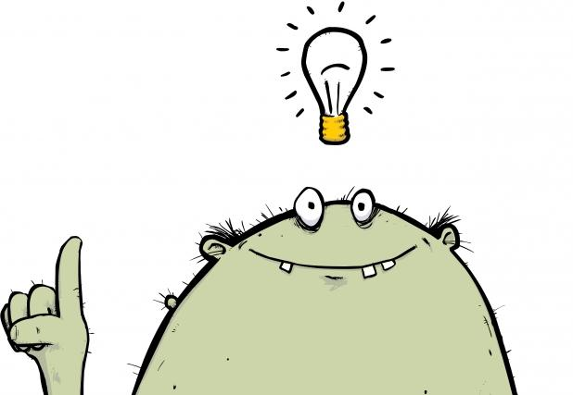
CONCLUSIONS
Do MORE TOPICS ABOUT PUBLISHING
Make them to feel special
Convince the user
Learn to teach
Notes:
Librarians need to be more convincing!
Individual approach during organization of target group is needed
There need to be realized more effective training for librarians – both pedagogically and subject aspect

Slide 13
THANK YOU!
ILVA.PAIDERE@LU.LV

