Slide 1
The European Commission’s solution to scholarly publishing

Slide 2
Ambitions of the European Commission
To lead by example in operationalising open science principles within scientific publishing & exploring sustainable open access publishing business models
Open peer review
Immediate publication
New generation article metrics
Transparency & cost-effectiveness
Notes:
So as Michael already mentioned, the EC wanted to lead the way in promoting open science and had a number of requirements the platform had to adhere to:
Open Peer Review
Immediate publication with open data deposited in trusted repositories
Article level metrics
Full transparency over policies and fees

Slide 3
ORE in the wider scholarly publishing landscape
Open Research Europe was identified as an example of successful implementation of Plan S in the 2022 Annual Report
June 2022 Council of the EU conclusions “recognises all forms of research and innovation output and processes” and “stresses that data should be FAIR”
May 2023 Council of the EU conclusions “encourage Member States to support the pilot programme Open Research Europe (to create a large-scale open access research publishing service)” as well as promoting open peer review practises
CoARA supports placing value on the diversity of outputs that researchers produce and other activities and practices they undertake

Slide 4
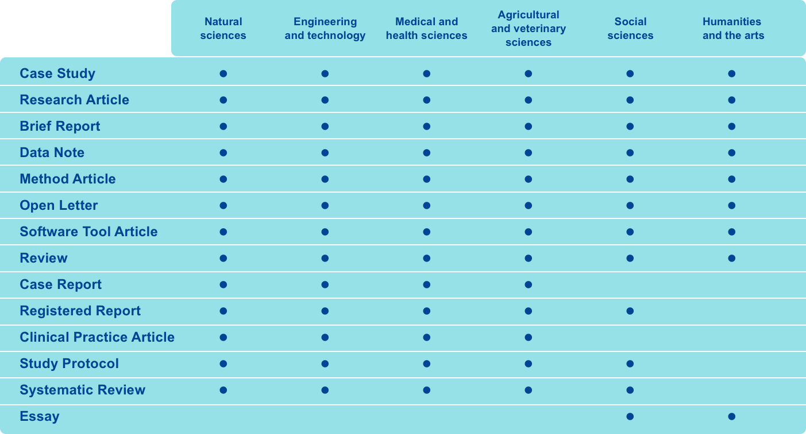
Supporting research across all disciplines

Slide 5
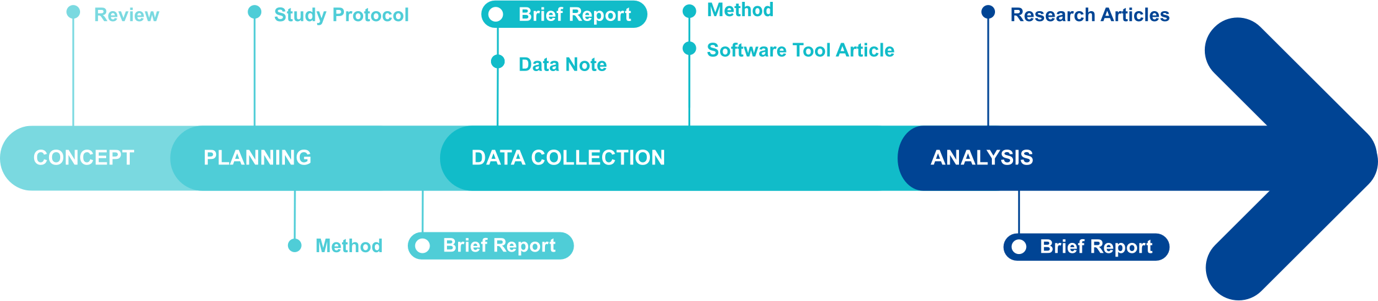
Supporting research across lifespan of the project

Slide 6
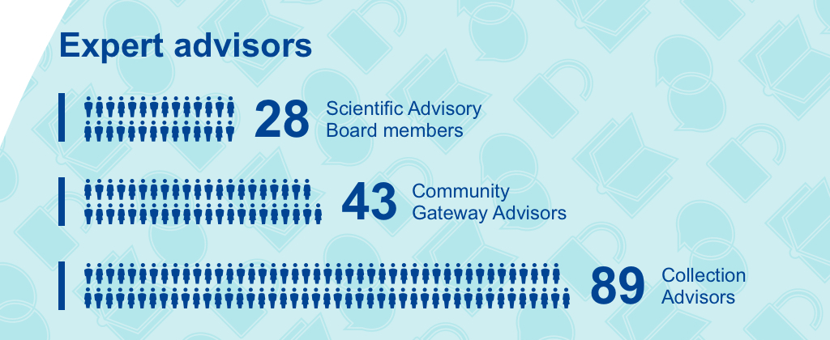
Academic Community Involvement

Slide 7

Academic Community Involvement
Notes:
70% growth from last year

Slide 8










Indexation
Various national approved journal lists

Slide 9
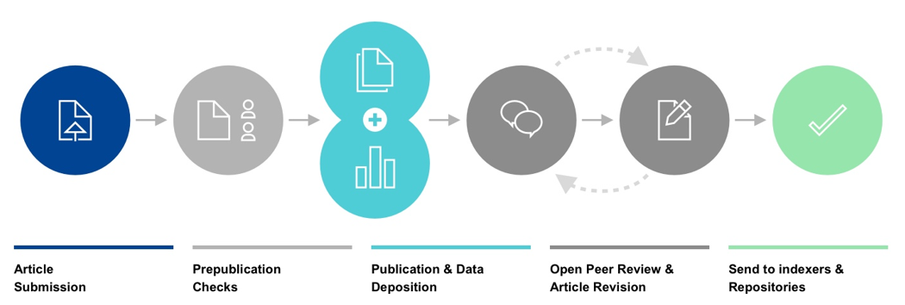
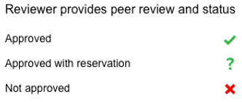
Open Research Europe Publishing Model
Notes:
Submit research via a single-page submission system one of the different article types we offer.
Our in-house team of profession editors carries out comprehensive prepublication checks to ensure that all policies and ethical guidelines are adhered to.
Once the article has passed the prepublication checks, a fully typeset version is published with a DOI, enabling immediate viewing and citation, as well as indexing in Google Scholar. Once the article is published, it cannot be sent to another journal for publication.
Expert reviewers are invited for peer review. Once peer review is complete, reviewer comments and names are published alongside the article, together with the authors’ responses and comments from registered users. Authors are encouraged to publish revised versions of their article. All versions of an article are linked and independently citable.
Articles that pass peer review are sent to major indexing databases such as PubMed, Scopus and Dimensions.

Slide 10
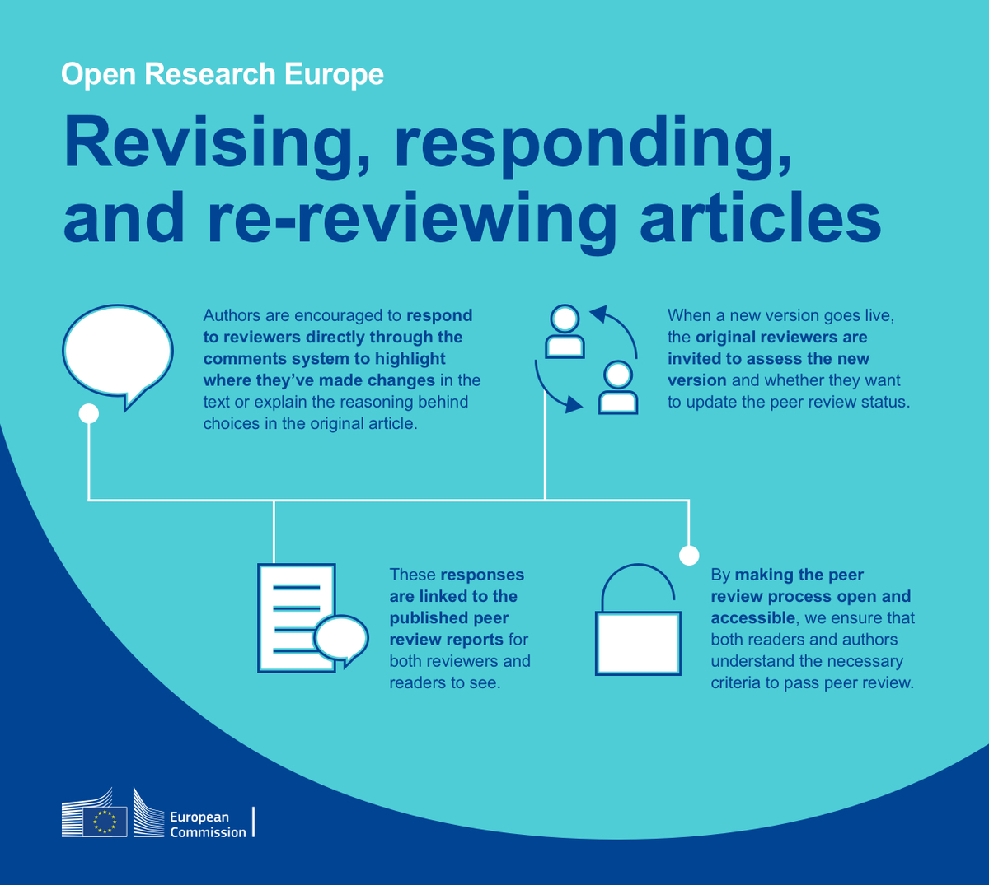

Slide 11
Review publication
When a review is received the editorial team:
  Ensure all aspects of an article is reviewed and the peer review questions have been answered fully
  Check the reports for tone and language and the correct status has been applied
  Publish the report online – email to authors
If the reviewers decline to review, the editorial team:
  Update the system with declinations and reasons
  Reach out to the author for more suggestions (which get verified again
  Provide support for selections if needed
When a review is published:
  Reviewer identity made publicly available
  Reviewer report made publicly available
  Must add any competing interests
  Asked to declare their reviewer expertise

Slide 12
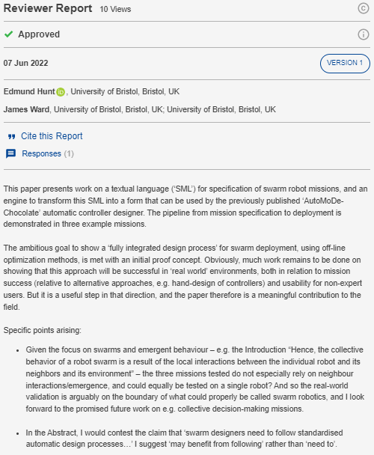
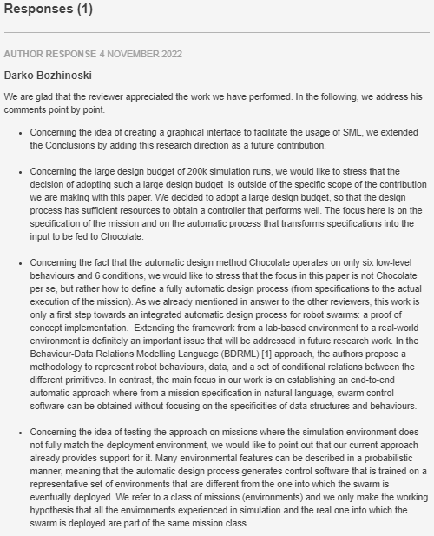
An example

Slide 13
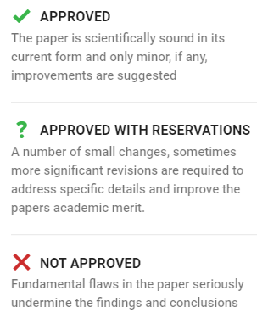
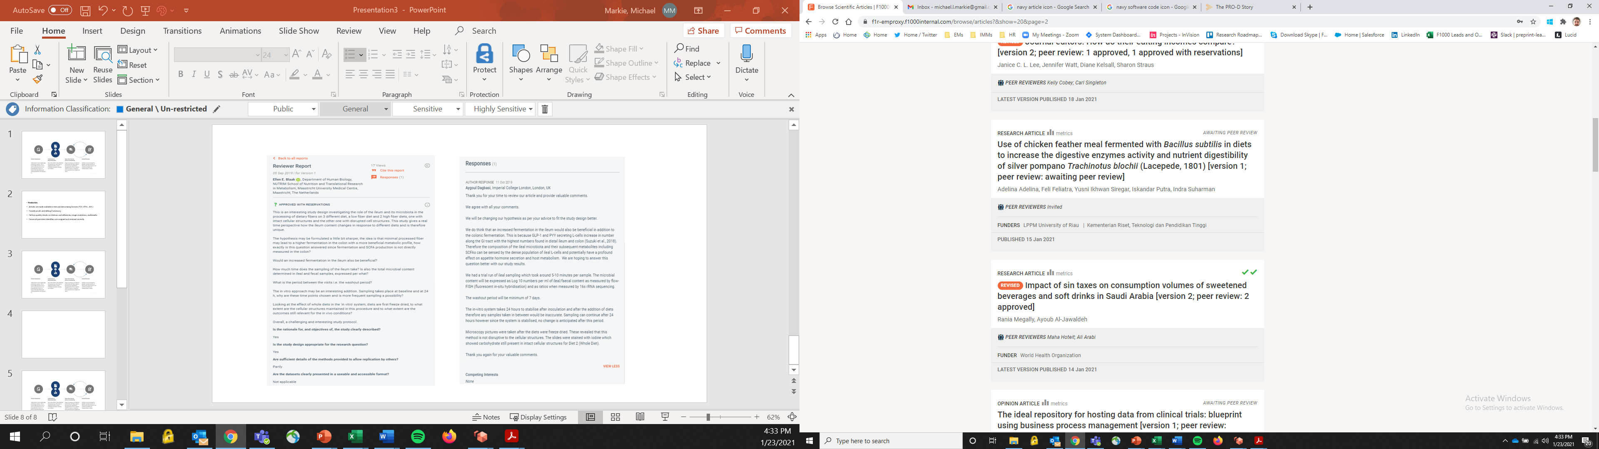

Passing peer review
2 ‘Approved’ Status
2 ‘Approved with reservations’ and 1 ‘Approved’ Status
Important:
Once published, articles can not be removed or published elsewhere

Slide 14

Article versioning
Authors are strongly encouraged to revise their article after the review and submit a new version
All versions remain available on the website, alongside their peer review reports
Peer review occurs openly and validates and improves the article in a fair and ethical manner
A pop-up lets readers know when a newer version of the article is available
Allows for transparent improvements to be made to articles – making them ‘living’ documents

Slide 15


What are the benefits of Open Research Europe?
Supporting a range of contributions
Accessibility
Usability
Interoperability
Equity, Diversity & Inclusion
Research Integrity
Research Assessment
Cost-Effectiveness
Community Building
Flexibility & Innovation
Notes:
Rigorous prepublication checks and transparent peer review that enhances the scientific discourse: not a version of record but a record of versions.
Supporting reform of research assessment by publishing diverse article types and peer review reports enabling recognitions for these other contributions of researchers to their fields. Supporting article level metrics over venue based metrics to enable a fairer evaluation system based on the quality and impact of the individual contribution itself rather than the publication venue.
Responsive infrastructure and policies to meet the changing researcher needs and adapting scholarly publishing ecosystem enabling innovation where needed.
Curated communities and gateways ensuring readers can find relevant content and further cultivating the research community

Slide 16
What’s next for Open Research Europe?
New tender recently announced with F1000 will last from March 2024 – 2026
Will include connection to OpenAIRE and multi-language metadata (including abstracts)
Expansion of the eligibility criteria to other EC-funded work
Continued collaboration with our partners (LIBER, EuroDoc, GYA & OpenAIRE) to increase awareness of ORE
Increased collaboration with European Commission Agencies and departments such as ERC and MSCA and also with European Institutional organisations
Adaptations to feedback received over the last two years to ensure ORE continues to meet the needs of the researchers it serves

Slide 17

Thank you! Questions?
Kelly Woods, Publisher
Kelly.Woods@f1000.com
https://open-research-europe.ec.europa.eu/
@OpenResearch_EU
publishing@open-research-europe.ec.europa.eu
Scan the QR code to sign up to the newsletter (4/year)
https://open-research-europe.ec.europa.eu/gateways/edctp/about

