Slide 1
Integrations in modern biodiversity platform
Open Access – Plans and Choices, 6 November, Tartu
Allan Zirk, University of Tartu, Estonia

Slide 2
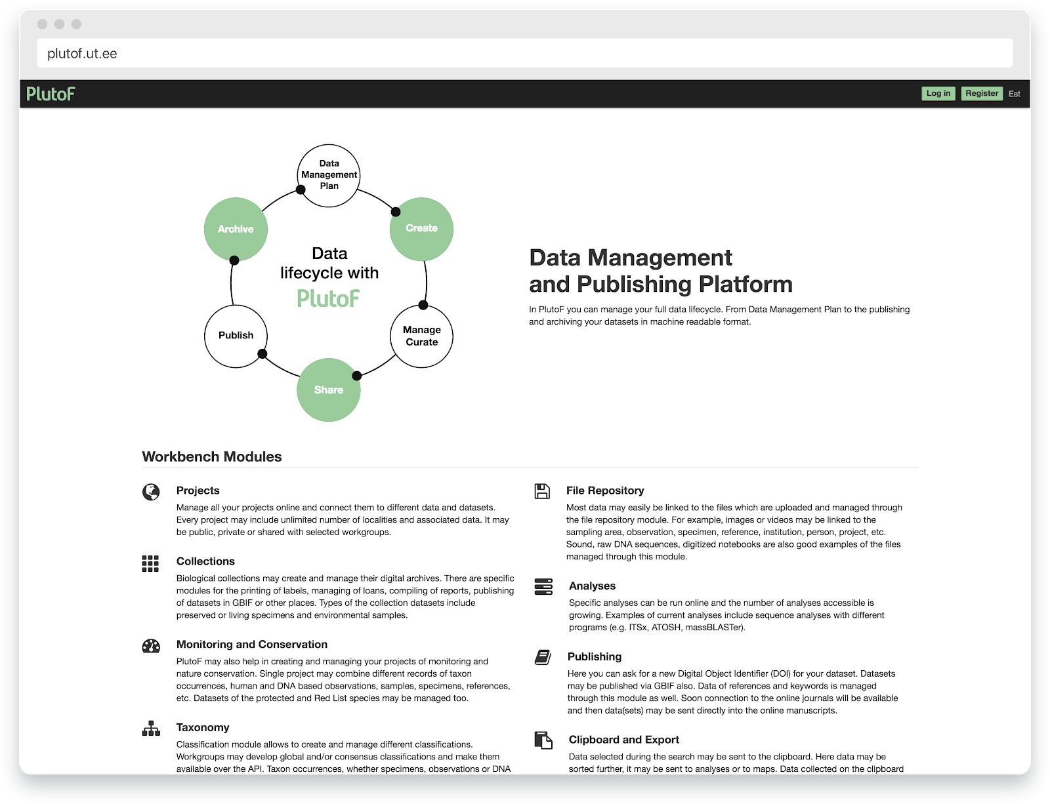
PlutoF statistics
Public release 2005.
Number of registered users 5300.
Over 7 million occurrence records managed.
Usage: every day ~150 people & every month ~1000 people work with data.
Users from over 100 countries, ~30% outside Estonia.

Slide 3
Who uses PlutoF
Scientists, Students, Governmental Officials
Museums & Scientific institutions
Communities
Citizen Science, Ecological, Taxonomical,
Monitoring, etc. Projects

Slide 4
What Data types are managed?
Taxon Occurrences
Classifications, Taxa, Traits
Projects, Studies, Expeditions, Organisations
Experiments, PCR, DNA
Persons, Keywords, Sampling Areas
Images, Videos, Sounds, References

Slide 5
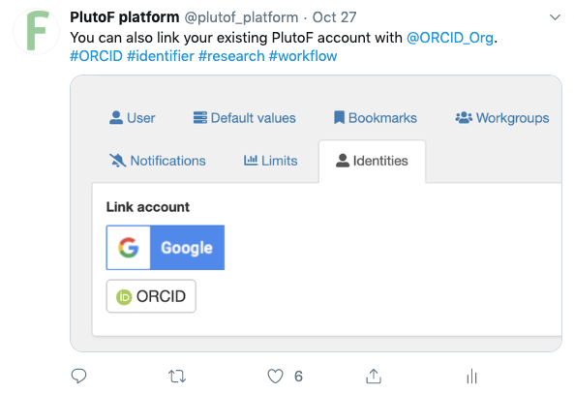

Identity providers
Sign up
Link existing account

Slide 6
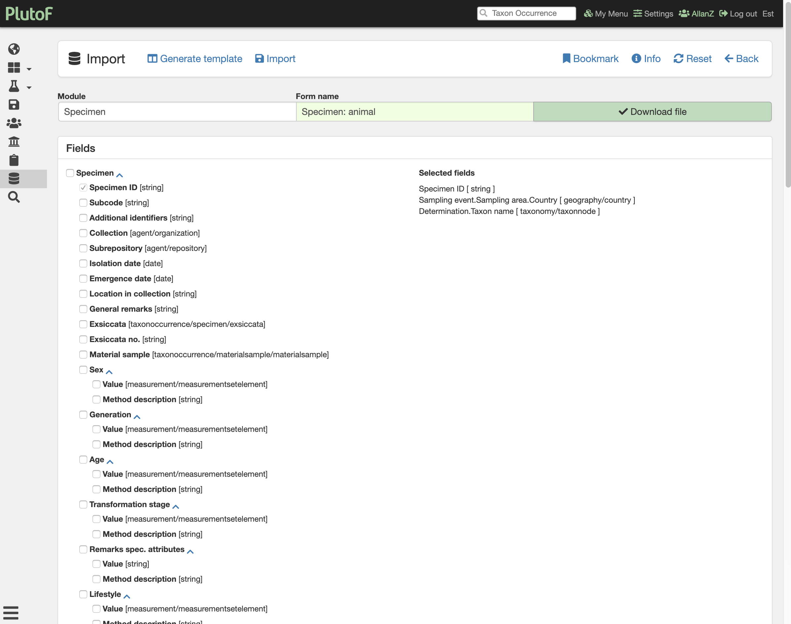
Import tools

Slide 7
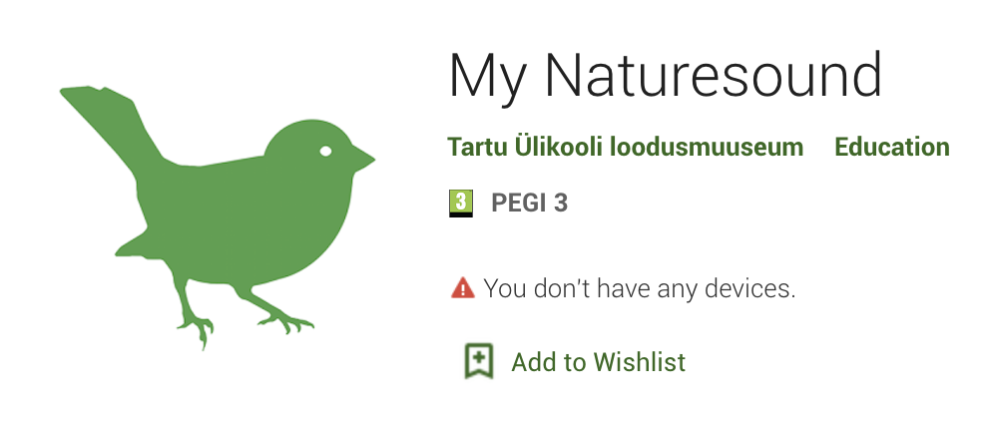
Mobile data gathering tools

Slide 8
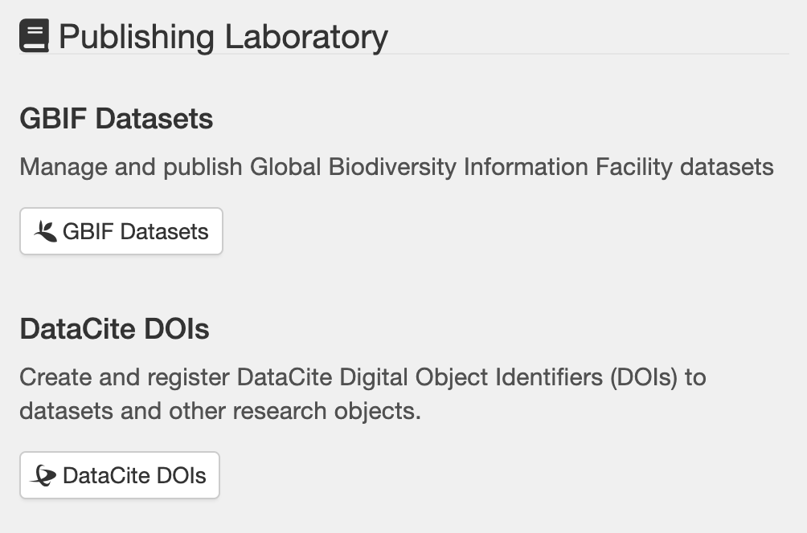
Publishing solutions
GBIF
DataCite
Pensoft
GenBank

Slide 9
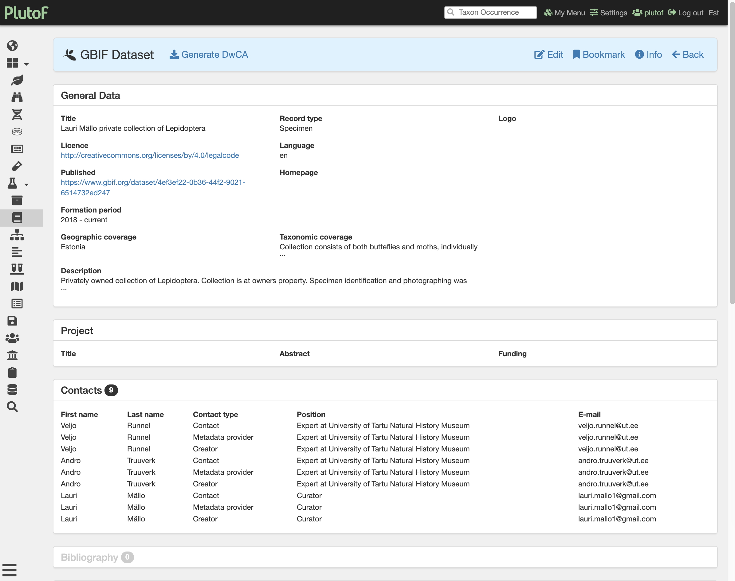
GBIF Dataset management

Slide 10
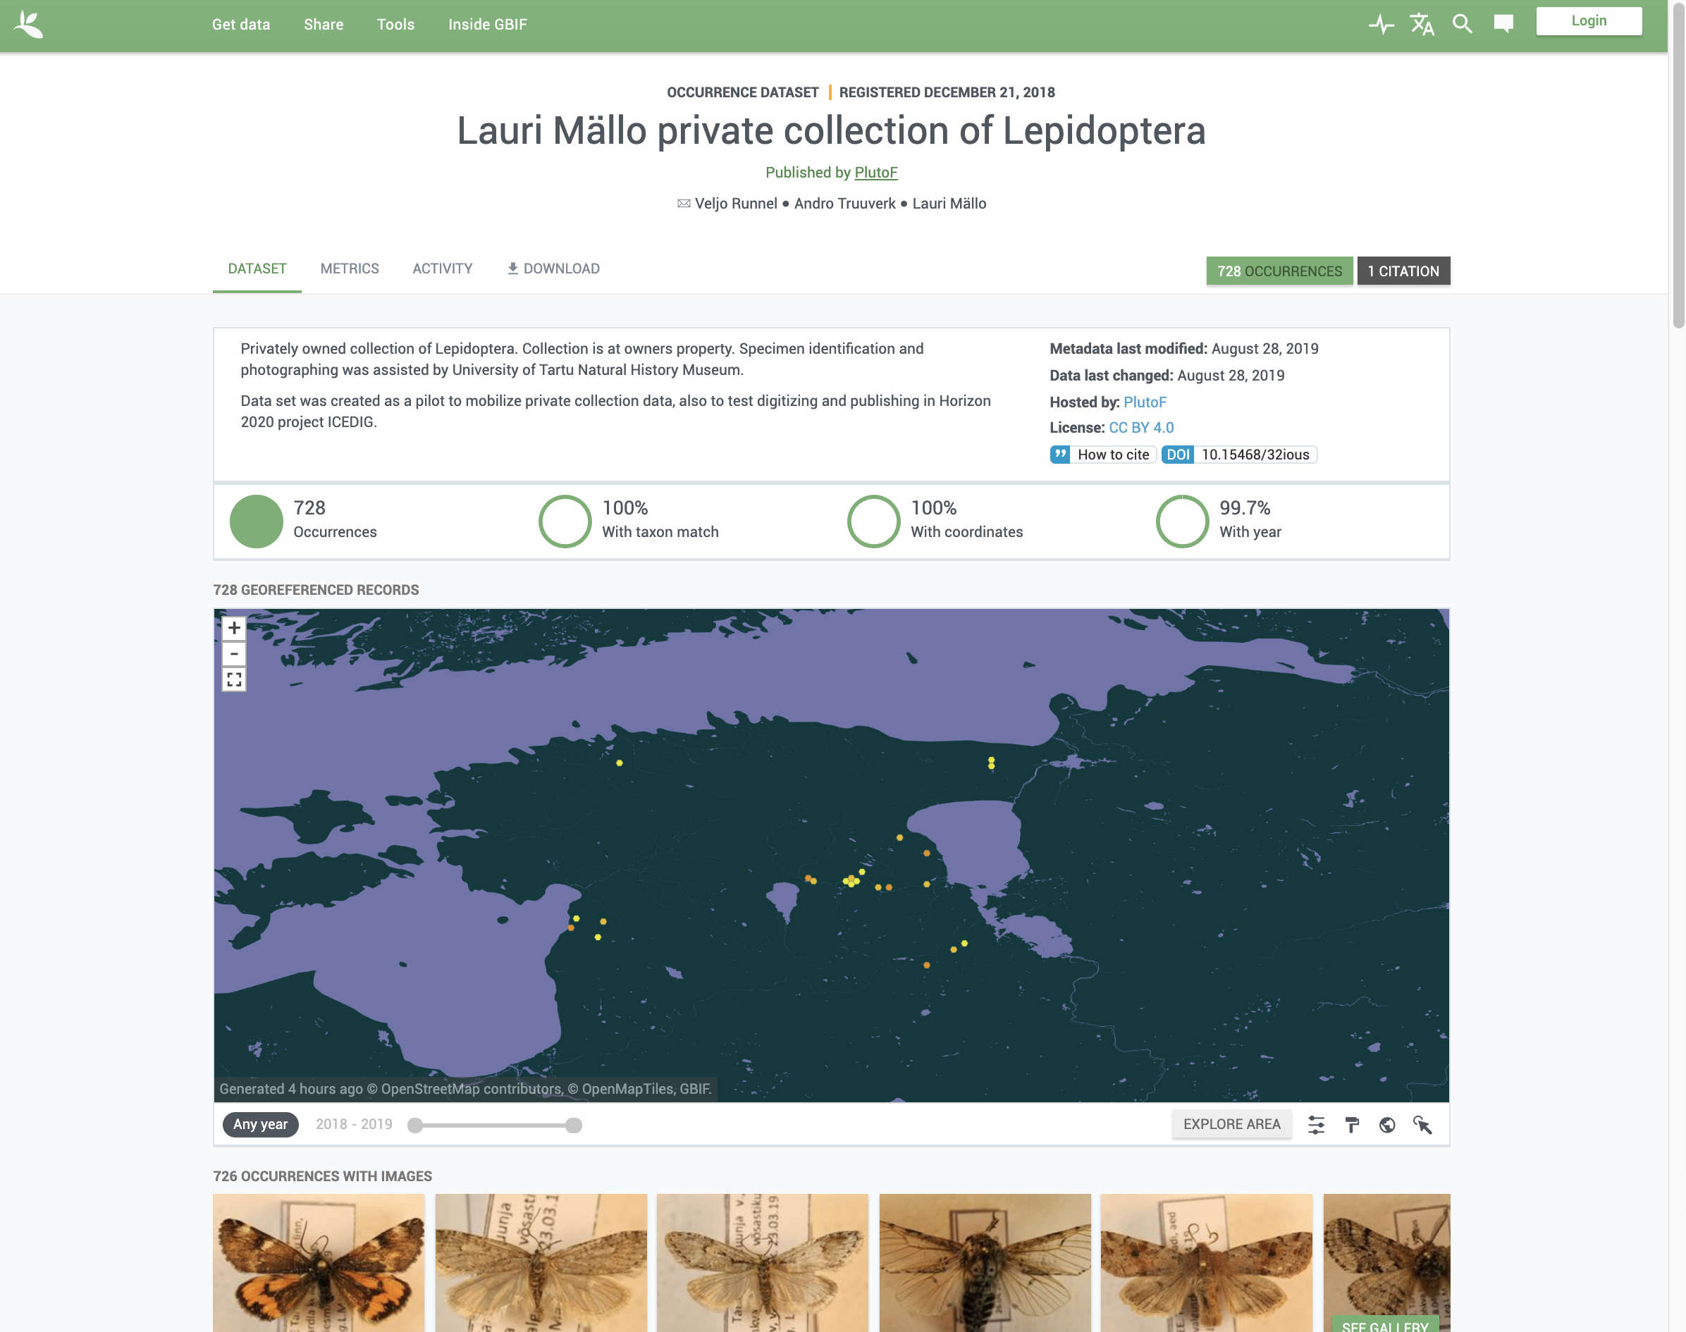
Published dataset in GBIF

Slide 11
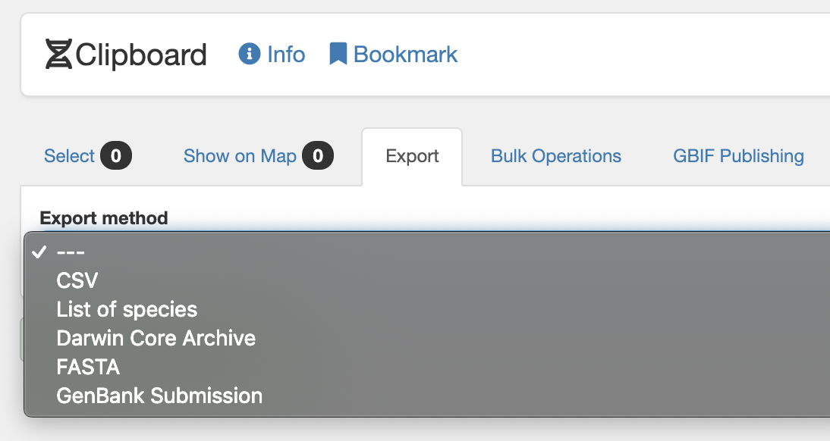
Exports/Downloads
Different formats
Reports
Visualisations

Slide 12
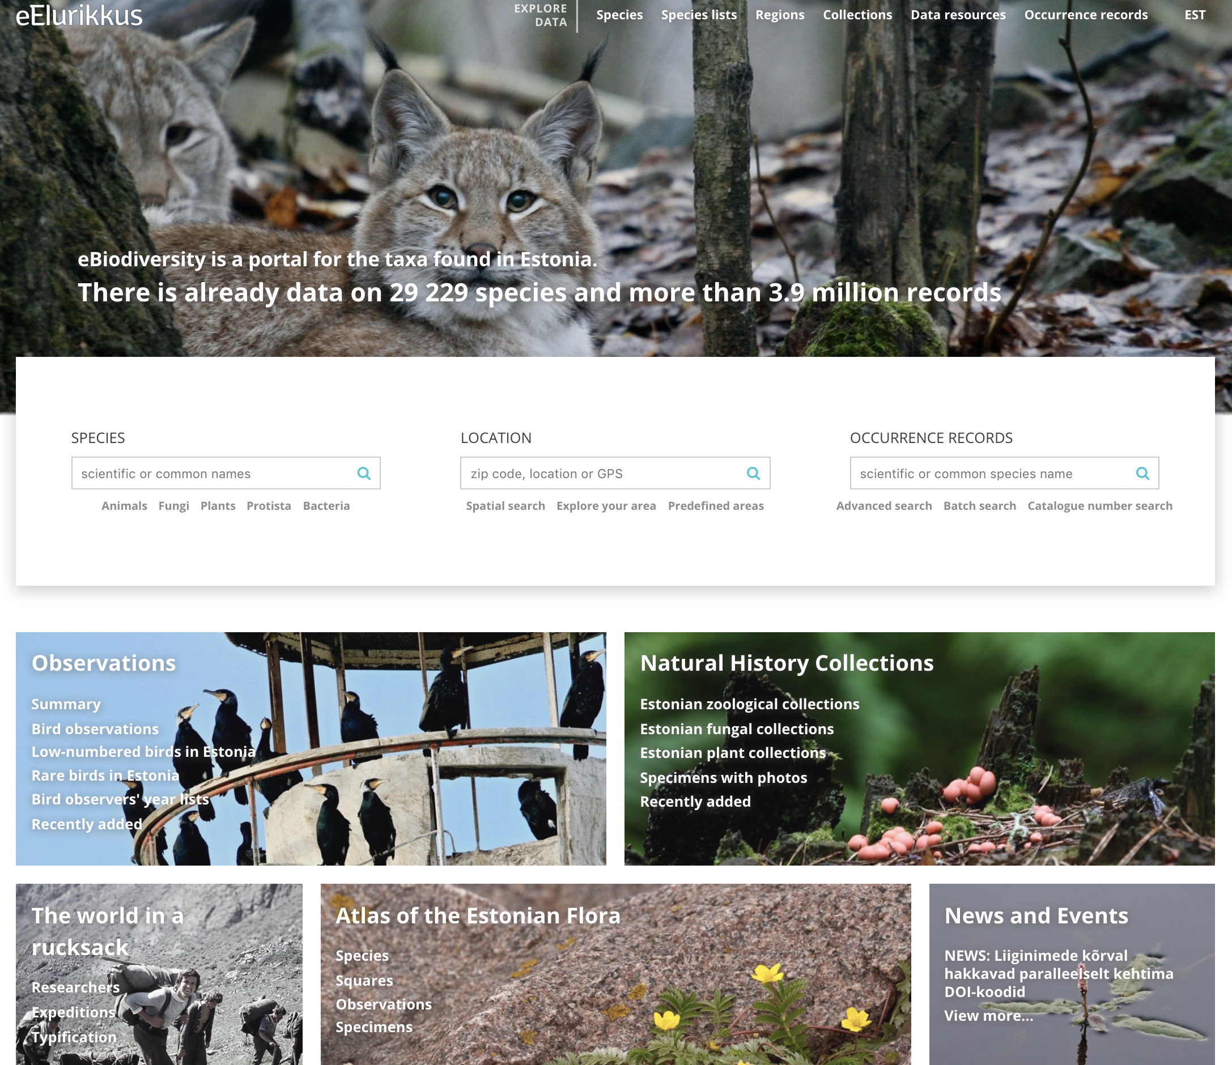
Public portals/sharing
eElurikkus (national portal)
UNITE (commuity services)
EELIS (Nature Conservation Registry)

Slide 13
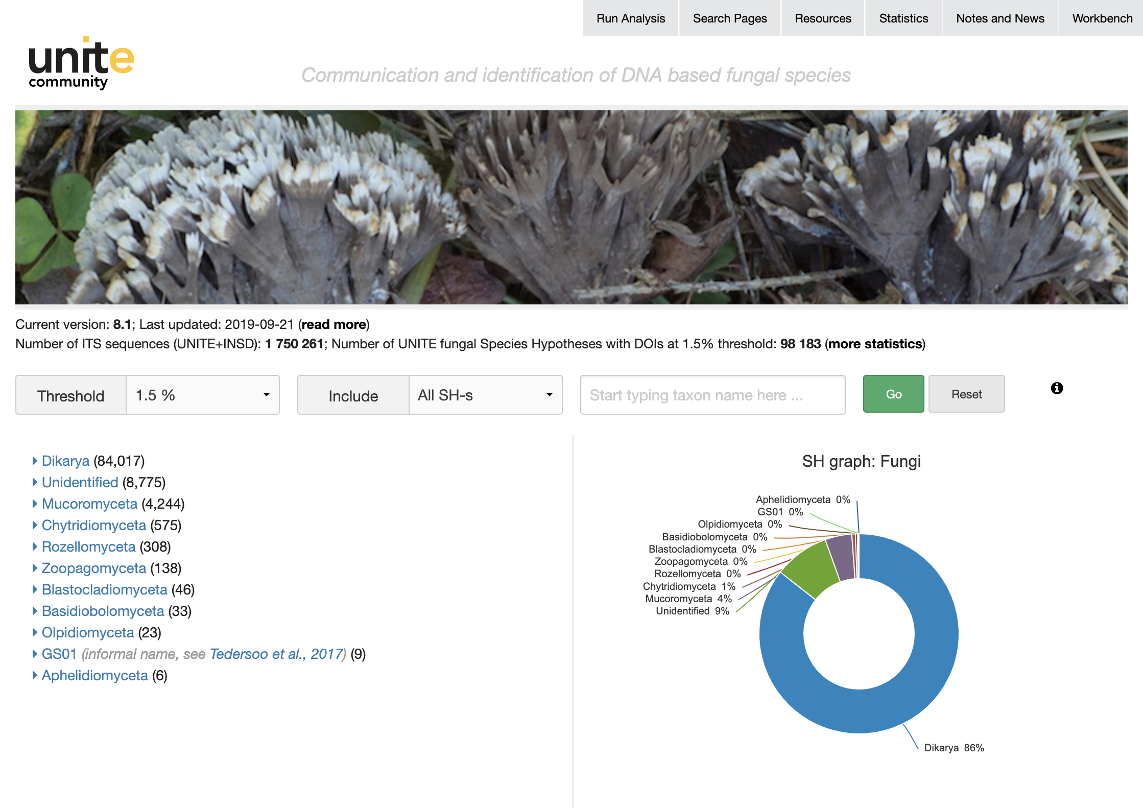
UNITE web services

Slide 14
Thank you!
allan.zirk@ut.ee
@AllanZirk

