Slide 1
New Perspectives in the University of Tartu Library
University of Granada
Staff Mobility Week 18.-22.05.2015
Lilian Neerut
Data Librarian
Department of Subject Librarians

Slide 2

Background
Internet resource

Slide 3
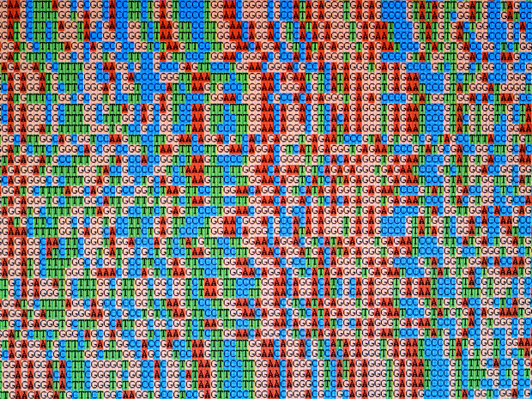
Background
Photo credit: Getty Images, Internet resource

Slide 4
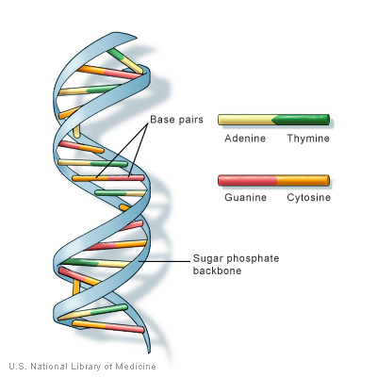
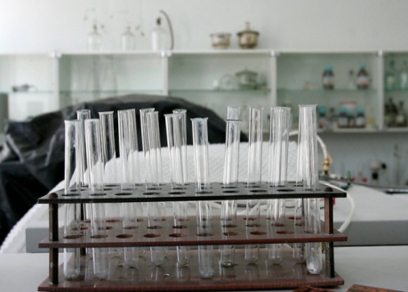
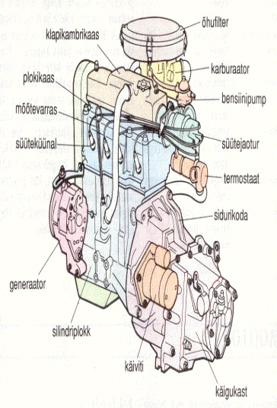
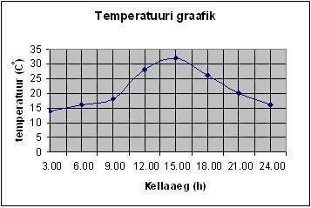
Research Data
Research data is that which is collected, observed, or created in a digital form, for purposes of analysing to produce original research results.
Documents (text, Word)
Spreadsheets
Laboratory notebooks
Questionnaires
Video
Audio
Models
.....
Photo credit: Karin Kaljuläte
Internet resource
Internet resource
Internet resource

Slide 5
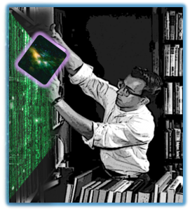
Library
Photo credit: David Fearon, Internet resource

Slide 6
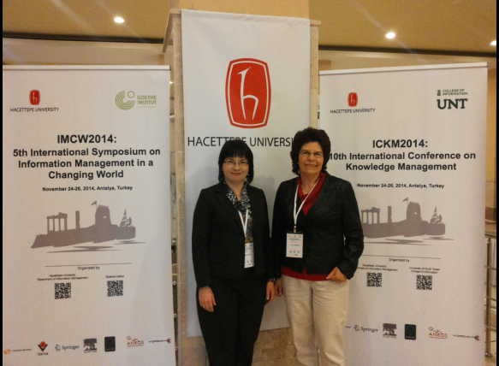
Research Data Management
Data librarians
RDM services

Slide 7
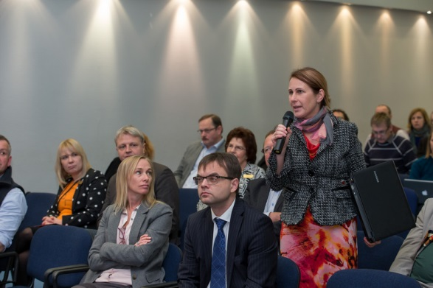
Open Access
Open Access week 2014 – seminar and workshop
Link to seminar
Photo credit: Andres Tennus/Tartu Ülikool, Internet resource

Slide 8


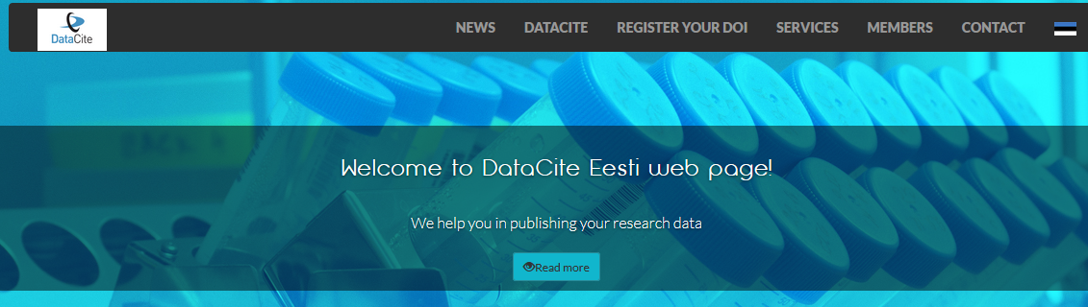
DataCite and DOI
University of Tartu joined DataCite - 2014
DOI – digital object identifier (first 100 DOIs registred in October 2014)
DataCite Eesti Consortium - 2015

Slide 9
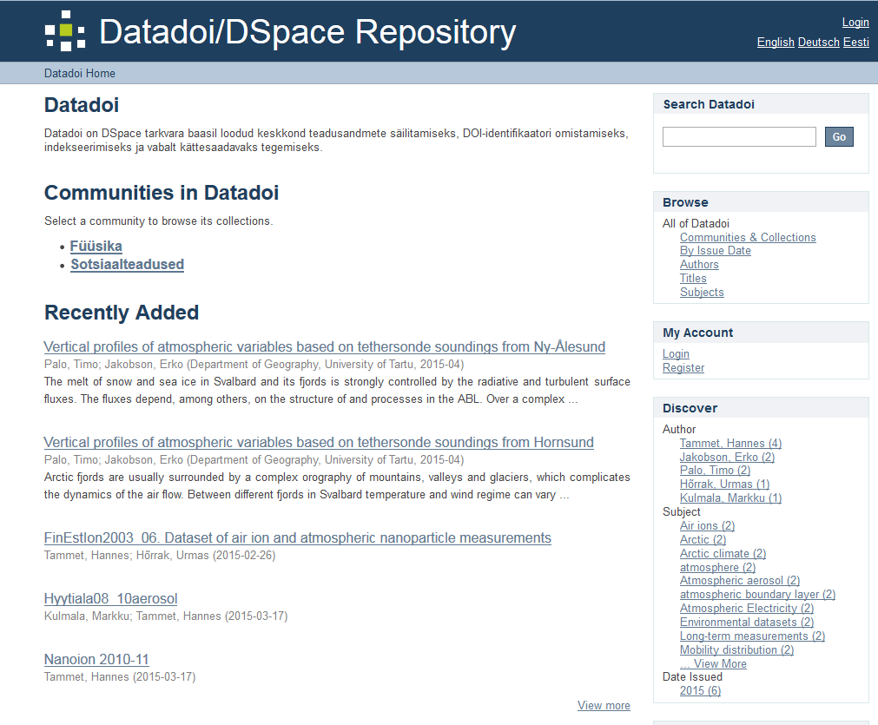
Data Repository
Datadoi/DSpace repository of Tartu University
datadoi.ut.ee

Slide 10
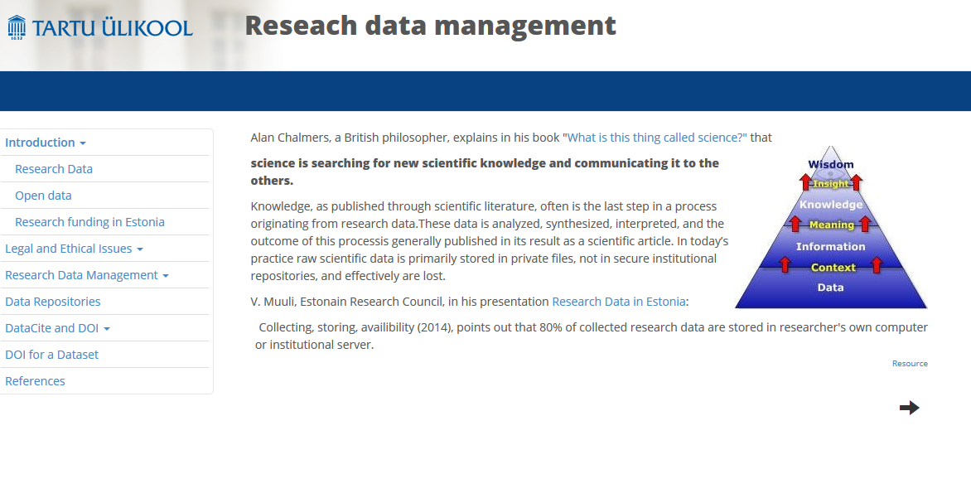
Teaching Materials
Information literacy course contains data topic

Slide 11

Next Steps
RDM policy
Open Access week seminar
RDM e-course
Data management plan
Providing support
Internet resource

Slide 12
Thank you!
lilian.neerut@ut.ee

