Slide 2
“I Didn’t use the library, I googled it”: using citation analysis to identify the use of library resources
Simona Juzėnienė, PhD
Vincas Grigas, PhD
Vilnius university library

Slide 3

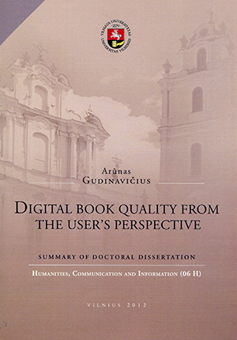
Prehistory. This is Arūnas and his dissertation...

Slide 4
Unofficial Research question: can it be true, that the academic library and it’s resources are worthless for Phd students?
Small pilot research:
Analysis of bibliographical references lists;
4 librarians, 4 science fields (Humanities is still in process);
12 randomly chosen dissertations, defended in 2014;
Analysis scheme and instruction.

Slide 5
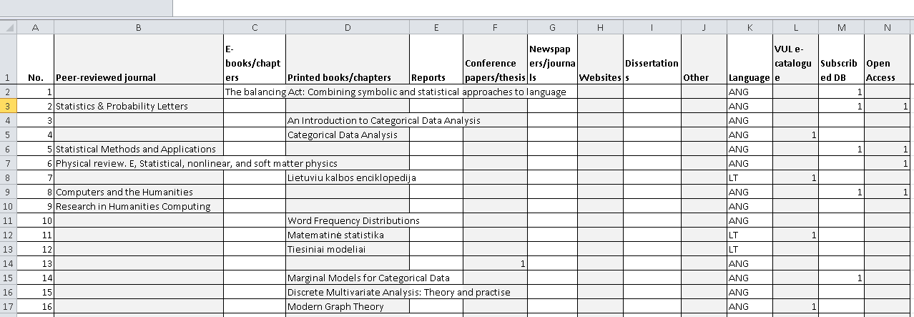
Data gathering example

Slide 6
Results (1)
Number of dissertations analysed |  | Total no. in 2014
Humanities | 0 | 16
Social Sciences | 3 | 39
Physical Sciences | 3 | 34
Biomedical Sciences | 3 | 35
Technological Sciences | 3 | 6
In total: | 12 | 130

Slide 7
Results (2). Types of information resources

Slide 8
Results (3). Types of information resources

Slide 9
Results (4). Types of information resources

Slide 10
Results (5). Types of information resources

Slide 11
Results (6). Types of information resources
Comments:
Physical sciences need more printed books than social sciences?
Why are electronic books so unpopular?
Category “other” is quite big, so we should pay more attention to various conference proceedings, reports, legal documents, even maps..
Biomedical scientists do not need books, they need lots of journals.

Slide 12
Results (7). Ways to get information resources

Slide 13
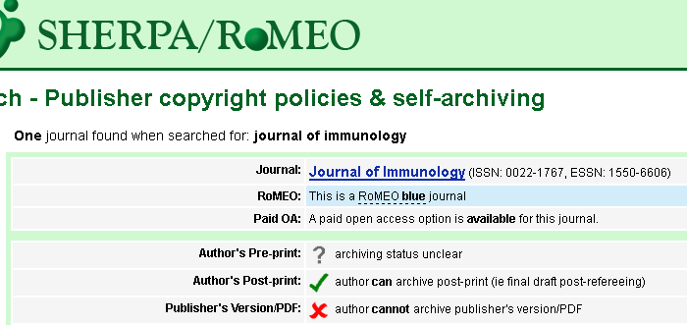
Results (8). Ways to get information resources
Comments:
Open Access was checked via Sherpa/Romeo. Either the journal was listed in DOAJ or a paid OA option was available, no matter green, yellow or blue archiving policies – it was considered as an open access journal. And there was at least a little possibility to find needed articles somewhere online.

Slide 14
Results (9). Core journals. Web of science journal citation reports

Slide 15
Results (10). Core journals. Web of science journal citation reports

Slide 16
Results (11). Core journals. Web of science journal citation reports

Slide 17
Conclusions. Discussion.
Citation analysis helps to identify usage of physical and electronic library resources among PhD students.
When doing analysis, a very specific instruction has to be made for librarians who collect data, so they understand everything the same.
Such research can show the need for evidence based information literacy or scientometrics courses for students from different science fields.

Slide 18
Conclusions. Discussion. (2)
Academic libraries have to rethink resource collection and development. Maybe all that we need are only textbooks for BA and MA students?
Open access articles and other freely available resources online are the core resources for dissertations. How can academic libraries still remain important for PhD students?
Can open access be seen as a threat for academic libraries and their information resources provider‘s role?

