Slide 1
OA: are we trapped or dodged
Jaak Järv
Estonian Academy of Sciences
University of Tartu

Slide 2
License
* Scientist, - first publication in 1971
* Editorial Board Member, Bioorganic Chemistry, Academic Press, later Elsevier, 1983 - 2019
* FEBS Publications Committee Member in 1998 - 2002
* Editor-in Chief, Proceedings of the Estonian Academy of Sciences, since 2008

Slide 3
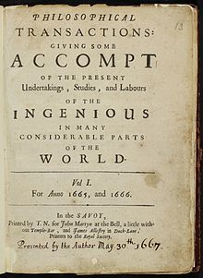
Philosophical Transactions of the Royal Society 1665

Slide 4
Unipolar Model
Scientists
(academia)
Journals
Library
Scholarly communication

Slide 5
Bipolar Model
Scientists
Publishers
Scholarly communication

Slide 6
Publishing is (big)business
In 2014
28,100 peer-reviewed English-language journals
6450 non-English-language journals
About 2.5 million articles per year
This number is increasing 3-4% per year

Slide 7
Electronic publishing
as precondition for OA

Slide 8
Electronic publishing
* Full text of papers in web
* Analysis of published papers, metadata
* Academic databases and search engines
* Scientometrics

Slide 9
Tripolar Model
Scientists
Publishers
Scientometric
data
Jacs-in-office

Slide 10
Public Library of Science
Online petition initiative in 2000
Harold Varmus, Patrick O. Brown and Michael Eisen
2002 PLOS was founded with a $9 million grant
PLOS charges an article processing charge
PLOS' balance sheet has improved from $20,511,000
net assets in 2012–2013
to $36,591,000 in 2014–2015.

Slide 11
Science publishing is expensive

Slide 12
Pay-to read
vs
pay-to-publish
Funders want Open Access

Slide 13
Open Access Models
Open Access Publishing (Gold OA)
Other models of Open Access
None is free!
How can it be cheaper?

Slide 14
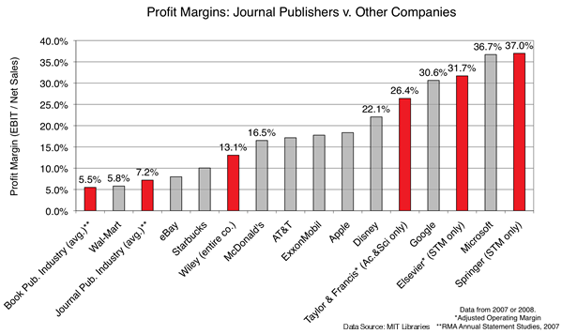

Slide 15
Open Access Self-Archiving (Green OA)
arXiv.org
*Repository of electronic preprints (known as e-prints)
*Published after moderation, but not full peer review
*Budget for arXiv is approximately $826,000 (2017)
*Owner is Cornwell University

Slide 16
Unipolar Model
Scientists
(academia)
Journals
Scholarly communication

Slide 17


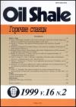

Slide 18
Journal | Published papers in 2019
Authors | Estonia |  |  | Estonia + other |  |  | Other | Total
 | TalTech | UT | TU | TalTech | UT | TU
PEAS | 12 | 5 | 2 | 12 | 1 | - | 15 | 47
EJES | 5 | 1 | - | - | 3 | - | 7 | 16
Total | 17 | 6 | 2 | 12 | 4 | - | 22 | 63

Slide 19
Thanks!

