Slide 1
PhD Vincas Grigas

Slide 2
Building evidence into subject librarians training:
existential angst about the bigger picture

Slide 3
If librarians
want to be seen as experts,
then their expertise
has to be visible (Dempsey, 2012).
\
\
It is important that libraries or librarians clearly show their added value within the “overhead” of university other important activities.
Notes:
To change your footer logo (SwissBiz), please go to VIEW > SLIDE MASTER and change it from there, it will automatically change to all your slides.
Dempsey, L. (2012), “Libraries and the informational future: some notes”, paper given at The Information Professionals 2050 Symposium, 4 June, UNC School of Information and Library Science, Chapel Hill, UNC, available at: www.oclc.org/content/dam/research/publications/library/2012/dempsey-informationalfutures.pdf

Slide 4
key challenges
1
2
3
unseen
underground
dilettante
Subject librarians are unseen for non library community.
Subject librarians were seen to be servicing themselves or were seen as a challenge to the system already made?
Subject librarians are usually illegal.
Subject librarians in a university are trying new and often shocking or illegal ways of living or forms of act.
Subject librarians are indefensible inter-disciplinary talents.
Who could certify: they own both subject knowledge and professional informationist knowledge.

Slide 5
The PhD students’ sense
of being valued
and self-esteem is high
(Gullbekk, 2013).
\
\
Many of PhD students maintain idea that the librarians lack knowledge about the research process.
Notes:
To change your footer logo (SwissBiz), please go to VIEW > SLIDE MASTER and change it from there, it will automatically change to all your slides.
GULLBEKK, Eystein. PhD candidates and the research process: The library's contribution. Universitetsbiblioteket, 2013.

Slide 6
key numbers
Summing up!
Students do not recognize librarians as having significant role or position in information-seeking process and do not perceive the librarian as an important support in research processes.
Google as primary source for students
75%
Students seek assistance from peers
81%
Contacted a librarian for a help
1%
Family members provided support
24%
Students rated themselves as experts
81%
Notes:
Nadel Arno, 1935, Woman with black hair
Song, Y.S. (2005), “A comparative study on the information‐seeking behaviors of domestic and international business students”, Research Strategies, Vol. 20, pp. 23‐34.
DUBICKI, Eleonora. Research behavior patterns of business students. Reference Services Review, 2010, 38.3: 360-384. (Song, 2005)
Educause Center for Applied Research. 2010. ECAR National study of undergraduate students
and information technology, 2010. Available at:
http://net.educause.edu/ir/library/pdf/ers1006/rs/ers1006w.pdf [accessed 28 October 2013].

Slide 7
anxiety
How can we be seen part of already made system?
How can we legalize forms of our act?
How can we certify our knowledge?
Notes:
Edward Munch. The_Scream. Wikimedia Commons.

Slide 8
Any university in Lithuania
has study programme intended
to train subject librarians
(Krivienė, 2015)
\
\
Looking for the best way about moving resources to where there is most benefit, and finding the right level in the network at which things should be done.
Notes:
To change your footer logo (SwissBiz), please go to VIEW > SLIDE MASTER and change it from there, it will automatically change to all your slides.
GULLBEKK, Eystein. PhD candidates and the research process: The library's contribution. Universitetsbiblioteket, 2013.

Slide 9
testimonials
Key problems!
Were identified knowledge and skills gaps and shortages in very different areas of expertise of selected subject librarians.
The lack of systematic trainings for subject librarians of different levels.
There is no policy tradition of supporting excellence as such is perceived by faculty.
Problems to articulate existing and required competencies for subject librarians.

Slide 10

blurred
Notes:
To change your logo (SwissBiz), please go to VIEW > SLIDE MASTER and change it from there, it will automatically change to all your slides.
August_Strindberg_-_Storm_in_the_Skerries._'The_Flying_Dutchman'. Wikimedia Commons.

Slide 11
process
4
1
evaluation.
description.
Kinds of competencies relevant to train were identified.
Outlined understanding of subject librarian implementation in VU Library.
5
2
3
plan.
categories.
Subject librarian training activities were arranged.
Three categories of subject librarians were outlined.
competencies.
Competencies were outlined using variuos standards.
Notes:
for science field
For reference service
For special collections

Slide 12
description
communication
consultation
Extensive communication with students and uphold contacts with academics.
Real-time support on information seeking processes, scientific research supporting services.
reference
training
Traditional conception as a reference librarian or bibliographer. Responding to queries.
Educating in information seeking and information literacy, advices on technical instruments and methods for information use.
management
material
Selecting material, describing material, classifying material of particular subject information sources collection.
Preparing teching material and guides for library users.

Slide 13
categories
science field.
Subject librarian for philologhy, law, economics etc.
reference.
Subject librarian for reference services.
collections.
Subject librarian for special collections.
Notes:
for science field
For reference service
For special collections

Slide 14
competencies
literacy.
special.
Information Literacy Competency Standards for Higher Education.
Competencies for Special Collections Professionals.
scholarly.
communication.
Subject librarians’ competencies in support of e-research and scholarly communication.
VU Library Customer service standard.
instruction.
reference.
Standards for Proficiencies for Instruction Librarians and Coordinators.
Professional Competencies for Reference and User Services Librarians.

Slide 15
evaluation
Agreement
76%
Information Literacy
21%
Scholarly communication.
37%
Instruction proficiecies.
Standards were used to make rubrics.
Rubricks were evaluated using 5 levels Likert scale.

Slide 16
plan
4
1
instruction.
literacy.
24 hours
formal lecture and practical seminar
11 hours formal lecture and practical seminar
5
2
3
feedback.
scholarly.
IL course outline
Individual page
Questionaires
15 hours
formal lecture and practical seminar
communication.
6 hours
formal lecture and practical seminar

Slide 17
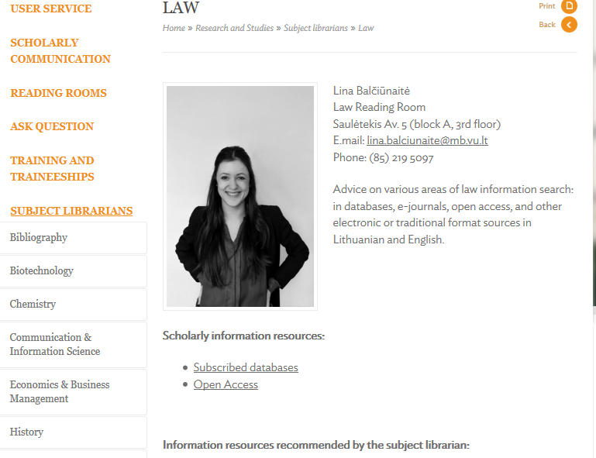
feedback

Slide 18
Through others we become
ourselves. (Vygotsky, 1987)
\
Learners constructing understanding together that wouldn't be possible alone
\
Notes:
Social constructivism, strongly influenced by Vygotsky's (1978) work, suggests that knowledge is first constructed in a social context and is then appropriated by individuals (Bruning et al., 1999; M. Cole, 1991; Eggan & Kauchak, 2004). According to social constructivists, the process of sharing individual perspectives-called collaborative elaboration (Meter & Stevens, 2000)-results in learners constructing understanding together that wouldn't be possible alone (Greeno et al., 1996)[citation needed]
Through others we become ourselves. (Vygotsky, 1987)
Through others, we become ourselves.
Vygotsky, L. S. (1987). The genesis of higher mental functions. In R. Reiber (Ed.), The history of the development of higher mental functions (Vol. 4, pp. 97-120). New York: Plennum.

Slide 19
foreseen
1
2
3
seen
authorized
professional
Subject librarians are seen for non library community.
Subject librarians are seen as partners for faculty and as authorities for students?
Subject librarians are legal.
Subject librarians has permission to teach IL, to participate in other departments meetings.
Subject librarians are professional informationists.
Their knowledge, trainers who trained subejct librarians are those who certifie.

Slide 20
Making choices that
increase impact
\
They cannot continue to spend a lot of time on activities that replicate what is being done elsewhere and do not create real value for their institutions (Dempsey, 2012)
\

Slide 21
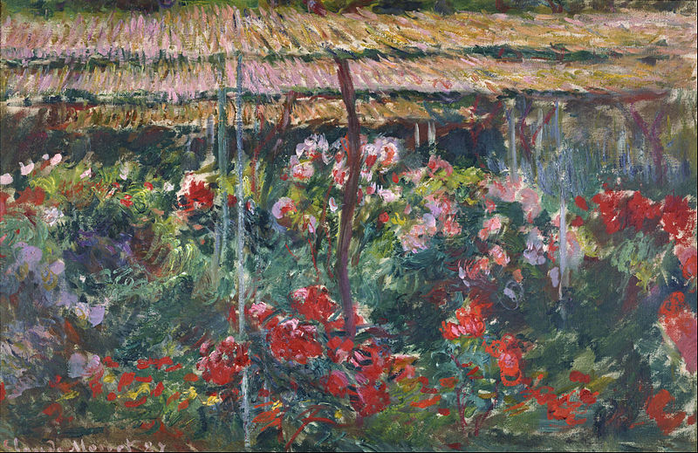
brighten
Notes:
To change your logo (SwissBiz), please go to VIEW > SLIDE MASTER and change it from there, it will automatically change to all your slides.
800px-Claude_Monet_-_Peony_Garden_-_Google_Art_Project

Slide 22
team

