Slide 1
Open Access and European University Presses
Ivo Volt
University of Tartu Press, Editor-in-Chief
Association of European University Presses, Vice Chair
OA – Plans and Choices, 6 Nov 2019, Tartu

Slide 2
AEUP: purpose
To develop and support relations between university presses in Europe:
  to improve communication between members
  to improve the visibility of member presses
  to promote distribution of knowledge
  to share knowledge about scholarly publishing
Open to all publishers belonging to or clearly linked to a university, a research institute or a learned society
OA – Plans and Choices, 6 Nov 2019, Tartu

Slide 3
AEUP: members
Established 2010
Currently 41 members from 18 countries:
    Armenia, Austria, Belgium, Czech Republic, Denmark, Estonia, Finland, France, Germany, Hungary, Italy, Latvia, Lithuania, The Netherlands, Norway, Romania, Sweden, United Kingdom
Diversity (business models, languages, policies)
Patron members: OAPEN, OpenEdition, RLUK
OA – Plans and Choices, 6 Nov 2019, Tartu

Slide 4
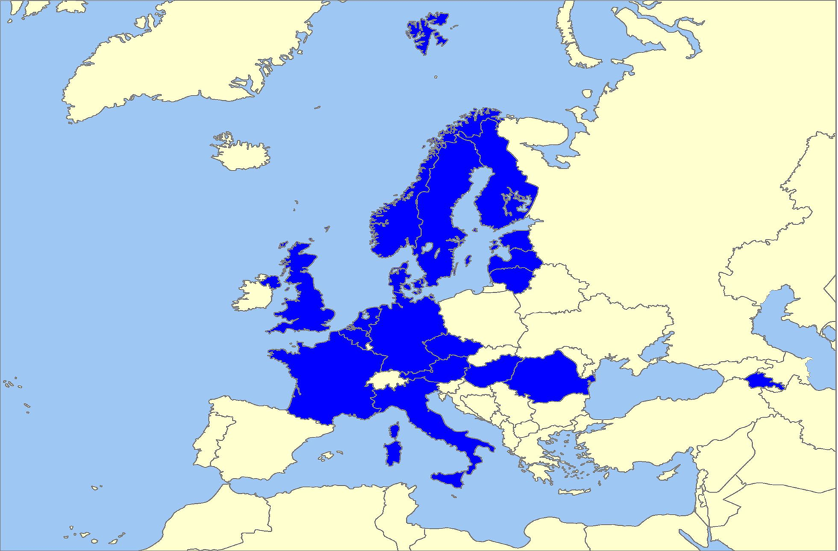
AEUP: members
Interactive map of Europe by Phil Archer, based on Madman2001/Wikimedia Commons, ed. by Ivo Volt, CC BY-SA 3.0
OA – Plans and Choices, 6 Nov 2019, Tartu

Slide 5
AEUP: activities
Joint online catalogue
  currently ca 4300 entries, work in progress
Member (and non-member) surveys
  publishing formats, quality standards, production and dissemination workflows, editorial skills etc
Representation at international publishing and library events
Cooperation with international projects (e.g. OPERAS)
OA – Plans and Choices, 6 Nov 2019, Tartu

Slide 6
AEUP: activities
Conferences
2017, Stockholm: Going digital in Europe – joining forces in scholarly publishing
2019, Brno: (Re-)Shaping University Presses and Institutional Publishing
Workshops
2018, Riga: Keeping up with the standards
2018, Göttingen: From text to structured edition – producing XML-TEI content
OA – Plans and Choices, 6 Nov 2019, Tartu

Slide 7
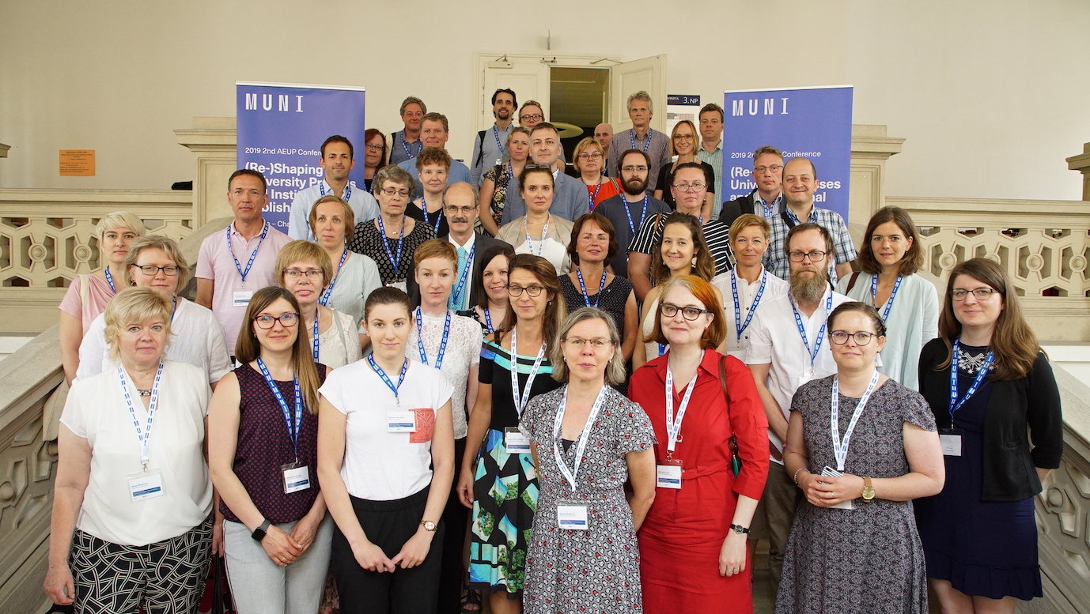
AEUP: 2019 conference in Brno
Photo by Tomas Kratochvil, CC BY-SA 4.0
OA – Plans and Choices, 6 Nov 2019, Tartu

Slide 8
AEUP and Open Access
No OA mandate to become a member
  Different backgrounds, national developments
But: strong support of OA
  One of the 7 statements of 2018
  Sharing knowledge, expertise and experience (incl. born-OA presses)
Mostly monograph publishers (although also around 370 journals/yearbooks)
  Lacking national standards on OA re: monographs
  Plan S on monographs still unclear!
OA – Plans and Choices, 6 Nov 2019, Tartu

Slide 9
Univ Tartu Press and Open Access
OA as one of the priorities declared by the Publishing Committee of the University of Tartu
14 journals, all Diamond OA
  OJS platform
  No APCs, supported by the university, faculties, other funding bodies
Monographs (mainly HSS)
  A selection in OAPEN and DOAB (currently 24 titles)
  Costs paid upfront, availability as top priority
OA – Plans and Choices, 6 Nov 2019, Tartu

Slide 10


Thank you!
AEUP
www.aeup.eu, info@aeup.eu
AEUPinfo @AEUP_info
Zenodo: zenodo.org/communities/aeup/
University of Tartu Press
www.tyk.ee, tyk@ut.ee
UniTartuPress @TUP1632 @kirjastus
Ivo Volt
Ivo.Volt@ut.ee
ivovolt @ivovolt
OA – Plans and Choices, 6 Nov 2019, Tartu

