Slide 1
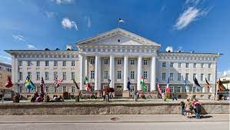
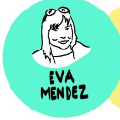


Open Science 20xx? Stop changing the date… Start changing the strategy
emendez@bib.uc3m.es @evamen

Slide 2
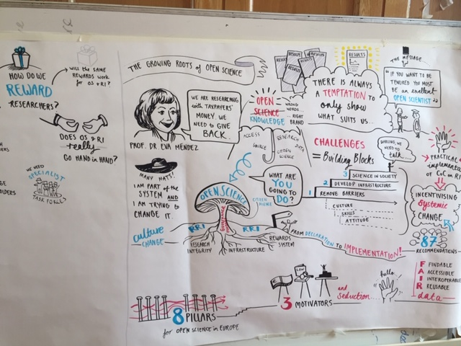
Outline
  A starting point and a Couple of reminders…
  Where we are now:
    What have we learned from COVID-19
    Some urgent CHA[LLE]NGES
    A strategy: PCIs
  Take away for the future

Slide 3


DIY-Calendar: https://zenodo.org/record/5961563#.Yl_eUOjP3IV

Slide 4
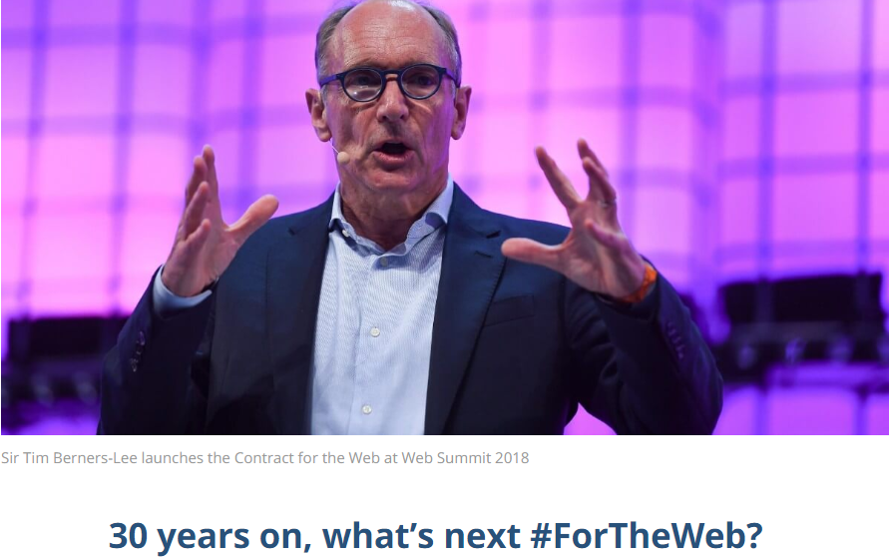
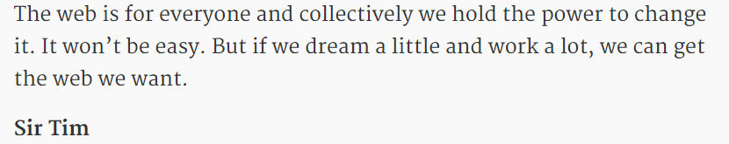
Where we are: Just a reminder!!
Science
https://webfoundation.org/2019/03/web-birthday-30/

Slide 5
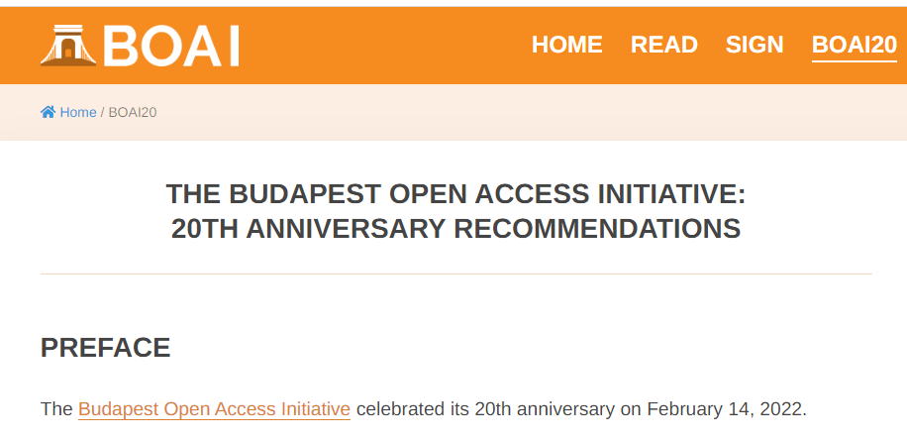

Slide 6
"The best way to predict the future is to invent it“
(Alan Kay)
https://webfoundation.org/2019/03/web-birthday-30/
20 years on, what’s next #ForOpenAccess???

Slide 7

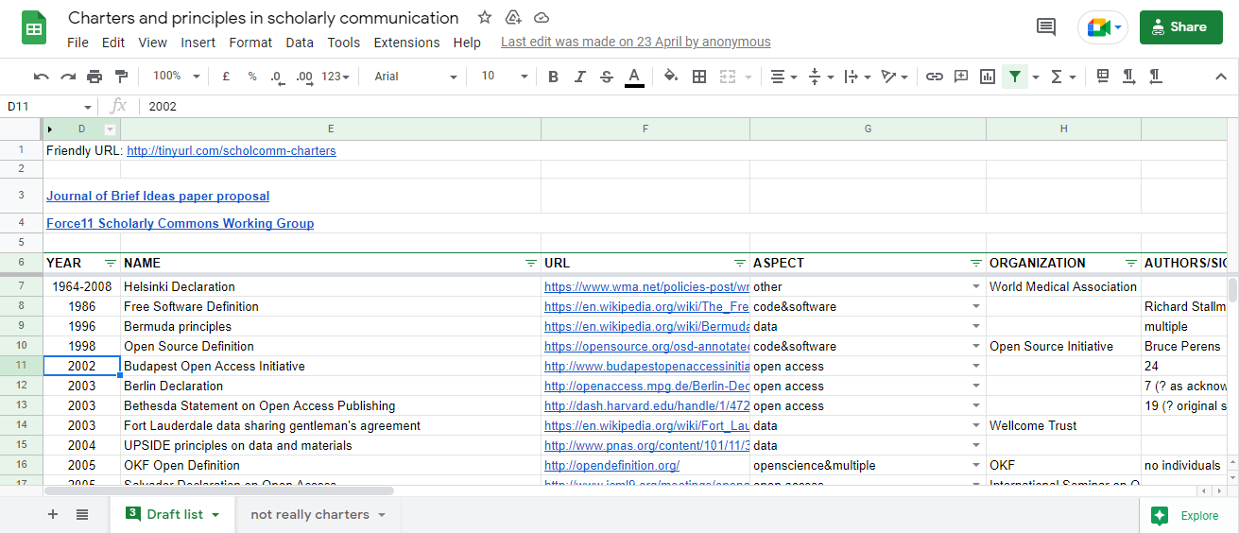
More than 100 DECLARATIONS
http://tinyurl.com/scholcomm-charters

Slide 8
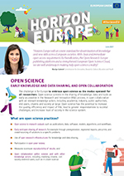
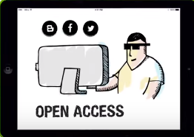
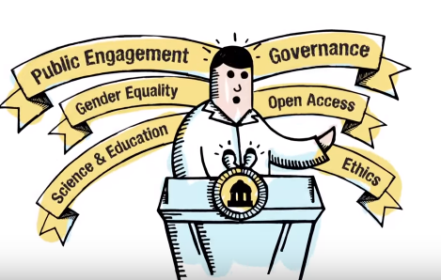


SCIENCE
RRI
… Where openness and transparency and EQUITY…
are an integral component of the research and innovation process

Slide 9
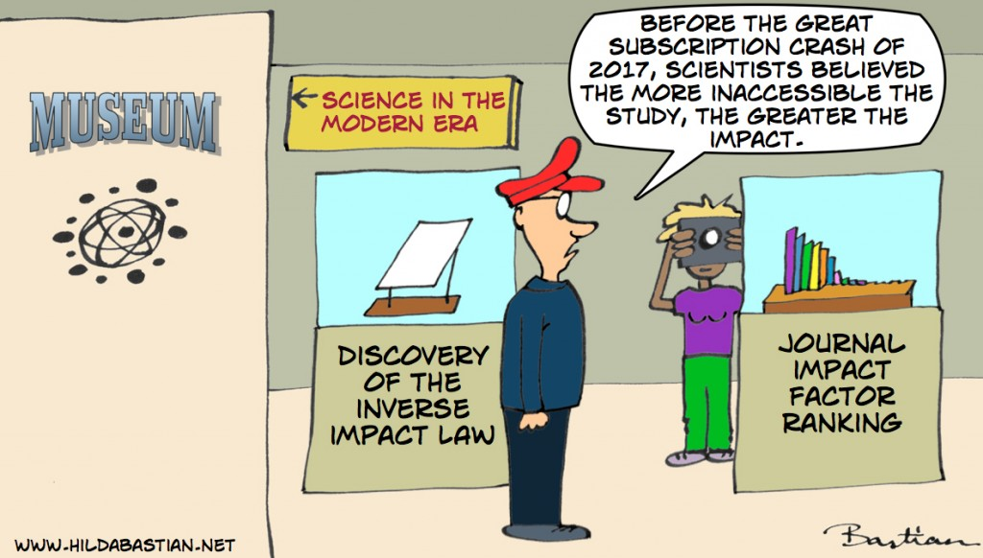
COVID-19
2030
2021
2020
https://blogs.plos.org/absolutely-maybe/2018/07/30/europe-expanded-the-no-elsevier-deal-zone-this-could-change-everything/

Slide 10
Some answers…

Slide 11
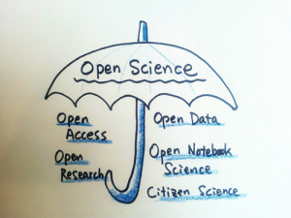
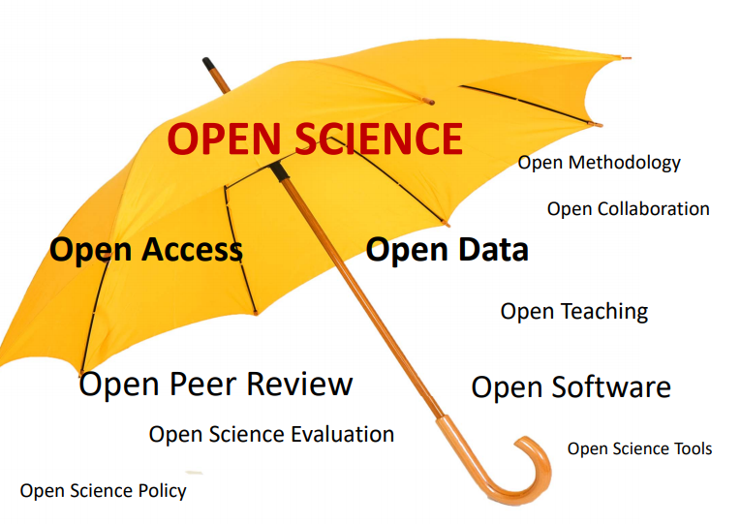
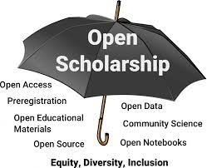
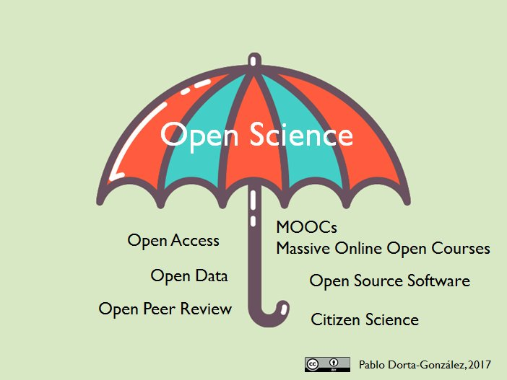
Open Science Umbrella. Image credit: Flikr user 지우 황 CC BY 2.0

Slide 12
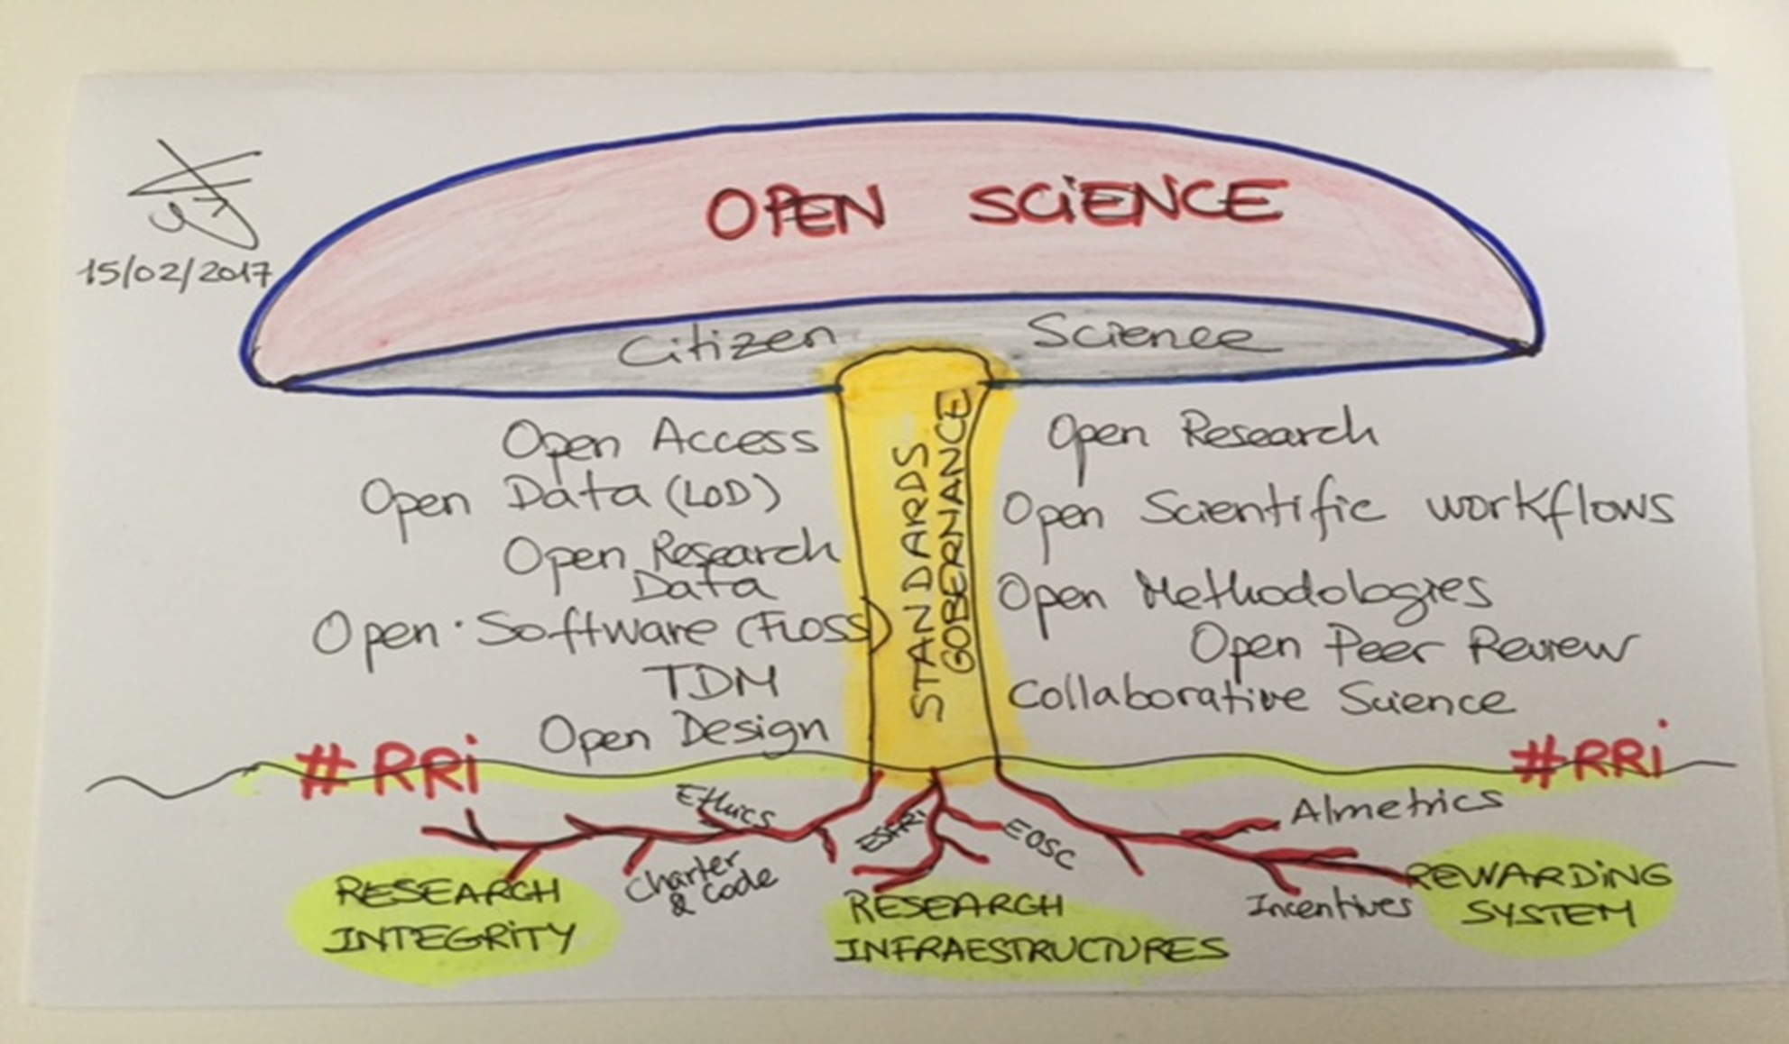

Social
Factual
Infrastructural
Notes:
Social
Factual
infrasturctiral

Slide 13
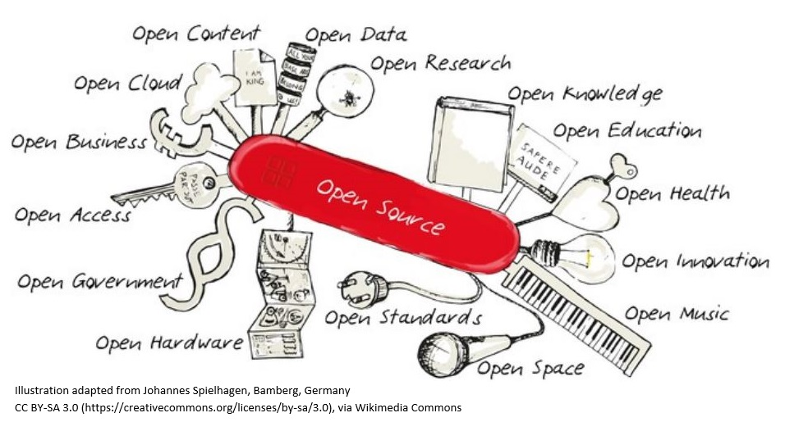
How can we lead our libraries in the world of openness?
ness

Slide 14
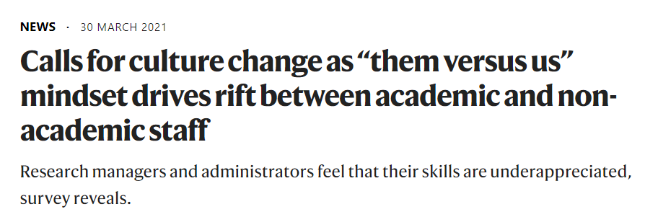
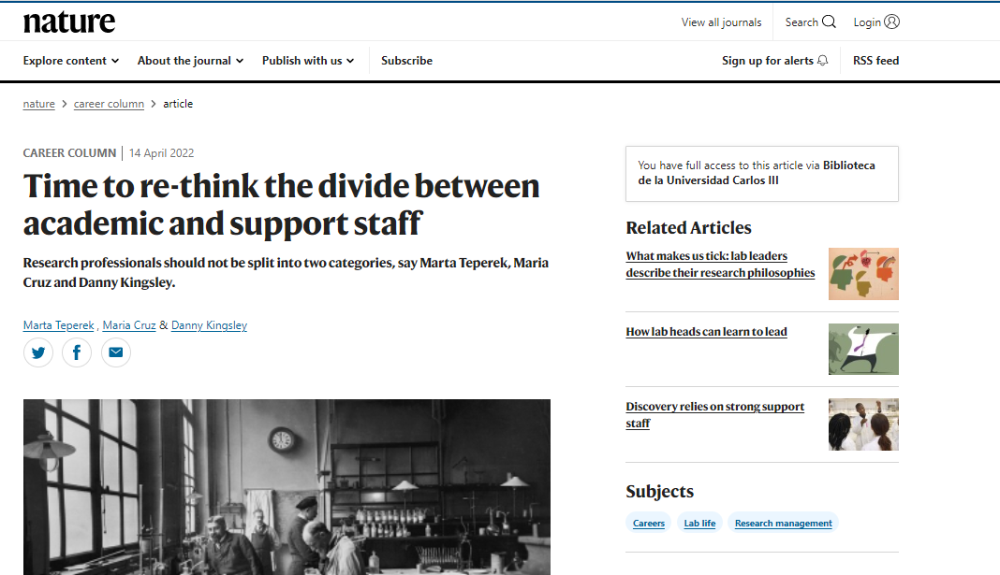
https://www.nature.com/articles/d41586-022-01081-8

Slide 15
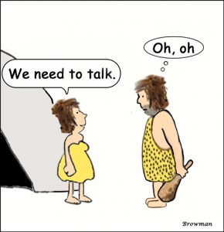
Something is going to CHANGE…
Source: http://yourvibrantlife.ca/we-need-to-talk-2

Slide 16
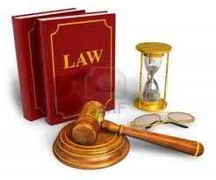

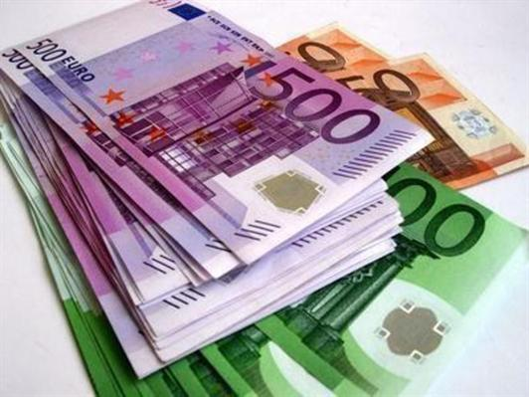

Motivators of will… (for academics)
Seduction

Slide 17


Open Science under Horizon Europe
Evolution of OS policies across FPs
Under Horizon Europe (2021)
Open Science (OA, RDM, Citizen Engagement, etc.) embedded across the FP
  Evaluation of proposals (excellence –methodology-, quality & efficiency of implementation )
  Grant Agreement, guidelines
  Reporting—during the project’s lifetime
  Work programmes
Strengthening of the obligations with respect to open access and focus on responsible RDM in line with FAIR
FP7
OA Pilot
Deposit and open access
H2020
OA Mandatory
Deposit and open access
& ORD/DMP Pilot
H2020
OA Mandatory
Deposit and open access
& ORD/DMP by default
(exceptions)
2017
2014
2008
Notes:
Quality of open science practices evaluated under ‘Excellence’ >methodology [both mandatory and recommended practices]
Up to 1 page to describe OS practices + up to 1 page to describe research data/output management
Capacity of participant/consortium + List of achievements evaluated under ‘Quality and efficiency of the implementation’
Explain expertise related to OS
List publications, software, data etc. relevant to project with qualitative assessment, PIDs; Publications expected to be open access; datasets are expected to be FAIR and ‘as open as possible, as closed as necessary‘; significance of publications to be evaluated on basis of proposers’ qualitative assessment and not per JIF.

Slide 18
Towards a new modus operandi for Science
Current System (dominant) |  | Open Science
Rewarding individual competing scientists - gaining scientific prestige |  | Rewarding collaboration and sharing to achieve societal impact (e.g. Covid-19)
Publish as much and as fast as possible (publish or perish!) |  | Share knowledge/data as early and as openly as possible
Excellence defined largely on the basis of where scientists publish |  | Composite definition of excellence
Incentivises researchers to produce specific outputs (mainly publications) | Use of quantitative metrics | Incentivises researchers to share, collaborate, increase quality and impact; while considering diversity of outputs and research cultures | Use of qualitative and quantitative metrics
Slide from EC. Open Science Unit

Slide 19
Horizon Europe goes beyond open access to publications & data (and more)
  It clarifies and strengthens OA requirements to empower researchers and their institutions
  It shifts the emphasis from research data to responsible RDM with DMP, FAIR and open data sharing, under the principle ‘as open as possible, as closed as necessary’
  It mainstreams Open Science practices beyond open access, such as science communication and citizen science
  Open Science will be embedded throughout the Framework Programme: elements included in the evaluation of proposals (EXCELLENCE)

Slide 20
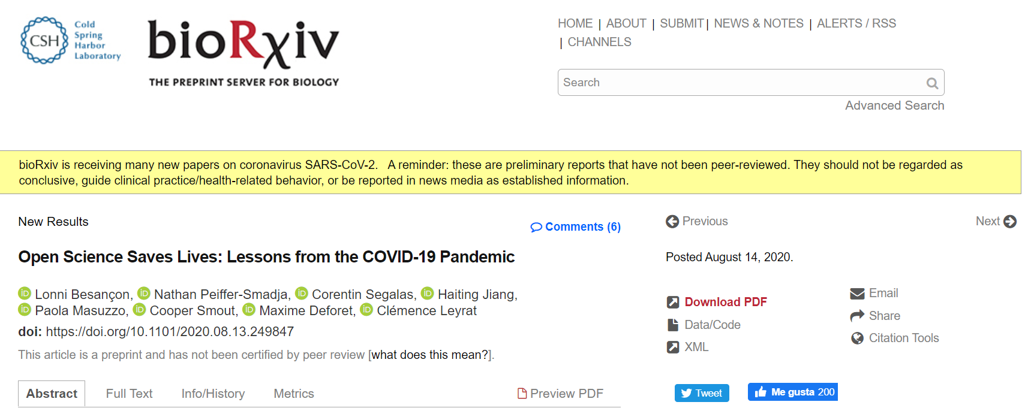
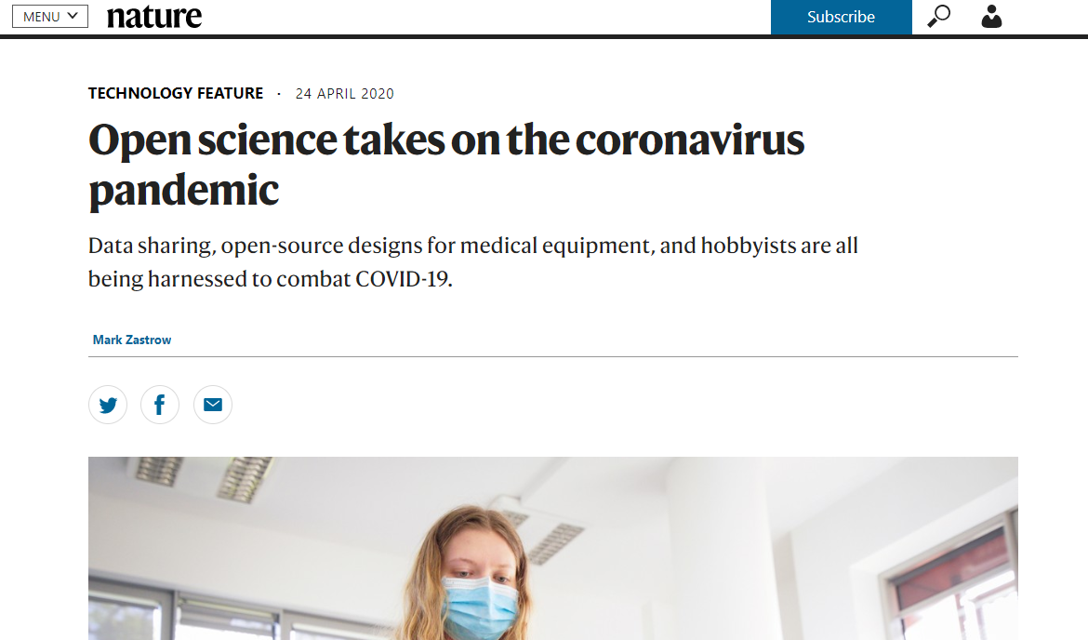
Did we learn something?
https://www.biorxiv.org/content/10.1101/2020.08.13.249847v1
https://www.nature.com/articles/d41586-020-01246-3

Slide 21
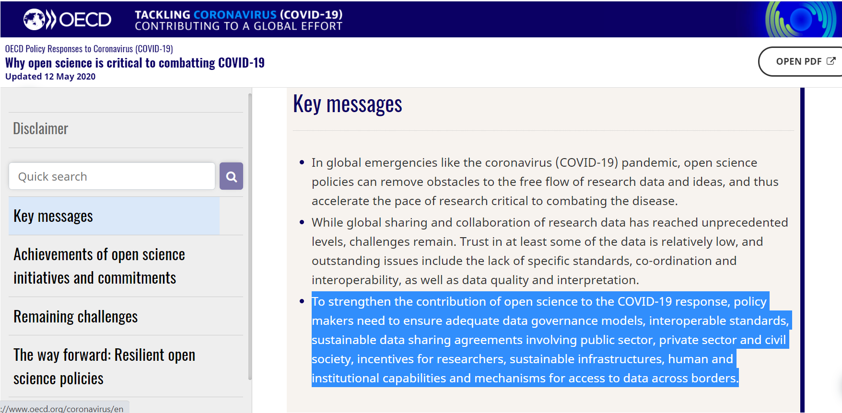
To strengthen the contribution of open science to the COVID-19 response, policy makers need:
to ensure adequate data governance models, interoperable standards,
sustainable data sharing agreements involving public sector, private sector and civil society,
incentives for researchers,
sustainable infrastructures,
human and institutional capabilities and mechanisms for access to data across borders.
http://www.oecd.org/coronavirus/policy-responses/why-open-science-is-critical-to-combatting-covid-19-cd6ab2f9/#boxsection-d1e24

Slide 22
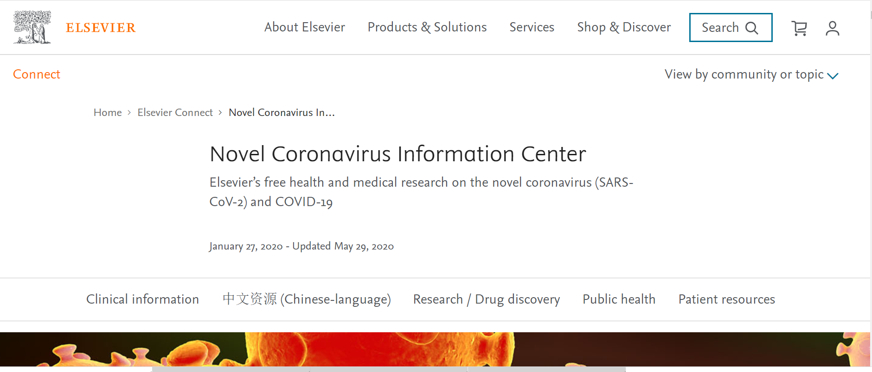
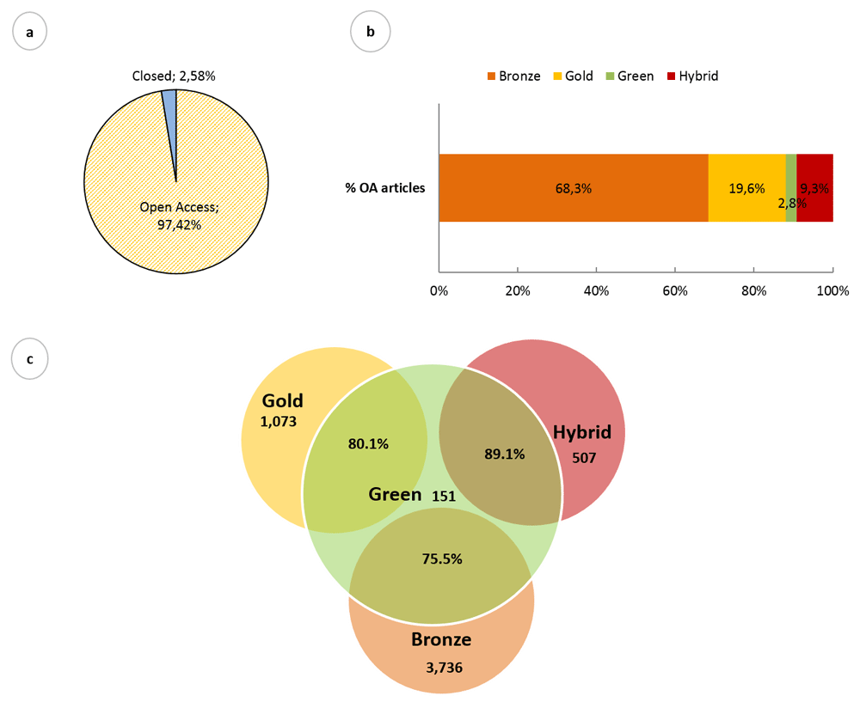
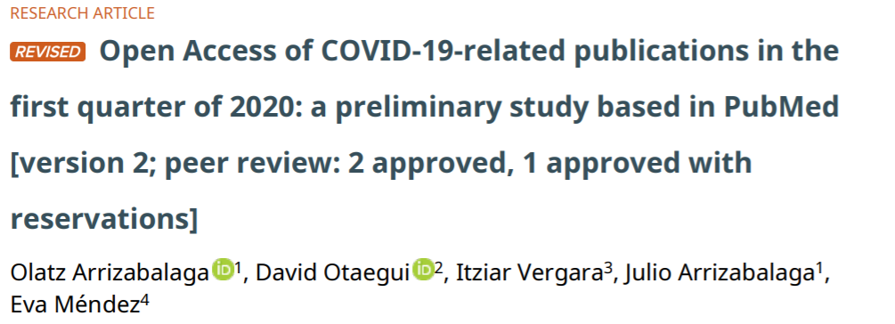
COVID-19: open vs OPEN
https://doi.org/10.12688/f1000research.24136.2

Slide 23
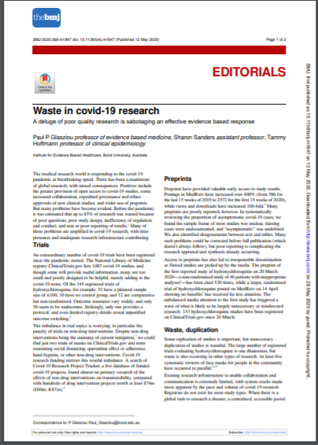
COVID-19: OPEN vs GOOD…
Waste in covid-19 research A deluge of poor quality research is sabotaging an effective evidence based response
https://www.bmj.com/content/bmj/369/bmj.m1847.full.pdf

Slide 24
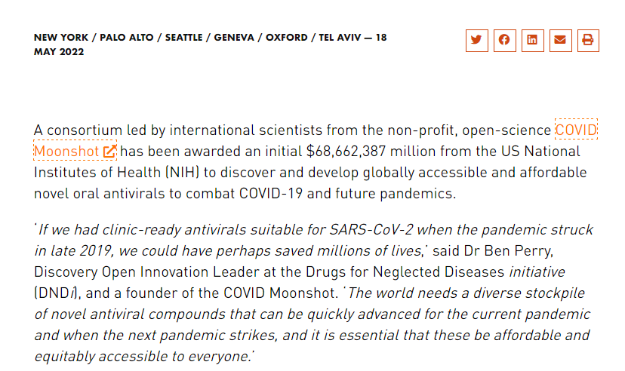
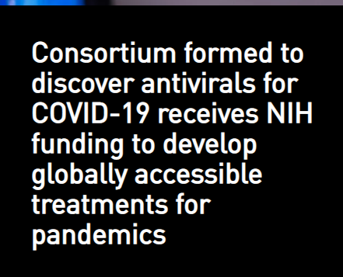
COVID-19 will advance Open Science
… and Open Science will advance COVID-19 research
https://dndi.org/press-releases/2022/consortium-to-discover-antivirals-covid19-receives-nih-funding-develop-globally-accessible-treatments-pandemics/

Slide 25
Revisiting OS Challenges @ERA

Slide 26
Cha[lle]nges = Building blocks
Removing barriers and creating incentives (alternative/next generation metrics, research integrity, TDM (Text and Data Mining).
Developing infrastructures for Open Science (e.g. European Open Science Cloud, EOSC).
Embedding Open Science in Society (citizen science, public engagement… knowledge coalitions to address societal challenges).
NEW ERA → Revisiting the challenges/pillars & PCIs

Slide 27
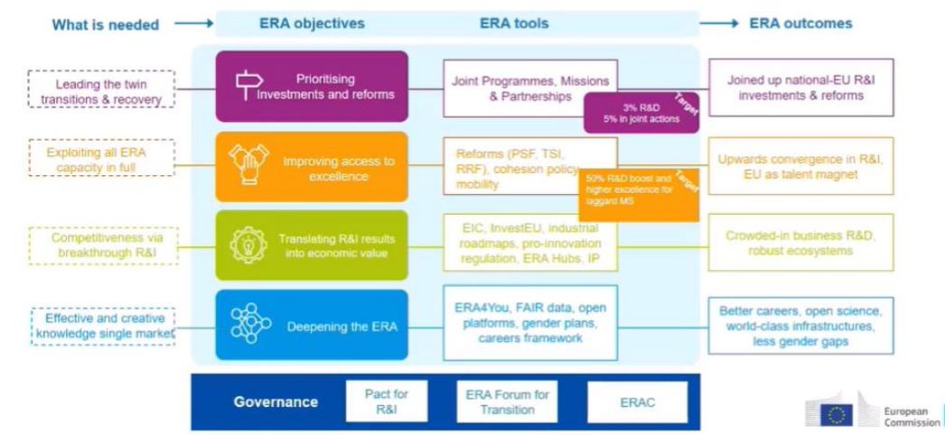
European Research Area

Slide 28

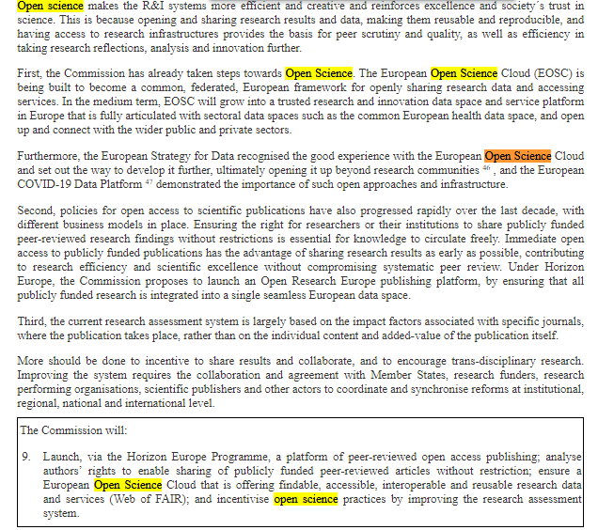
COMMUNICATION FROM THE COMMISSION TO THE EUROPEAN PARLIAMENT, THE COUNCIL, THE EUROPEAN ECONOMIC AND SOCIAL COMMITTEE AND THE COMMITTEE OF THE REGIONS
A new ERA for Research and Innovation

Slide 29







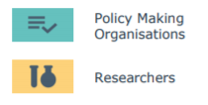
Rewards and Incentives
FAIR DATA
EOSC
FSP (Future of Scholarly Communication)
Next Generation metrics (new indicators)
Rewards and Incentives
Research Integrity
Education and Skills
Citizen science
Stakeholders / Actors of Open Science
Open Science challenges / pillars in EUROPE

Slide 30
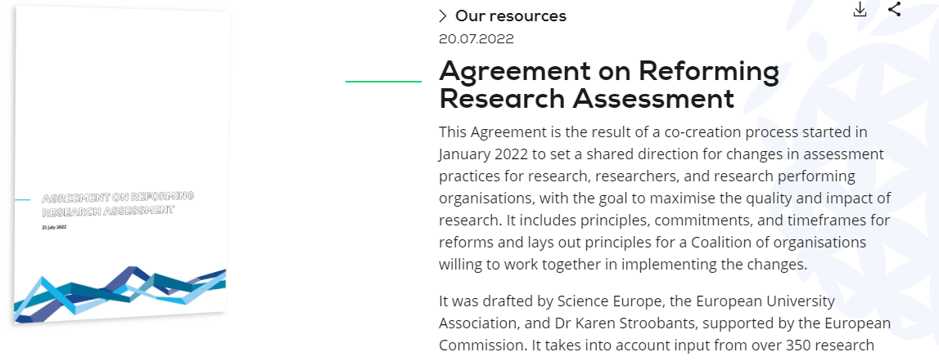
https://www.scienceeurope.org/media/y41ks1wh/20220720-rra-agreement.pdf
https://coara.eu

Slide 31
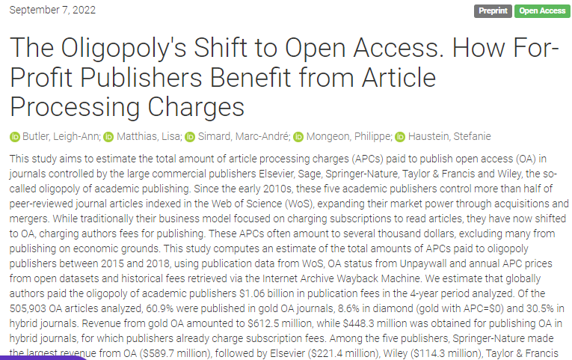
https://zenodo.org/record/7057144#.YyBwFHbP3IW

Slide 32
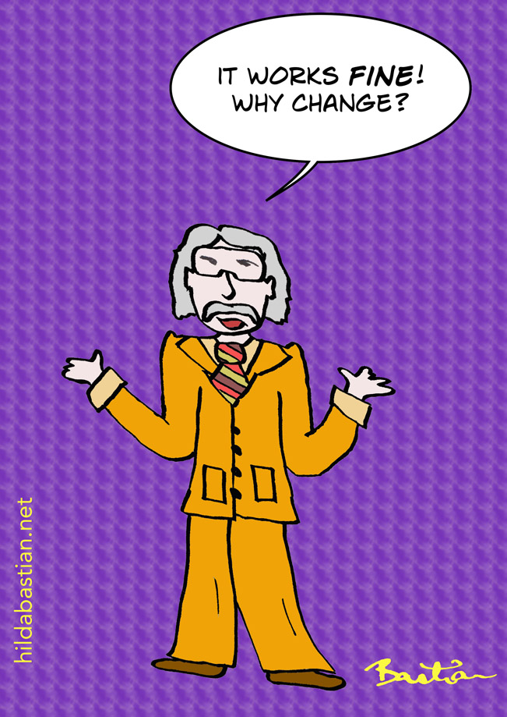
Urgent changes
    The way we communicate science (papers)
    The way we evaluate Science (JIF)
    The way we give credit (copyright)
https://absolutelymaybe.plos.org/2019/01/17/open-access-2018-a-year-of-funders-and-universities-drawing-lines-in-the-sand/

Slide 33
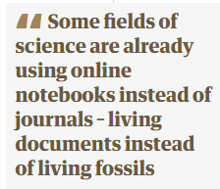
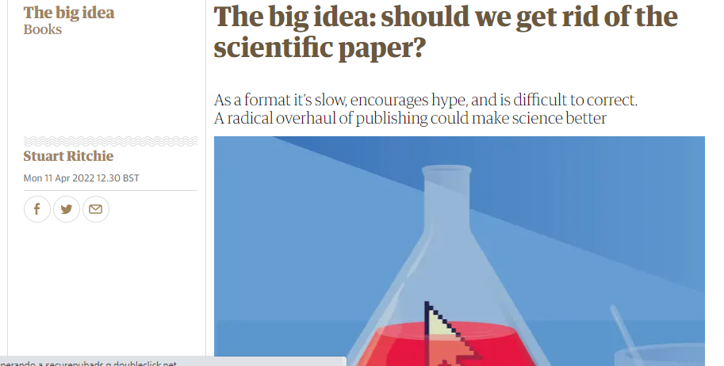
    The way we communicate science (papers)
https://www.theguardian.com/books/2022/apr/11/the-big-idea-should-we-get-rid-of-the-scientific-paper

Slide 34
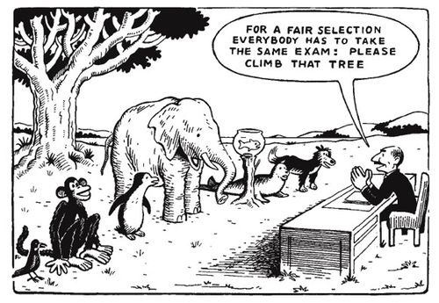
    The way we evaluate science
https://www.quora.com/What-did-Albert-Einstein-mean-when-he-said-Everybody-is-a-genius-But-if-you-judge-a-fish-by-its-ability-to-climb-a-tree-it-will-live-its-whole-life-believing-that-it-is-stupid

Slide 35
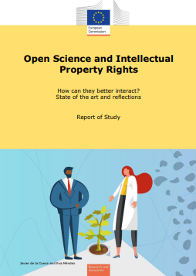
    The way we give credit
    From IPR to knowledge valorization
Therefore, the Mertonian CUDOS, … institutional imperatives, cannot be achieved with digital technologies if IP, instead of being a system of rewards, consists in a system of payments not to the contributors to science but to intermediaries only interested in monetary income… (p. 50)
https://ec.europa.eu/info/sites/default/files/research_and_innovation/research_by_area/documents/ec_rtd_open-science-and-ip-report.pdf
Notes:
Communism, Universalism, Disinterestedness and Organised Scepticism
The Strategic Research and Innovation Agenda of the EOSC is a key document in the development of the EOSC and all the developments in Europe towards a common federated infrastructure of FAIR research data. The agenda quotes Merton’s CUDOS norms (see Section 3.1) and also reflects the statements of the EIF, relevant to creating an interoperable metadata framework, for ensuring openness and interoperability across disciplines while respecting privacy and security (copyright status, disclosure limitations, patents pending, other IPR on the data sets or workflows, the existence of personal data, designation of data as public sector information).

Slide 36
The strategy: PCIs

Slide 37
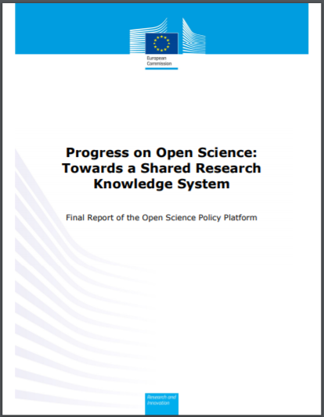
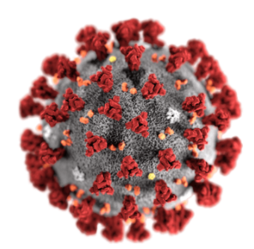
OSPP: Final report
PCI (Practical Commitments for Implementation)
@stakeholder level
From “declaration mode” → to “implementation mode”
You, at your institution, at your office, with your attributions, etc. what can you do for Open Science? (regarding the 8 challenges, and taking into account your condition as stakeholder…)
    I am a researcher….
    I am a publisher…
    I am a research infrastructure manager…
    I am a librarian, etc.
https://ec.europa.eu/research/openscience/pdf/ec_rtd_ospp-final-report.pdf#view=fit&pagemode=none
Notes:
Commitments regarding any aspect (challenge) of Open Science
Actual, realistic and affordable… in a level where the proponent has “jurisdiction”
Effect → real implementation
They answer to the question: What CAN I do to make Open Science happen?
Open science at “action level” (practical)

Slide 38
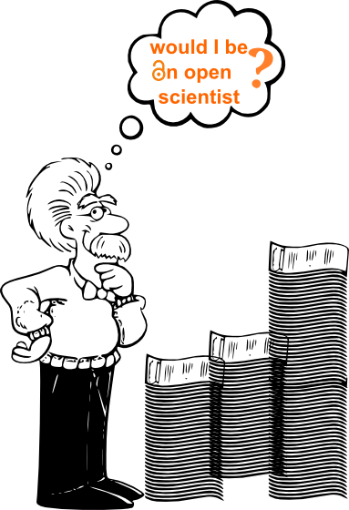
Open Science @University Libraries managinga complex change
How to incentivize the systemic change?
How does it affect our researchers? → Promotion, research assessment…
How does it affect our research infrastructures?→ New ones?
How does it affect our T&Learning? → Data literacies? (skills)
How does it affect to our researcher’s behavior (research integrity)
→ Public Institutions + Transparency

Slide 39
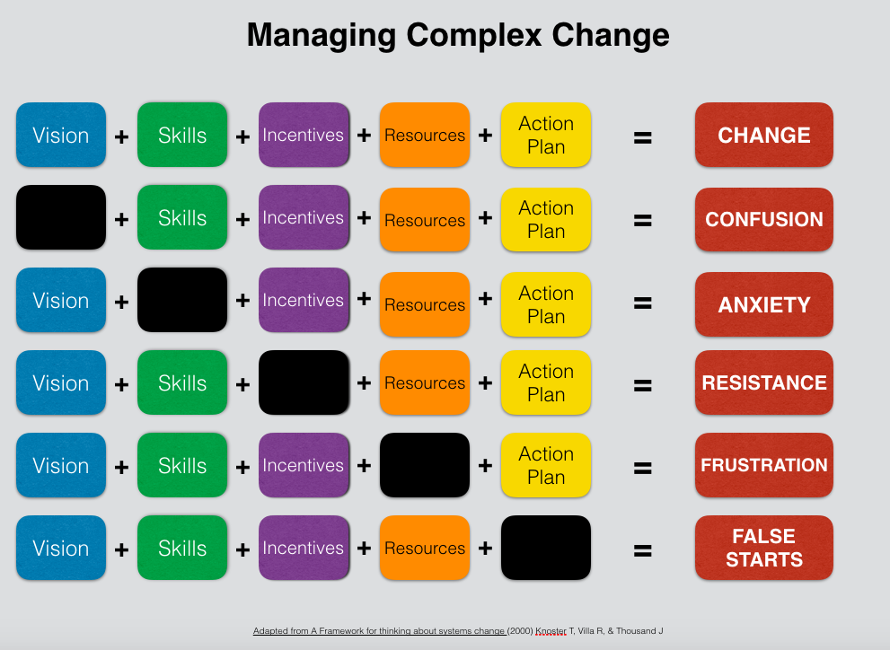
Based in Knoster Model

Slide 40
Take away… for the FUTURE

Slide 41
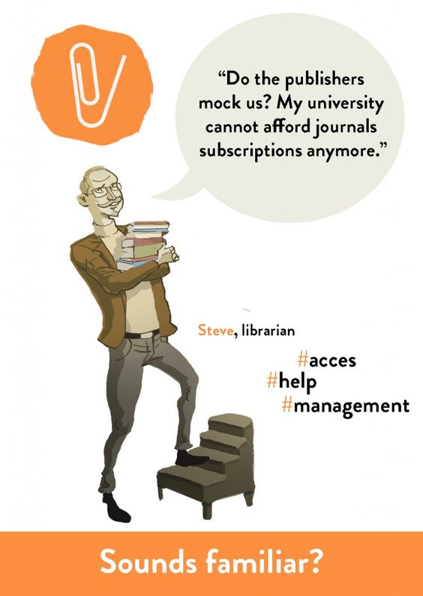
… We cannot aford APCs trick either [NOT equity]
RaP & PaR → not the solution!!!
Rewards System → Seduction
Education → no false Friends
Publications + Data → FAIR data
& reproducibility

Slide 42

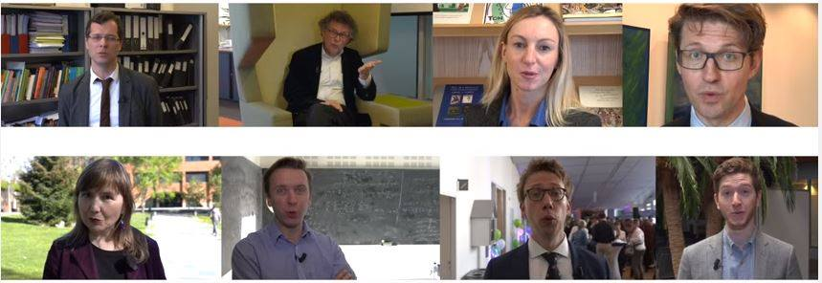
And you?...
What are you going to do?
Introduction video: Conference Open Science 4- 5 April 2016, Dutch Presidency EU2016: https://www.youtube.com/watch?v=C9a3Ap3yyak [Amsterdam Call for Action]
Notes:
Who can legitimately decide on the “right kind of openness”

Slide 43
Thank you!!
http://databib.org
@evamen
emendez@bib.uc3m.es
Notes:
43

