Slide 1
Are There Users for Open Science in the Government?
Arko Olesk, Esta Kaal, Kristel Toom
Tallinn University
RDA Estonia seminar, 6.04.2020

Slide 2
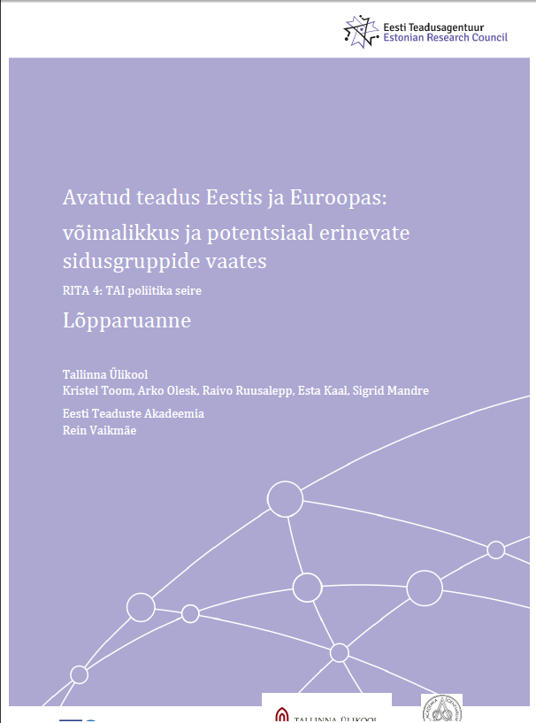
Background
Study for Estonian Ministry of Science and Education and Estonian Research Council about the possibility and potential of Open Science in Estonian science (2017).
Open Science:
  Open-access publishing
  Open research data

Slide 3
2017 study
Document analysis – practices across Europe
Web survey among Estonian scientists (n=671)
Individual and focus groups interviews with Open Science stakeholders (scientists, representatives of libraries, universities, funding agencies, ministries; 12 interviews with 38 people)
Web surveys among science councillors of ministries (n=7) and NGOs (n=7)
Whom do stakeholders consider the users and beneficiaries of Open Science?

Slide 4
Results
High support (3.92/5) for the claim: „the demand of state/sponsor that the results of scientific work should be open access is the correct path“
Barriers to Open Science:
  Money and other resources
  Lack of motivation (current situation good enough)

Slide 5
Results: motivation of researchers
2/3 believe someone else could be interested in their data
„Do you consider that open access to data or scientific articles is necessary to other groups in society? If yes then for whom (politicians, civil servants, journalists, etc.) and why?“
  „No“
  „Definitely“
  „Yes, but…“
Experiences with policy-making have not been encouraging

Slide 6
Open Science and policy making
„[I]ncreased access to scholarly outputs might help foster a culture of greater scientific education and literacy, which in turn could have a direct impact on public policy, particularly in domains such as climate change and global health, as well as increasing public engagement in scientific research“ (Tennant et al. 2016).
Influence that research has on policy makers is most likely to come about through an extended process of communication between researchers, policy makers and lay actors (Elliott & Popay 2000).

Slide 7
Scientific councillors in ministries
Since 2016; link between R&D community and the ministry
  Advising the ministry on R&D matters;
  Planning and managing international and national R&D collaborations;
  Developing a research programme for the field and putting it into practice with various partners;
  Representing Estonia in various international R&D initiatives.
RQ: How do the scientific councillors see the role of Open Science in the knowledge transfer between research and policy?
In-depth interviews with science councillors (SCs)) of ministries (n=10)

Slide 8
Results: SCs as users of Open Science
Open-access
See themselves as „knowledge brokers“
SCs call lack of access to scientific papers „a real frustration“
  frequently use alternative options
Believe there would be more users in the public sector

Slide 9
Results: SCs as users of Open Science
Open Data
data are valuable and should be used more in policy-making
a lot of relevant data already exists and should be used better
SCs personally lack data skills and other resources
in many cases the government has better, newer and more encompassing data than scientists

Slide 10
Conclusion and further questions
Lack of common understanding about Open Science benefits among stakeholders
Experience of societal users could increase motivation of researchers for Open Science
SCs as well-placed “knowledge-brokers“
How is Opeen Science actually used in actual policy-making process? Wor what topics is it most relevant/useful?
Government as a role model in Open Science

Slide 11
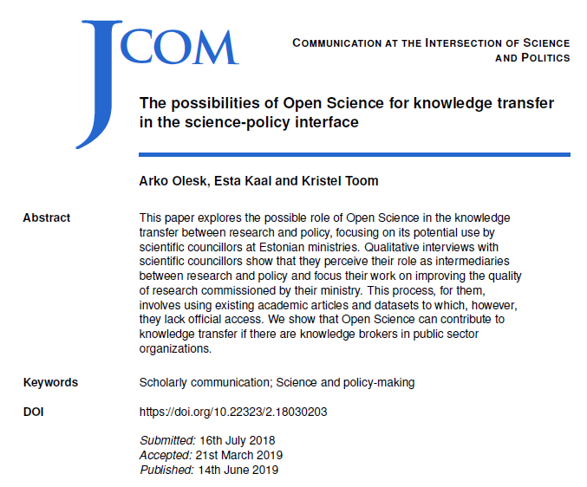
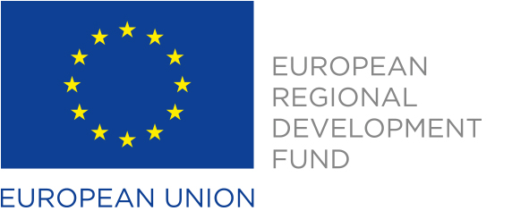
Thank you!
Article published in Journal of Science Communication
Corresponding author: arko.olesk@tlu.ee

