Slide 1
Librarians in the Loop: the future of research libraries in a data-driven world
MacKenzie Smith
University Librarian
University of California, Davis

Slide 2
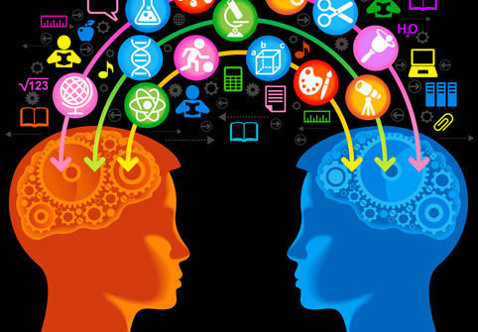

Slide 3
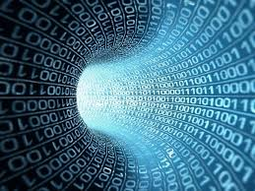

Slide 4


Slide 5
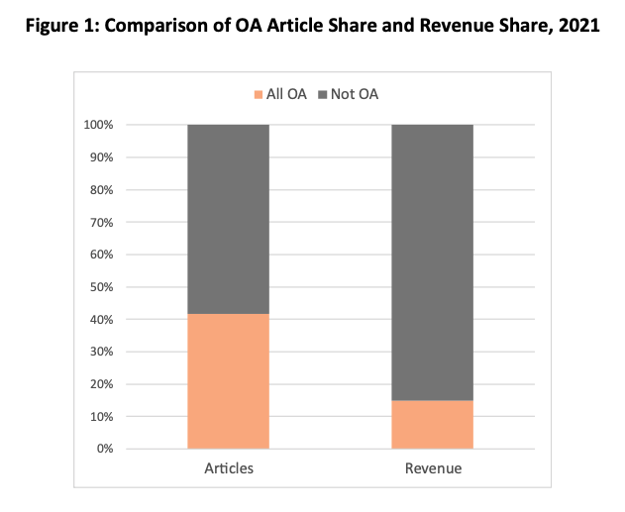
Delta Think: Open Access Market Sizing Update 2022

Slide 6


Slide 7
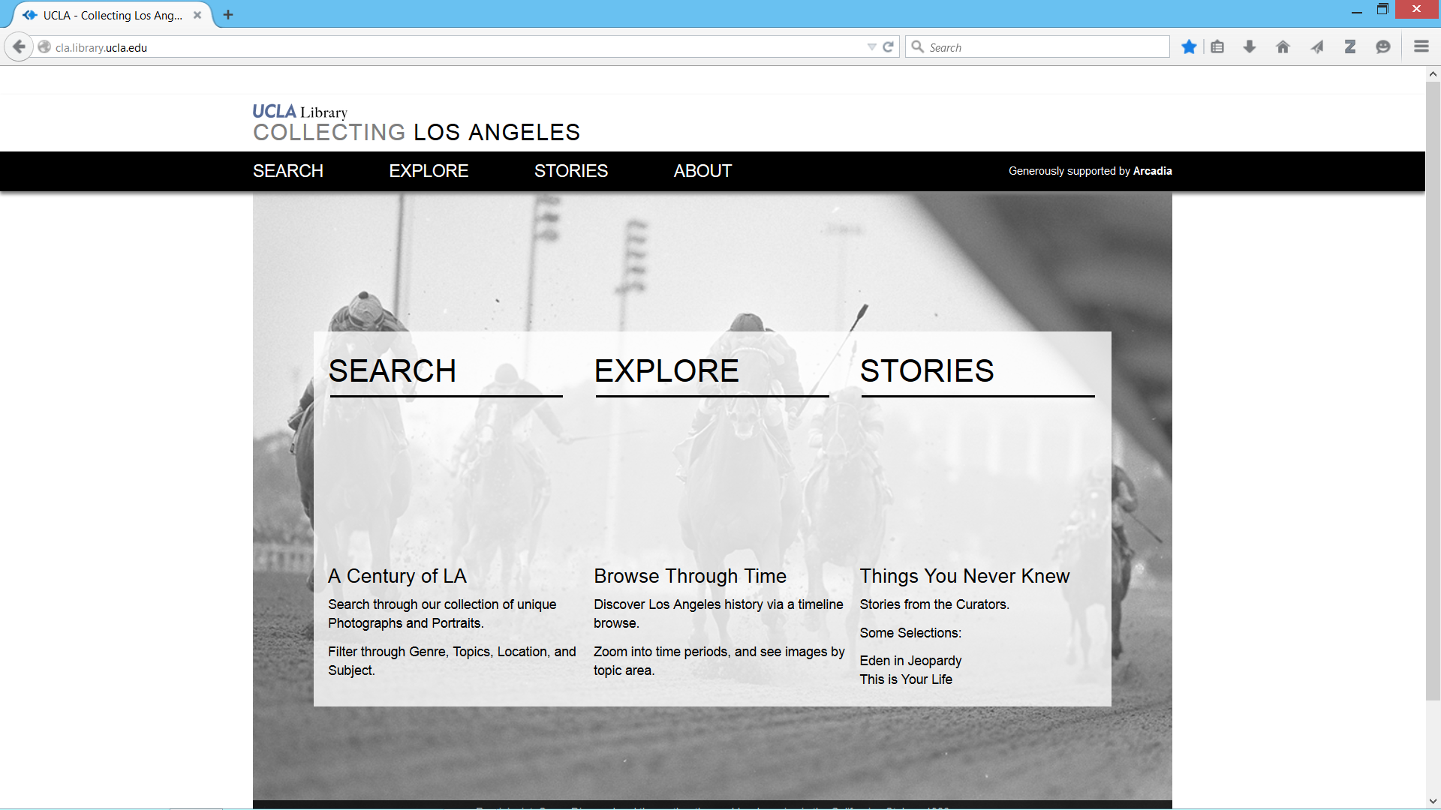

Slide 8
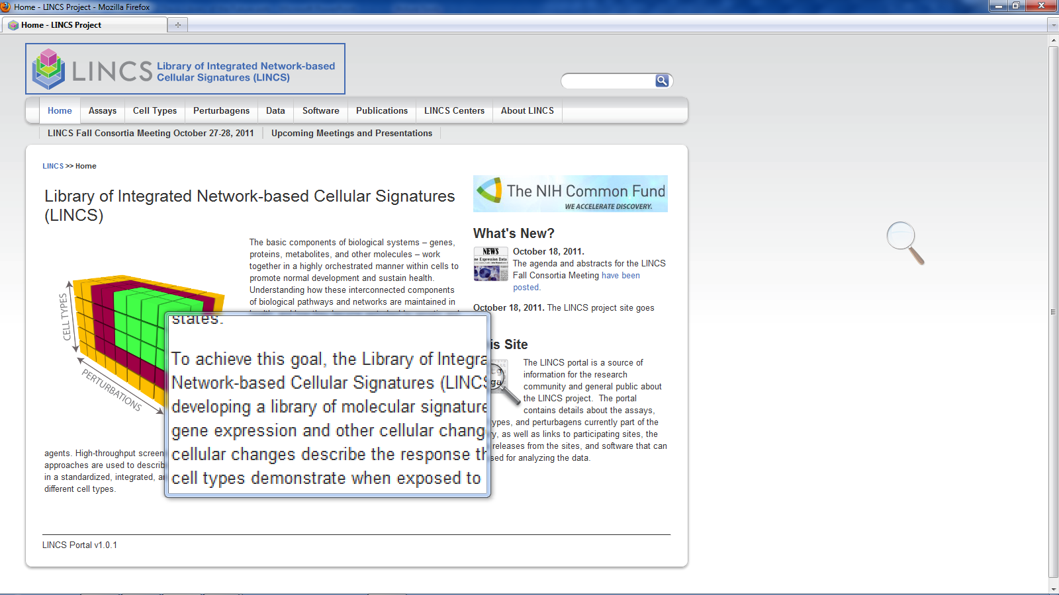
http://lincsproject.org/index

Slide 9


Slide 10
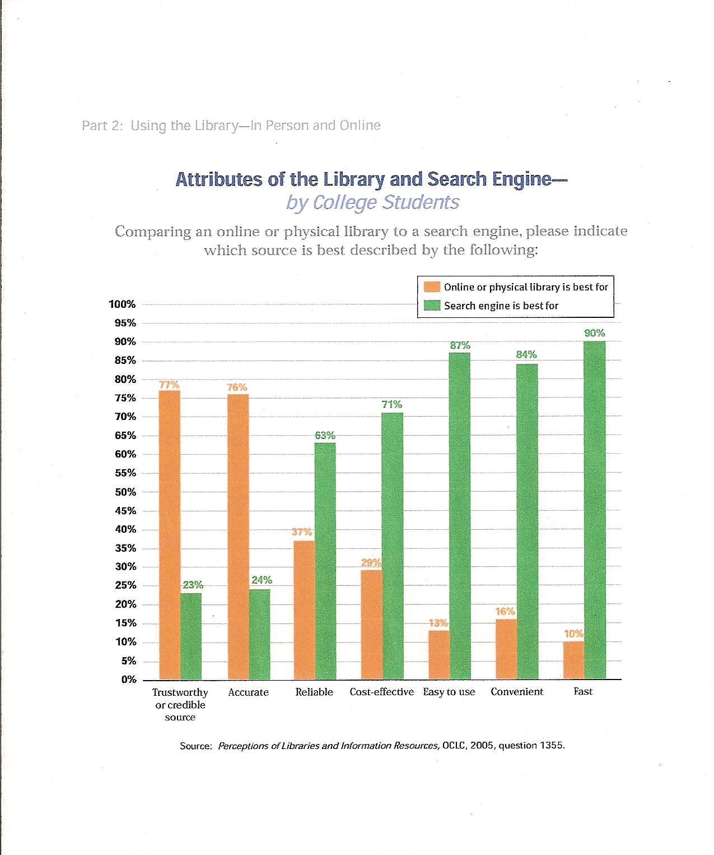

Slide 11
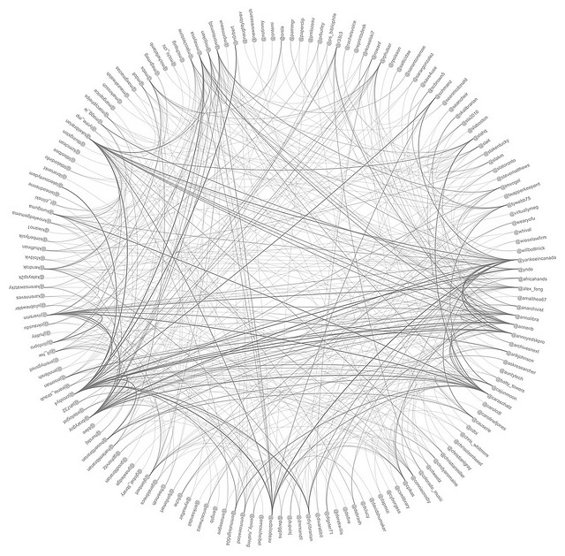
The Web and Linked Data

Slide 12
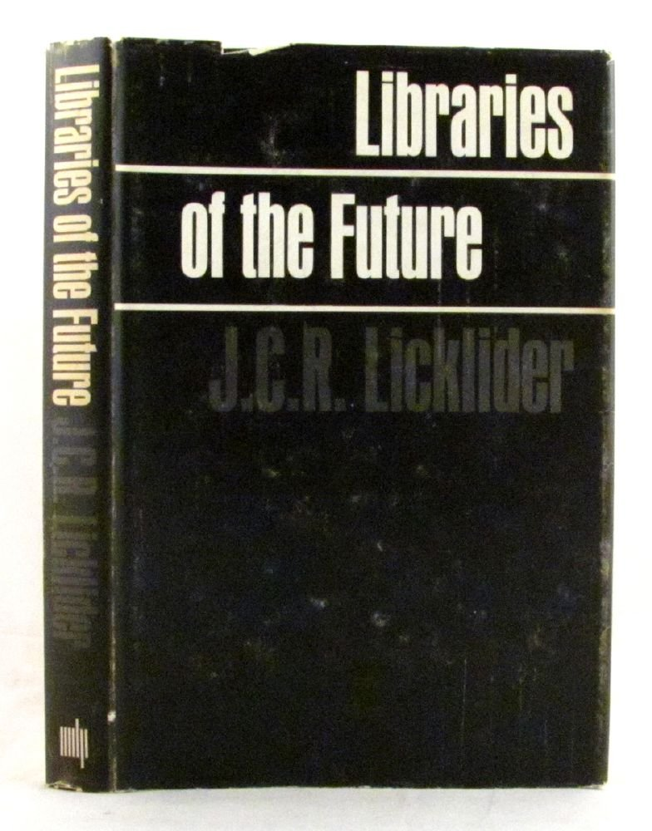
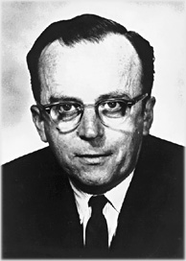
J.C.R. Licklider
Psychologist, Computer Scientist
Joseph Carl Robnett Licklider, known simply as J. C. R. or "Lick", was an American psychologist and computer scientist who is considered one of the most important figures in computer science and general computing history.

Slide 13
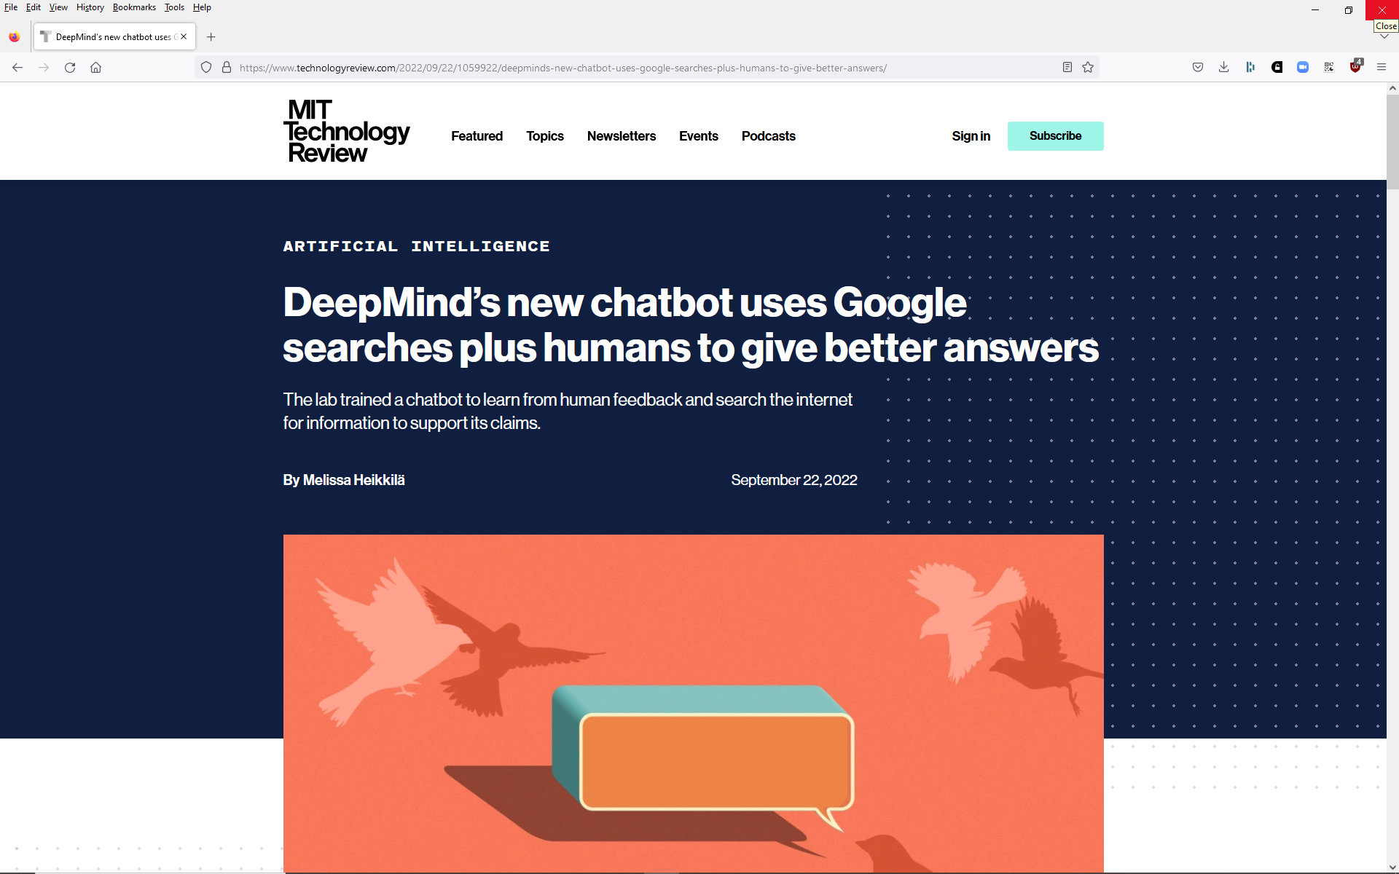

Slide 14


