Slide 1

Good Practice in Research Data Management
Stuart Macdonald
Research Data management Services Coordinator & Associate Data Librarian
University of Edinburgh
stuart.macdonald@ed.ac.uk

Slide 2
Running order
Introductions
Research data explained
Research data management & data management plans (DMPs)
Organising data
File formats & transformation
Documentation & metadata
Coffee break
Storage & security
Data protection, rights & access
Sharing, preservation & licensing

Slide 3
Research data

Slide 4
Defining research data
Research data are collected, observed or created, for the purposes of analysis to produce and validate original research results.
Both analogue and digital materials are ‘data’.
Lab notebooks and software may be classed as ‘data’.
Digital data can be:
  created in a digital form ('born digital')
  converted to a digital form (digitised)

Slide 5
Research data can also be regarded as situational i.e. the same digital information or materials may be data for some research questions but not others
Data can also be created by researchers for one purpose and used by another set of researchers at a later date for a completely different research agenda.

Slide 6
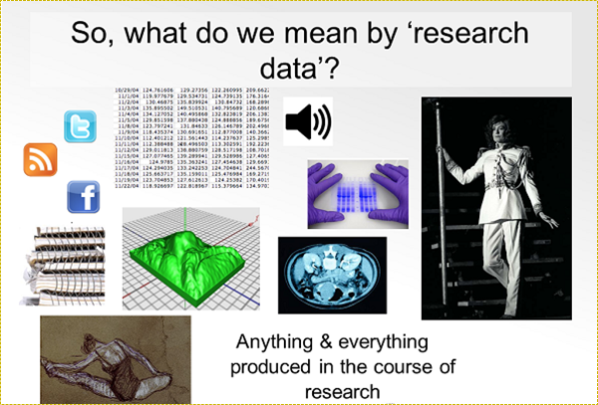
Types of research data
Instrument measurements
Experimental observations
Still images, video and audio
Text documents, spreadsheets, databases
Quantitative data (e.g. household survey data)
Survey results & interview transcripts
Simulation data, models & software
Slides, artefacts, specimens, samples
Sketches, diaries, lab notebooks …

Slide 7
Research data management & data management plans (DMPs)

Slide 8
Research data management
Research data management is caring for, facilitating access to, preserving and adding value to research data throughout its lifecycle.
Data management is part of good research practice.
Good research needs good data!

Slide 9
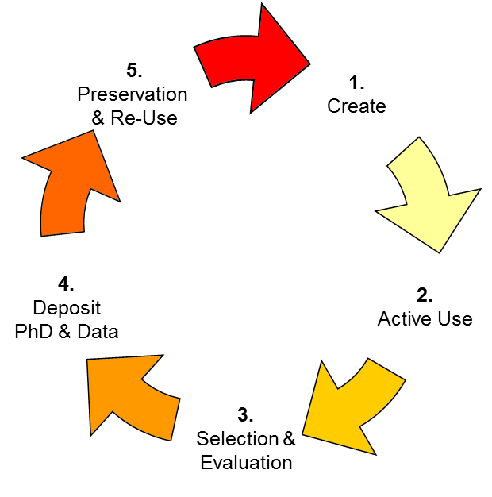

Activities involved in RDM
Data management Planning
Creating data
Documenting data
Storage and backup
Sharing data
Preserving data

Slide 10
Why manage your data well?
So you can find and understand it when needed.
To avoid unnecessary duplication.
So you can finish your PhD!
To validate results if required.
So your research is visible and has impact.
To get credit when others cite your work.

Slide 11
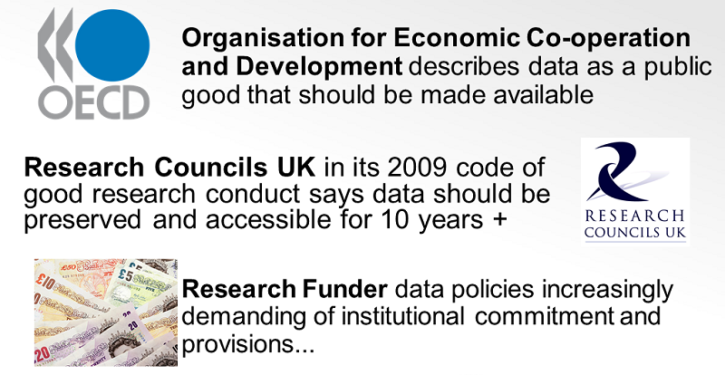
Drivers

Slide 12
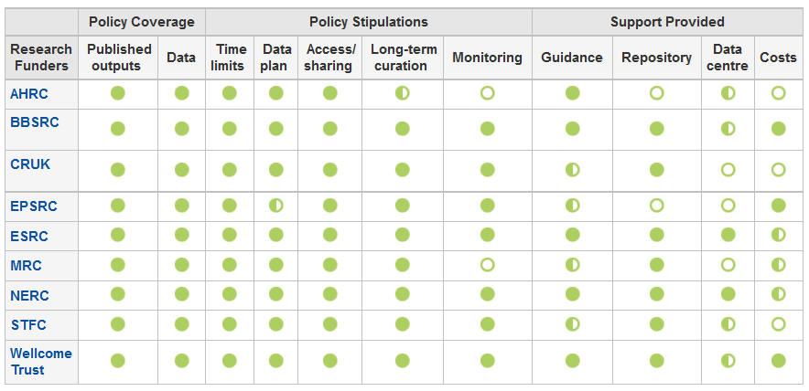
Funder policies
http://www.dcc.ac.uk/resources/data-management-plans/funders-requirements
http://www.dcc.ac.uk/resources/policy-and-legal/overview-funders-data-policies

Slide 13
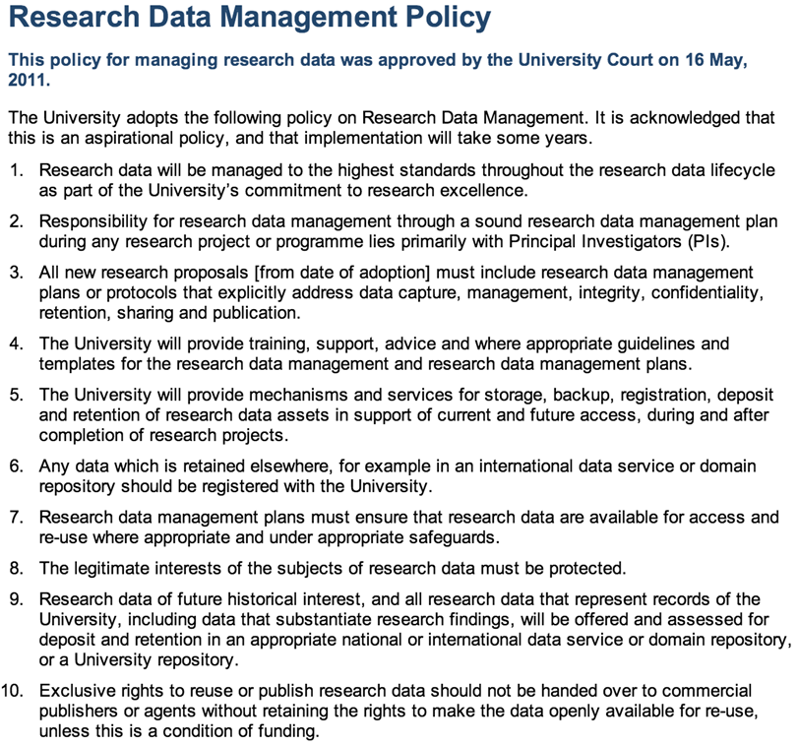
University’s RDM Policy
University of Edinburgh is one of the first few Universities in UK who adopted a policy for managing research data: http://www.ed.ac.uk/is/research-data-policy
The policy was approved by the University Court on 16 May 2011.
It’s acknowledged that this is an aspirational policy and that implementation will take some years.
http://www.ed.ac.uk/is/research-data-policy

Slide 14
What is a DMP
DMPs are written at the start of a project to define:
What data will be collected or created?
How the data will be documented and described?
Where the data will be stored?
Who will be responsible for data security and backup?
Which data will be shared and/or preserved?
How the data will be shared and with whom?
DMPs are often submitted as part of grant applications, but are useful whenever you are creating data.

Slide 15
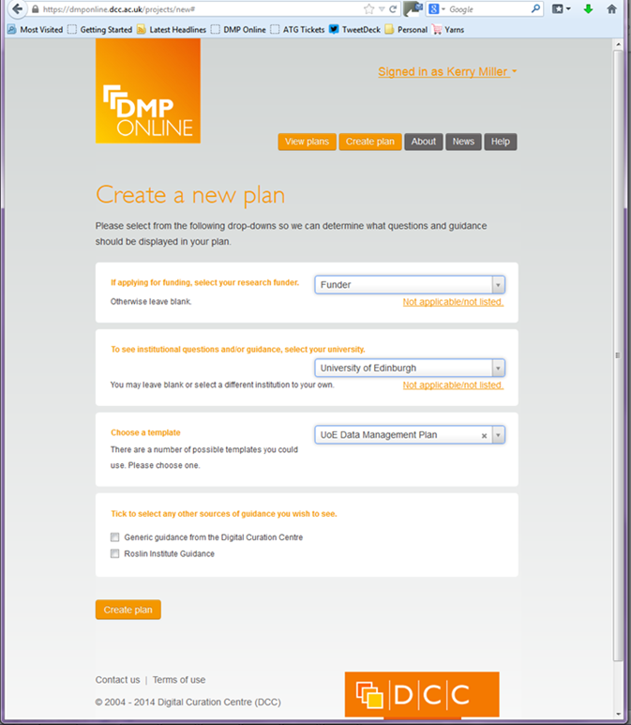
DMPonline
Free and open web-based tool to help researchers write plans: https://dmponline.dcc.ac.uk/
It features:
  Templates based on different requirements
  Tailored guidance (disciplinary, funder etc.)
  Customised exports to a variety of formats
  Ability to share DMPs with others
DMPonline screencast:
http://www.screenr.com/PJHN

Slide 16
Tips to share
Keep it simple, short and specific.
Avoid jargon.
Seek advice - consult and collaborate.
Base plans on available skills and support.
Make sure implementation is feasible.
Justify any resources or restrictions needed.
Also see: http://www.youtube.com/watch?v=7OJtiA53-Fk

Slide 17
Organising data

Slide 18
Why?
To ensure your research data files are identifiable
* by you and others in the future*
Organising and labelling your research data files and folders will help to:
  prevent file loss through overwriting, deleting, misplacing
  facilitate location and future retrieval
  save you time (mostly in the future)
  It’s good research practice!

Slide 19
How?
With an organised, consistent & disciplined approach:
    Setting conventions at the start of your project
    Establishing a good directory structure
    Appropriate file naming & renaming conventions – don’t make it up as you go along!
    File version control - a clear audit trail exists for tracking the development of a data file and identifying earlier versions
Project_1

Slide 20
File naming
  Good file naming will:
  Provide context for the contents (describe your file)
  Distinguish files from each other (different versions too)
  Good file names:
  Avoid special characters (“£$%!”¬&*^()+=[]{}~@:;#,.<>)
  Use_underscores_rather_than spaces
  Include date of creation or modification eg. YYYY_MM_DD
  Be consistent!

Slide 21
Version control
  Useful
  Provides audit trails (versions are identifiable and trackable)
  Files are easier to locate, browse and sort by you and others
  Files retain a useful context if moved to other storage platforms (eg. data repository)
Suggested strategies
Use sequential number system ( FileName_Date_v1, _v2, _v3)
Avoid potentially confusing labels (FileName_final, _final2)
Discard obsolete versions (but NEVER the raw copy!)
Use auto-backup system, rather than archiving yourself

Slide 22
File formats & transformation

Slide 23
File formats
Formats encode information in a standard form to enable another programs to access data within it.
  Example: .html, .csv, .jpeg, .tex, .pdf
Files encoded as text or binary files:
  Text encoding: machine- and human-readable. Less likely to become obsolete .txt, .csv, .html, .xml, .tex, etc.
  Binary encoding: only readable with appropriate software .fcp, .xlxs, .docx, .psd, .nc, etc.

Slide 24
Recommended formats
Type | Recommended | Avoid for sharing
Tabular data | CSV, TSV, SPSS portable | Excel
Text | Plain text, HTML, RTF, PDF/A only if layout matters | Word
Media | Container: MP4, Ogg Codec: Theora, Dirac, FLAC | Quicktime, H264
Images | TIFF, JPEG2000, PNG | GIF, JPG
Structured data | XML, RDF | RDBMS
See also UKDA File Formats Table: http://www.data-archive.ac.uk/create-manage/format/formats-table

Slide 25
File format migration
If you need to convert or migrate your data files (change the format) be aware of the potential risk of loss or corruption of your data.
Take appropriate steps to avoid/minimise it
Always test the files you convert or migrate

Slide 26
Data normalisation
You may also use the data normalisation process:
This means to convert data from one format (e.g. proprietary) into another for use or preservation (e.g. ASCII).

Slide 27
Data compression
When compressing your data files (storage, sending, sharing) you encode the information using fewer bits than the original representation.
Compression programs like Zip and Tar.Z produce files such as .zip, .tar.gz, .tar.bz2

Slide 28
Data transformation
When you need to compute new values from your data. Three transformation techniques:
Aggregation (combine data into larger units)
Anonymisation (remove personal information)
Perturbation (distortion) - Example: population data in Census are sometimes released with perturbations as a trade-off for geographical detail.

Slide 29
Documentation & metadata

Slide 30
What it is
Documentation (intending for reading by humans)
  Contextual information
    Aims & objectives of the originating project
  Explanatory material
    data source
    collection methodology & process
    dataset structure
    technical information
Metadata (intended for reading by machines)
  ‘data about data’
  descriptors to facilitate cataloguing and discoverability.

Slide 31
What it does
Documentation
Facilitates understanding and interpretation of your data.
  @ project level
    It explains the background to the research that produced it and its methodologies.
  @ file or database level
    Its describes their respective formats and their relationships with each other.
  @ variable or item level
    It supplies the background to the variables and their descriptions.
Metadata
Provides context for your data, particularly for those outside your research environment, discipline and institution.
Tracks its provenance.
Makes your data easier to find and use.
Makes your data discoverable.
Helps support the archiving and preservation of your data.

Slide 32
Why it is necessary
To help you …
    remember the details of your data
    archive your data for future access & re-use
To help others …
    discover your data
    understand the aims and conduct of the originating research
    verify your findings
    replicate your results

Slide 33

Types of documentation
Varies from project to project and may include:
Laboratory notebooks.
Field notes.
Questionnaires.
Methodologies.
Standard operating procedures.
Reports of decisions made that relate to conduct of the research.

Slide 34
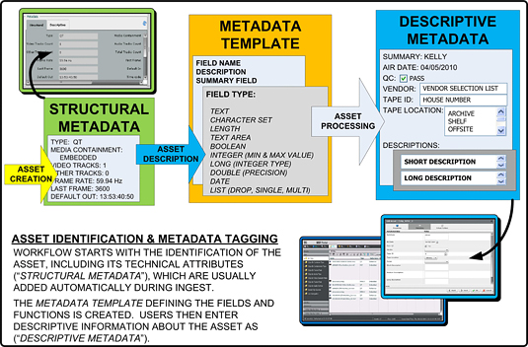
Types of metadata
Categories of metadata
Descriptive
    Title
    Author
    abstract,
    location,
    keywords for discoverability
Administrative
    terms of access
    rights management
    preservation
Structural
    components of the dataset
    their relationship to each other
Acknowledgement: www.tvtechnology.com

Slide 35
Storage & security

Slide 36
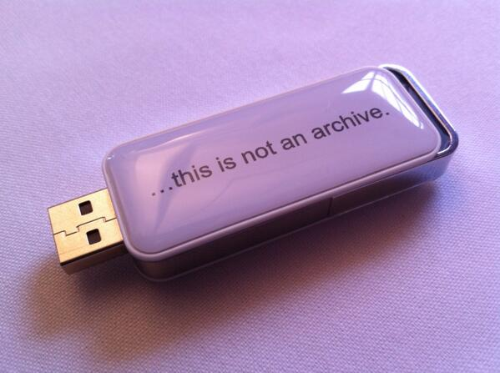
Basic Principles
Use managed, network services whenever possible to ensure:
  Regular back-up
  Data Security
  Accessibility
Avoid using portable HD’s, USB memory sticks, CD’s, or DVD’s to avoid:
  Data loss due to damage, failure, or theft
  Quality control issues due to version confusion
  Unnecessary security risks
Digital preservation Coalition’s new promotional USB stick:
https://twitter.com/digitalfay/status/411444578122600450/photo/1

Slide 37
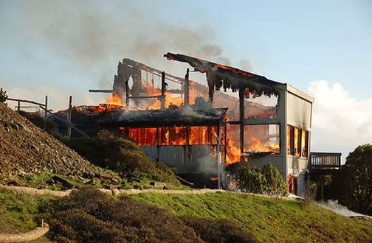
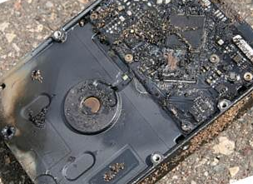
Secure storage & regular backup
  Make at least 3 copies of the data:
    on at least 2 different media,
    keep storage devices in separate locations with at least 1 offsite,
    check they work regularly,
    ensure you know the process and follow it.
  Ensure you can keep track of different versions of data, especially when backing-up to multiple devices.
    Use a versioning software e.g., Tortoise, Subversion
One copy=risk of data loss
CC image by momboleum on Flickr
CC image by Sharyn Morrow on Flickr

Slide 38

Keeping Sensitive Data Secure
Ensure PC’s, laptops, and portable data storage devices are stored securely and encrypted if necessary.
University of Edinburgh Data Encryption policy warns users that "medium and high risk personal data or business information must be encrypted if it leaves the University environment".
However, be aware that any encrypted data will be lost if you lose the password/encryption key or if the disk image is corrupted or the hard disk fails.
System lock: Image by Yuri Yu. Samoilov - Flickr (CC-BY)
https://www.flickr.com/photos/110751683@N02/

Slide 39

Data Disposal
Ensure disposing confidential data securely.
  Hard drives: use software for secure erasing such as BC Wipe, Wipe File, DeleteOnClick, Eraser for Windows; ‘secure empty trash’ for Mac.
  USB Drives: physical destruction is the only way
  Paper and CDs/optical Discs: shredding
The University of Edinburgh has a comprehensive guide to the disposal of confidential and/or sensitive waste held on paper, CDs, DVDs, tapes, discs and other holding devices.
http://www.ed.ac.uk/schools-departments/estates-buildings/waste-recycling/how/confidential-waste

Slide 40
Data protection, rights & access

Slide 41
Things to think about
Ethics
    Requirements relating to data that relates to human subjects.
Privacy, confidentiality & disclosure
Data protection
Intellectual Property Rights (IPR)
Copyright

Slide 42
Ethics
Ethics committees
Review research applications and advise on whether they are ethical.
Safeguard the rights of research participants.
Participants
Must be fully informed as to the purpose, methods and intended uses of the research, and advised of what their involvement will entail.
    NB As funding councils expect that you will be sharing your data, best to include mention of this when consent is obtained.
Their participation must be voluntary, fully informed and free of any coercion.
Confidentiality of information collected and anonymity of subjects must be respected at all times.

Slide 43
Privacy, confidentiality & disclosure
Privacy
An entitlement of the subject.
Subsequent handling, storage and sharing of data must be carefully managed to preserve the privacy of the subject.
Confidentiality
Refers to the behaviour of the researcher, whereby the privacy of the subject is maintained at all times.
Disclosure
Must be guarded against!
Various techniques to avoid it, whether for ethical, legal reasons or commercial reasons, e.g.
    removing identifiers from personal information
    aggregating geographical data to reduce precision
    anonymising data – but without overdoing it!

Slide 44
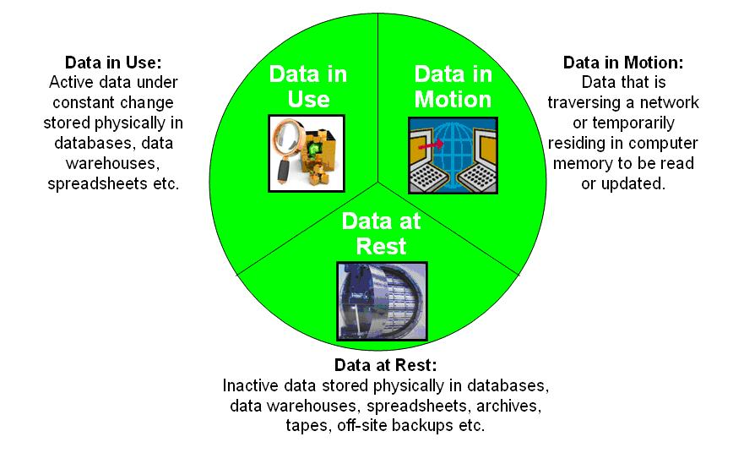
Data protection
1988 Data Protection Act
Research data, specifically what you can do with it, falls within the scope of this Act.
Failure to observe its requirements can get you into a lot of trouble!

Slide 45
Intellectual property rights (IPR)
IPR
Legally recognized exclusive rights and protection for creations of the intellect.
IPR grants exclusive rights to creators to
    Publish a work
    License its distribution to others
    Sue if unlawful copies or use is made of it

Slide 46

Copyright
Can be contentious & complex!
When data are archived or shared, the creator retains copyright.
Where data are then structured within a database as a result of substantial intellection investment, an additional ‘database right’ can also sit alongside the copyright attaching to the data contents.

Slide 47

Freedom of information
The Freedom of Information Act 2000 (FOIA) …
  … gives a right of access to information held by 'public authorities‘, which includes most universities, and
  … covers all records and information held by them , whether digital or print, current or archived.
Therefore a very good idea to anticipate such requests and ensure that your data are ready to meet them!

Slide 48
Sharing, preservation & licensing of data

Slide 49
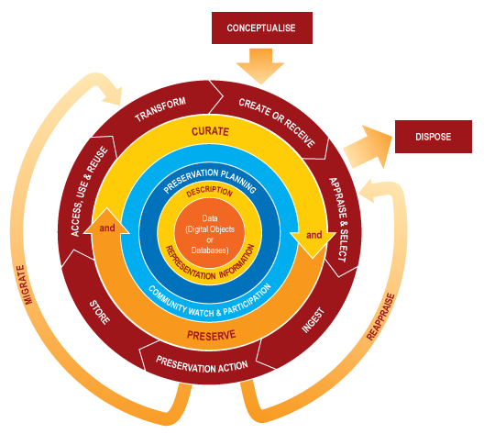
Data preservation
Preservation is key to the long term existence and future accessibility of research data …
    … by the original creator (yourself)
    … by future researchers
    … by any other person
    Mapping the preservation process, workflow devised by DCC (Digital Curation Centre)

Slide 50
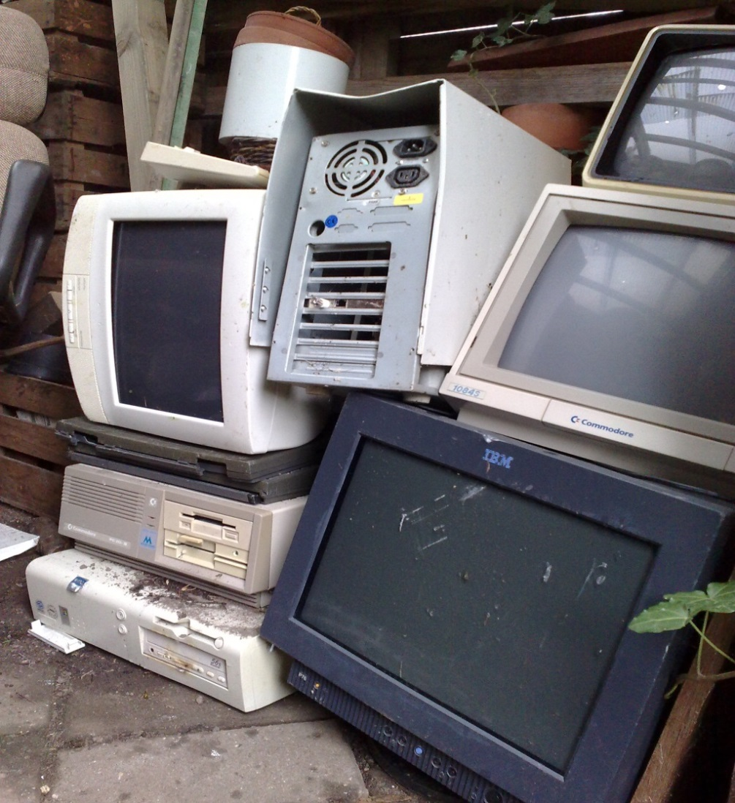
Data preservation
Storage and access media (formats, hardware, software)…
    … are superseded
    … fail (software/hardware)
    … deteriorate
Worth thinking about preservation at the planning stage.

Slide 51

Data preservation …
… requires a trusted repository.
Research-funders
    ESRC data store http://store.data-archive.ac.uk/store/
Institutional (UoE)
    Edinburgh DataShare http://datashare.is.ed.ac.uk/
Discipline-specific
  Archaeology Data Service http://archaeologydataservice.ac.uk/
Discipline-agnostic
    Figshare http://figshare.com/

Slide 52
Data sharing
What is it?
Is making your research available for others to reuse and build upon.
Who’s involved?
data creator
data repository managers
secondary data user
technologists

Slide 53
Benefits of sharing for …
… the researcher
Comply with funding council requirements
Research can be validated
Increase reach & impact (reputation)
Increase visibility of research
Long-term data storage (preservation)
Enables future retrieval (you & others)
… research & society
Avoid duplication of effort & resources
Publicly funded research is available
Academic & scientific integrity
  increases transparency & accountability
  facilitates scrutiny of research findings
  prevents fraud
Extend reach of original research
Fosters collaboration

Slide 54
Informal drivers for sharing
Because it’s possible!
“… we have the technologies to permit world-wide availability and distributed process of scientific data, broadening collaboration and accelerating the pace and depth of discovery…”
John Willbanks, VP Science, Creative Commons
‘Open’ everything
… science
… source
… standards
… knowledge
… government
… content
Open data!
“… By open data in science we mean that it is freely available on the public internet permitting any user to download, copy, analyse, re-process, pass them to software or use them for any other purpose without financial, legal, or technical barriers other than those inseparable from gaining access to the internet itself.”
See more at: http://pantonprinciples.org/#sthash.8D4LWqpi.dpuf

Slide 55
Formal drivers for sharing
    Funders (public funding bodies)
    Consider your future application to one of these funding bodies:
    You will be required to share, unless data protection applies
    You want your research to have a wide impact, don’t you?
    You want others to use/cite your work (recognition)

Slide 56

Barriers to sharing
“Scientists would rather share their toothbrush than their data!”
  Carol Goble, Keynote address, EGEE (Enabling Grid for EsciencE) ’06 Conference
  http://openclipart.org/detail/172856/toothbrush-by-bpcomp-172856
Valid barriers to sharing
the researcher
(intellectual property issues)
the institution
(commercial value)
the subject
  (confidentiality, data protection)

Slide 57
Planning for sharing
“Everyone in a research team should have a clear sense of their responsibilities in ensuring that … research data are of the highest quality; … are well documented so that other researchers can access, understand, use and add value to them … independently of the original investigators.”
MRC Guidance on Data Management Plans
Issues to consider
Future ‘share-ability’ of the data
  format
  software
  anonymisation
  documentation
  ethics
  consent & confidentiality
Timescale for release (embargo)
Infrastructure for sharing
Rights management & licensing

Slide 58
Data licensing
Why?
The license explicitly states how your data may be used
Makes them available to others
Ensures your data are open!
How?
Repository rights statement’
Creative Commons (CC) http://wiki.creativecommons.org
Open Data Commons (ODC) http://opendatacommons.org/ *Recommended for data*

Slide 59
Supporting you for RDM

Slide 60
RDM support
Make the most of local support!
Postgraduate Research Administrators in your School
Your Academic Support Librarian
Data Library staff
IT staff in your School
Your School’s Ethics Committee
Check out what facilities are in your school/centre
Ask your supervisor for advice
General RDM queries can be sent to the Helpline who will direct them as appropriate

Slide 61
Useful links
Record Management: Taking sensitive information and personal data outside the University’s computing environment
http://edin.ac/1hZaL07
UK Data Archive: Anonymisation
http://www.data-archive.ac.uk/create-manage/consent-ethics/anonymisation
UK Data Archive: Ethical/Legal
http://www.data-archive.ac.uk/create-manage/consent-ethics/legal
Dublin Core metadata creator
http://www.dublincoregenerator.com/generator_nq.html
Digital Curation Centre (DCC): Data management plans
http://www.dcc.ac.uk/resources/data-management-plans

Slide 62
Thank You!
Any questions?

